Slide 1
VIVA 19th Annual
Users Group Meeting
October 22, 2015
Virginia Library Association
Richmond, VA
Cy Dillon, Hampden-Sydney College, VIVA Outreach Committee Chair
Anne Osterman, VIVA Director
Genya O’Gara, VIVA Associate Director

Slide 2
Agenda
Welcome: Cy Dillon, Hampden-Sydney College, VIVA Outreach Committee Chair
VIVA Update: Anne Osterman, VIVA Director and Genya O’Gara, VIVA Associate Director
Vendor Introductions
A Vision for VIVA: Anne Osterman, VIVA Director

Slide 3
VIVA Budget Update

Slide 4
Leveraging Funds to Expand Access
Drop of $370,159 (5%) from base in FY15 and FY16

Slide 5
VIVA Revenues FY16

Slide 6
Updates on Committee Work

Slide 7
Steering Committee
Chair: Carrie Cooper, College of William and Mary
Proposal for 2016-18 Biennium
  Regain funding lost in 2014-16 (5% of budget)
  Funding for sustaining current collections
  Funding for e-book collections with statewide relevance
  Increased support for the VIVA nonprofit institutions
  Supporting preservation services for a proposed Virginia DPLA Service Hub
JMU Procurement Fee increase for FY17
  It will be the first increase in ten years

Slide 8
Steering Committee
VIVA to participate in Virginia Model for Preservation Service (VAMPS) program proposal
  Led by Bradley Daigle (UVA)
  Seeking Mellon Foundation and General Assembly funding
  If funded, will enable a Virginia Service Hub for the DPLA and corresponding preservation services
Virginia Heritage Town Hall Meeting
  41 registered attendees
  Included discussion about ArchivesSpace, EAD, VAMPS, and more
  Thank you to Bradley Daigle (UVA) for organizing!

Slide 9
Outreach Committee
Chair: Cy Dillon, Hampden-Sydney College
Product Announcement for new social sciences and nursing resources
Ask VIVA webinars
  The first one will be October 29th from 10:00-10:30 am
  Planned for October, January, April, and August

Slide 10
Resource Sharing Committee
Chair: Rosemary Arneson, University of Mary Washington
17th VIVA Community Interlibrary Loan Forum, July 2015
Cooperative Borrowing Project continues
Open Educational Resources Task Force Update

Slide 11
VIVA Interlibrary Loan Forum
  100 registered attendees -- held at UMW Stafford Campus
Included an update from OCLC, and moderated open discussions on policies, challenges, and best practices. Presentations focused on copyright, licensing, and lending, as well as issues in international ILL
Forum location survey
    83 people from 49 different institutions responded
    There is an overall preference for a central location, with some suggesting rotating amongst a few central location options

Slide 12
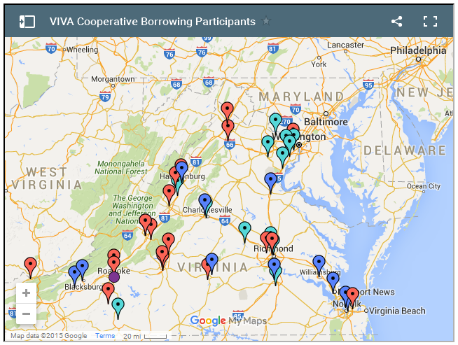
Cooperative Borrowing Project
We now have a map!

Slide 13

Open Educational Resources (OER) task force
Surveyed VIVA members
Identified ongoing OER initiatives in VA
Made recommendations for next steps

Slide 14
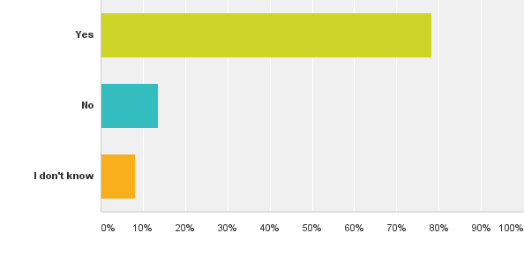
OER Survey Highlights
39 institutions participated
78% of respondents
are exploring or
using OER

Slide 15
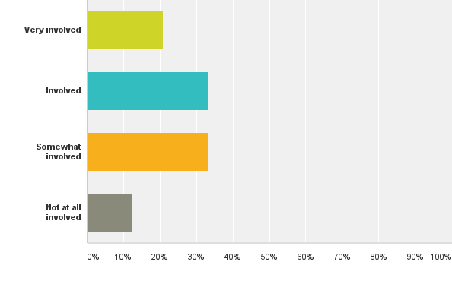
OER Survey Highlights
Library levels of OER
involvement varied
84 % thought
libraries should play
a role

Slide 16

OER Findings and Recommendations
Highlights:
  OER textbook and shareable course projects
  OER in instruction sessions and online resources
  Grant funding supporting faculty incorporating OER
Key recommendations:
  Educate on statewide efforts & coordinate with SCHEV Open VA
  Centralize information on OER resources

Slide 17
Collections Committee
Chair: Sharon Gasser, James Madison University
Results of Nursing & Social Sciences RFP
Selected product updates
(1st) VIVA Collections Forum August, 2015
Monographic collection analysis update

Slide 18

Results of the Nursing & Social Sciences RFP
Cancellations:
  EconLit via ProQuest
  PAIS*
  Sociological Abstracts*
  Ovid Total Access LWW Collection*
*Opt-in contracts are available for these products

Slide 19

Results of the Nursing & Social Sciences RFP
New subscription products from EBSCO
  CINAHL Full Text (replaces VIVA’s base CINAHL subscription)
  EconLit with Full Text (this is also a Private Pooled Funds product)
  Political Science Complete
  SocIndex with Full Text

Slide 20
Results of the Nursing & Social Sciences RFP
New supplemental products from EBSCO
  Abstracts in Social Gerontology
  Child Development & Adolescent Studies
  Family Studies Abstracts
  National Criminal Justice Reference Service Abstracts
  Peace Research Abstracts
  Public Administration Abstracts
  Race Relations Abstracts
  Urban Studies Abstracts
  Violence & Abuse Abstracts

Slide 21
Selected Product Updates
IOP move to IOPScience*
  Provides an increase of 21 journal titles, provides 180 e-book titles, and fills archive gaps
Springer Nature merger with Palgrave
  Behavioral Science now Behavioral Science and Psychology with an estimated increase of 87% in title count
Ulrich’s must move to cost share
  If it does not, VIVA contract will be cancelled
Wiley to database model*
  Provides an increase of 246 journal titles to core collection
*Pending final license negotiation

Slide 22
Full Text Usage within VIVA
Abstracting and Indexing Services

Slide 23
VIVA Collections Forum
Had 91 registered attendees
Included such topics as the shared collections initiative, Digital Public Library of America, ways for VIVA institutions to share technical services work, and liaison program models
Thank you to the organizing committee!
  Cheri Duncan (JMU), Alison Armstrong (Radford), Beth Blanton-Kent (UVA), Stephen Clark (CWM), Rob Tench (ODU)

Slide 24

Monographic Collection Analysis:
Background
Pilot with Sustainable Collection Services began Fall 2013
Analyzed the main stacks holdings of 12 VIVA member libraries, over six million records
Used the analysis to:
  Protect scarcely held titles
  Inform collection development
  Ensure safe deduplication
  Reduce print redundancy in the state

Slide 25
Monographic Collection Analysis:
Data Results
Identified Widely Held, Highly Circulated, Recently Used Publishers
Analyzed Circulation
patterns of “top”
publishers
Evaluated average
number of print copies
held by VIVA institutions
Highly circulated titles
Widely held titles
Top publishers

Slide 26
Monographic Collection Analysis:
Data Results
Wide dispersal of subject area holdings across the Commonwealth
Distribution of collection depth (uniqueness) indicates great potential for coordinated
consortial collection development of print.

Slide 27

Monographic Collection Analysis:
In-Process/Implementation
MOUs for Unique Titles Signed & Submitted
  Identified and protected > 70,000 titles
Ebook Acquisitions!
  5% reversion by the State -- schools used 100% shared funds for a purchase
  This cost shared purchase resulted in a cost avoidance of millions.

Slide 28

Monographic Collection Analysis:
In-Process/Implementation
MOUs for Widely Held – Approved
  At least one copy held
  Easy entry (NO SHELF CHECK/NO CATALOG MARKING)
  Green glass for weeding - over 1.7 million titles “safe” to weed
  Retention distributed by size and subject preference
Voluntary threshold of 4
  VOLUNTARY – alleviates just in case
  Saves local money for local collection priorities
  Relies on robust (and fast) VIVA ILL system
  YBP’s GobiTween available

Slide 29












Thank you to our vendors here today!
APA: Neil Lader
EBSCO: Ann Murdock
Gale: Kate Vincent
IEEE: Joe Vaitkus
IOP: Kevin Batt
Mergent: John Carino
OCLC: Suzanne Butte
OUP: Jenifer Maloney
and Colleen Bussey
ProQuest: David Fiumara
Springer: Alan Roseman
and Bob Boissy
Wolters Kluwer: David Troy

Slide 30
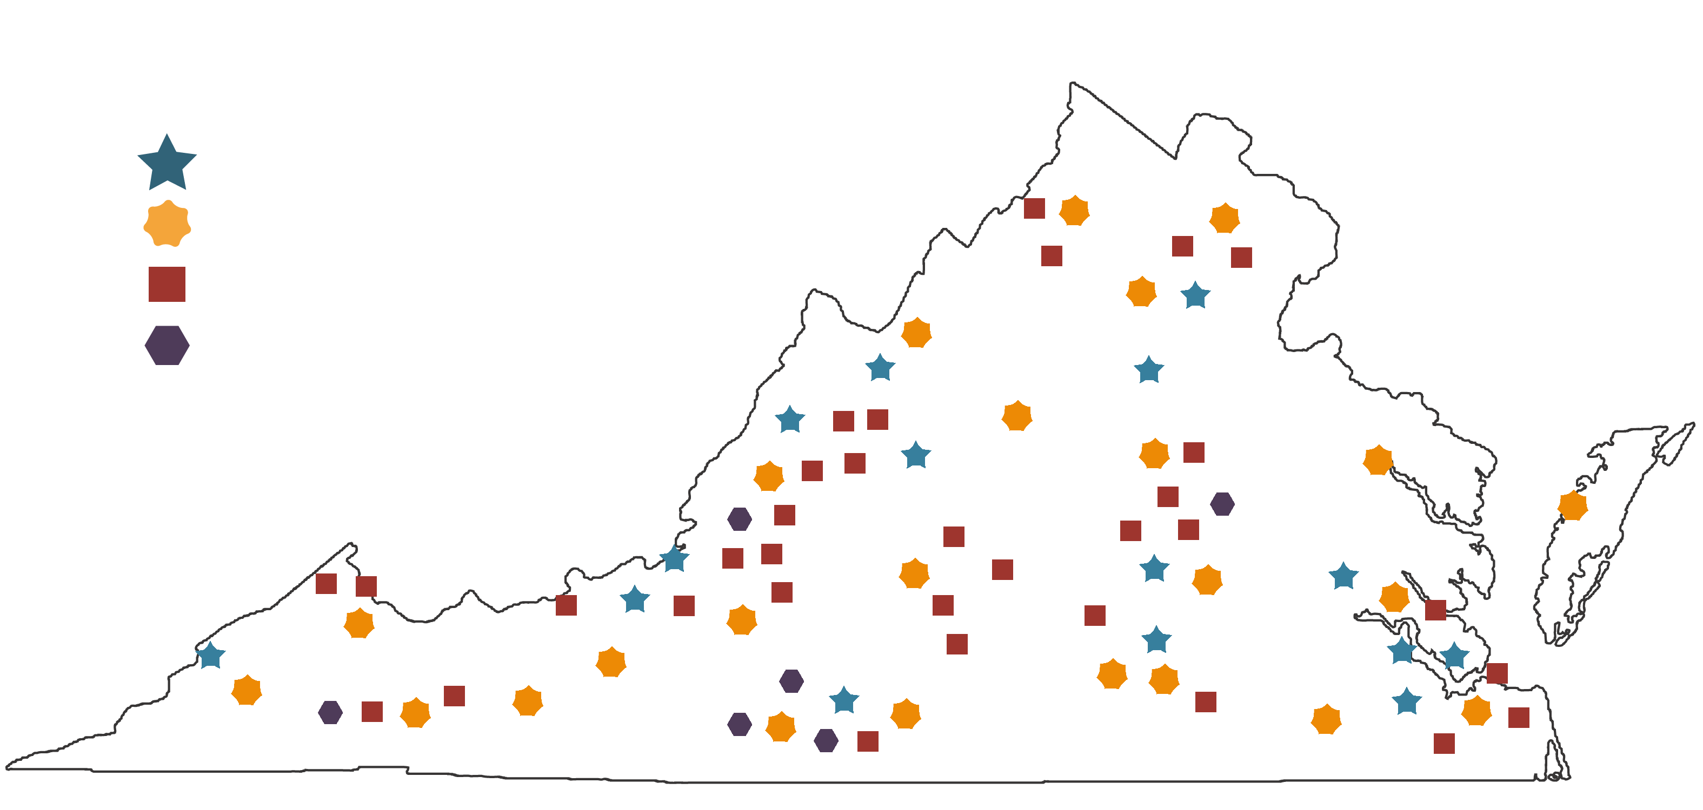
V
www.vivalib.org

Slide 31

Join us on Facebook!

Slide 32
Image credits
  Survey image created by Steve Morris, Noun Project
  Ebook image created by Amelia Edwards, Noun Project
  Open education image by Luis Prado, Noun Project
  Cancellation image by Agus Purwanto, Noun Project
  Books image by vincentnova, Noun Project
  Contract image created hunotika, Noun Project
  $ in hand image by Lemon Liu, Noun Project

Slide 33
A Vision for VIVA
Anne C. Osterman, VIVA Director

Slide 34
What is my perspective?
Elementary School Library Shelver
Florida State Govt Contract Worker
Library School Student
Lesson learned:
Technology is critical to libraries.
Libraries take daily care and feeding.
I think I should have been an information science student.

Slide 35
What is my perspective?
Public Community College
Large Public Doctoral University
Mid-sized Private University
Lesson learned:
Consortia are an excellent way for two-year schools to get electronic resources.
Direct partnership with faculty is critical to library integration with the campus.
Universities are more like businesses than you might think.

Slide 36
Guiding Concepts for Today
A consortium should help its member libraries face their shared challenges.
These shared challenges can be divided into two main categories:
Improving the User Experience
Improving process and infrastructure
(External)
(Internal)

Slide 37

Improving the User Experience
Three key factors impact a user’s experience of a library – the content, services, and space.
Content
I my library!
Services
Space

Slide 38

Challenges with Content
E-Books
  There is no good academic reader or tool
  Lending rights are insufficient
Data
  Free resources are important
  Licensed resources often require
  individual attention
Media
  Often requires additional technical
  considerations
  Vendors are heading away from
  allowing true purchases

Slide 39

Ideas for Content
Aggressively seek new areas of collaborative purchasing
Conduct a subscription/vendor review to see where undiscovered overlap may lie
Adopt and promote Occam’s Reader or
its equivalent for whole e-book ILL
and gain the appropriate sharing
rights

Slide 40

Challenges with Services
Staff turnover is a constant problem
Discovery is complicated, and it is only going to get more complicated with the rise in Open Access and Open Educational Resources
It is difficult to keep up with the new and exciting trends when your budget is decreasing

Slide 41
Ideas for Services
Create collaborative documentation and work teams based on the upcoming Skills Survey
If VIVA wants to tackle discovery, we need a big, capable partner, and we likely
need to think more about connections
and less about a customized system
Expand central support through
a shared staffing model,
with member library staff doing
official service for the consortium

Slide 42

Challenges with Space
Libraries are under great pressure to provide a productive and effective environment for their users, and that can mean getting the books out ASAP
Dealing with the increasingly dynamic and complex web environment alone is a no-win scenario

Slide 43
Ideas for Space
Buy into and act on the shared, distributed repository and the voluntary print monograph threshold
Extend this collaboration to a wider region or other consortia
Collaborate through shared content
(such as via LibGuides) or best
practices to avoid duplicate effort
in creating web services

Slide 44

Challenges for Internal Process
E-books represent a largely unrealized opportunity for changing library workflow
We are all working in the same systems… separately
Starting initiatives from the ground up is incredibly difficult

Slide 45
Ideas for Internal Process
Combine shared technical services with shared purchases
Create a distributed model for knowledge base management that employs GOKb for the central management of titles
Consider partnering with a
consortium that already has an
effective resource sharing tool

Slide 46

What about VIVA Central?
I hope we can:
  Migrate from our Access database to a better consortium management tool
  Employ a usage statistics tool with visualization capability and analysis tools
  Create and communicate more structure
  around our renewal process for our
  vendors and libraries

Slide 47

For all of you out there in VIVAland -
Please consider strategic compromises in the best interests of the user
Be a champion for an effort you believe in and negotiate for the time to make it happen
Send your ideas for collaboration my way!

Slide 48

And from the lessons learned -
Through valuing the small things that enable the big things to happen…
…employing technology creatively…
…remembering the different roles the consortium may play for different members…
…connecting in valuable and effective ways with our users…
…and making the best possible use of all of our resources…
…we can carry the success of VIVA into the future.

