Slide 1
Summer Read & Feed
2015 VLA Conference
Heather Ketron, Loudoun County Public Library

Slide 2
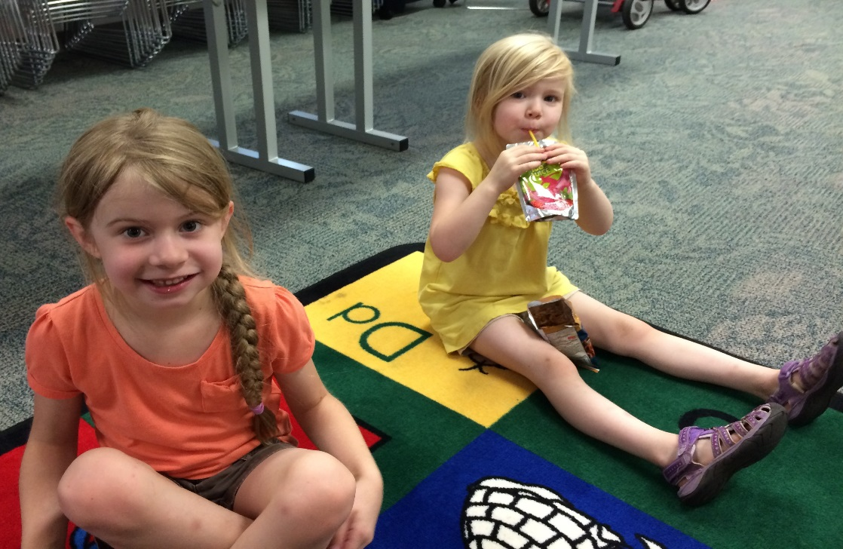
Summer Read & Feed
What is the Summer Food Service Program (SFSP)?
Why have SFSP @ the library?
How does it work?
Programming
Outcomes
Lessons Learned
Resources
Questions?

Slide 3



Introduction
USDA Summer Food Service Program
The Summer Food Service Program (SFSP) ensures that low-income children continue to receive nutritious food when school is not in session.
USDA
State
Sponsor
Site
Notes:
Free food for children 0-18 in low-income neighborhoods
Must be located in low-income area or serve low-income children
USDA funds the program,
Administered through state agency, in Virginia it is the Department of Health
The state agency uses USDA funds to reimburse Sponsors, they provide the food to Sites
Site staff/volunteers serve food free to children & teens

Slide 4

Introduction
What happens when schools close for the summer?
Harder for low-income families to make ends meet in the summer
32% report they sometimes do not have enough food in the summer
Food banks report increased demand during the summer
Notes:
The need for free/reduced lunch does not disappear in the summer
Food insecurity is associated with developmental, cognitive, behavioral and physical issues.
Harder for low-income families to make ends meet in the summer
32% report they sometimes do not have enough food in the summer
Food banks report increased demand during the summer
Low-income kids may experience greater summer learning loss than more affluent peers
loss in grade level math and reading skills
6 weeks = $1,500 per student re-teaching
Sources: Leadership for Healthy Communities, 2012; Share our Strength, 2013; National Summer Learning Association, 2012; Summer Matters, 2013.

Slide 5
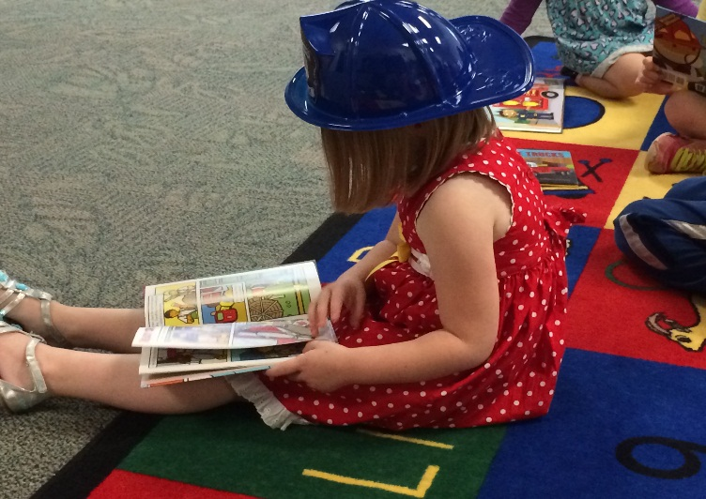
Why food in the library?
Community space
People trust the library
Opportunity to introduce and engage low-income families with the library
Help prevent summer learning loss
“At the moment that we persuade a child, any child, to cross that threshold, that magic threshold
into a library, we change
their lives forever,
for the better.”
President Obama
Notes:
Libraries are natural, yet underutilized, spaces for serving meals to children whose access to lunch disappears when school ends and summer begins.
Libraries are community spaces in the heart of the neighborhood. They welcome all and they provide access, free of charge, to resources that support the community’s lifelong needs.
People trust their local library and feel positively toward it.
Summer Read & Feed is a great opportunity to introduce families to the library's services and resources, as well as helping them feel and become healthier.
our program is feeding children during the summer, helping prevent summer learning loss, and engaging low-income families with their public library: the one free community space that sustains democracy, levels the playing field, values the individual, nourishes creativity, opens young minds, builds community, supports families, builds technology skills, and offers sanctuary—all free of charge to the user.

Slide 6
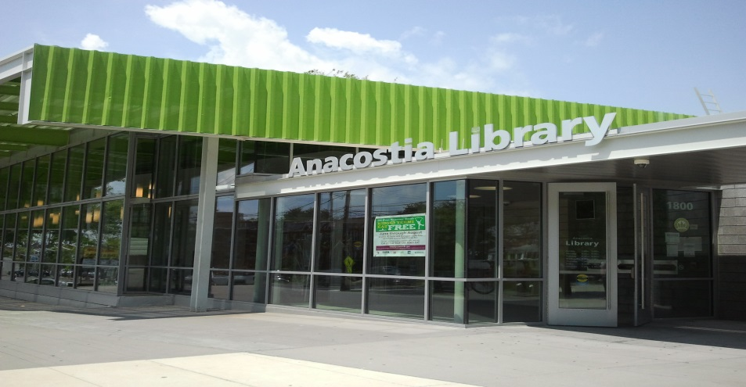
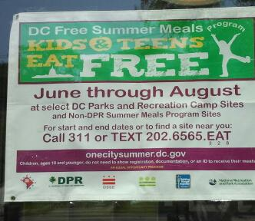
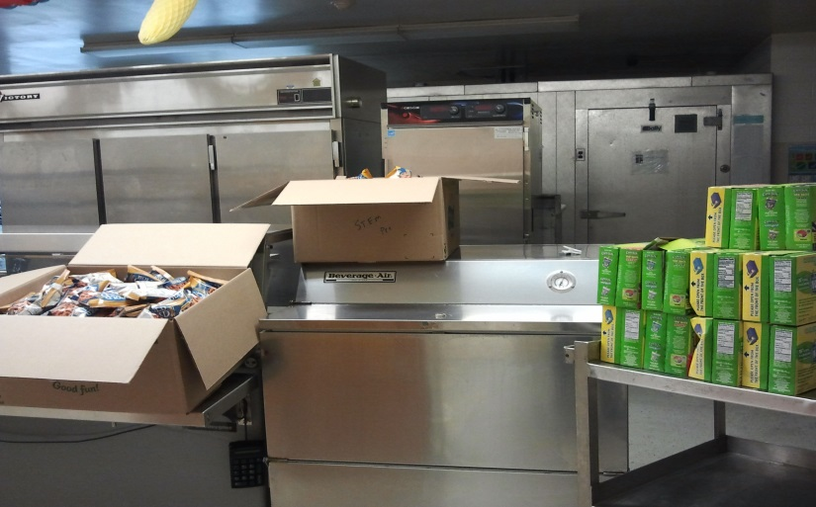
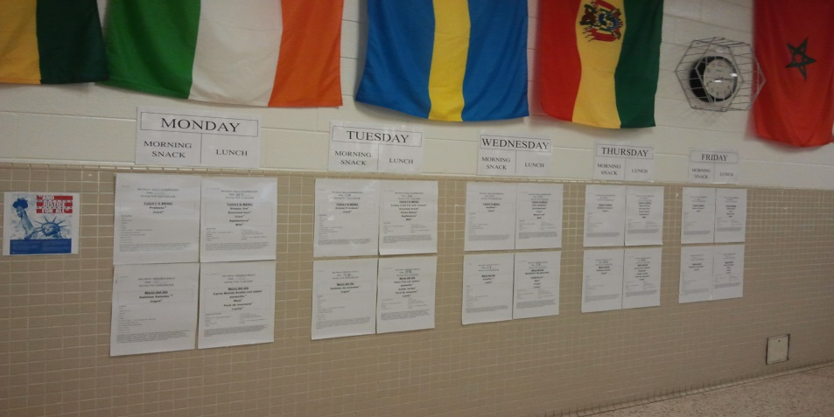
Visit other sites…
Notes:
Visit other SFSP sites to see how it is working.
We visited Anacostia Public Library, AN OPEN site, in Washington DC and Sully ES, our neighborhood school, a closed site.
This helped us to envision programming possibilities and also experience the recordkeeping processes.

Slide 7
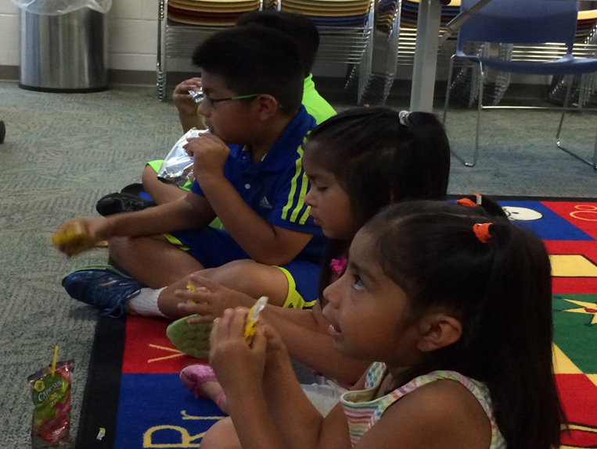
Why food in our library?
“LCPL provides free and equal access to a full variety of library resources and innovative technologies to enhance the quality of life and meet the informational, educational and cultural interests of the entire community. “
Notes:
While Loudoun County, a suburb of Washington, D.C. currently ranks as the highest-income county by median household income. However, the community where Sterling Library is located , over 70% of the children receive free or reduced lunches, the Hispanic/Latino population has grown 226% in the past ten years; 35%: are foreign born and 31% speak Spanish – our community has unique needs – especially when compared to the rest of Loudoun County.

Slide 8
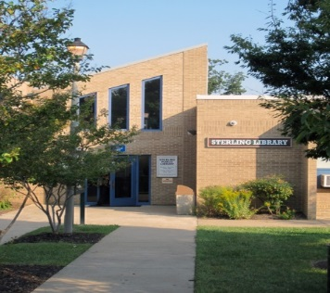
Sterling Library
Why do we exist?
  “To make people’s lives better,” make a “better world” in Sterling Park
How do we behave?
  “all hands” –we work together in all aspects of library service
  “public servants” – we provide user-centered services with a kindly disposition
  “look-outs”– face toward the community, address reality, see and hear all people
What do we do?
  We provide Sterling Park residents:
    “access” … to library resources, services, and materials;
    “opportunities for lifelong learning;”
    and “a safe place” … to honor, celebrate, and engage with their community.
Notes:
Also, we asked ourselves if a Summer Read & Feed program fit our mission and core values as defined by our staff.
Our staff believes that Sterling Library exists to make the Sterling Park community a great place to live, study, and work.
Our staff described the 3 behaviors that we engage in and these demonstrate our Core Values :
With one service desk, every staff member is engaged in all aspects of our work
We are here to serve the community, and our branch surveys indicate that patrons think we are “nice.”
Finally, we are looking out for ways to serve our community’s needs vs. staff interests
The Summer Read & Feed program did, indeed, fit with our mission, vision, and core values – it was something we would pursue.
Finally, our efforts , like the efforts of all LCPL staff members are in support of our LCPL mission.

Slide 9

“Buy In”
Administration
Staff
Description: Over 70% of the children in the Sterling Library neighborhood receive free or reduced lunch at school. When the school closes for the summer, many children lose access to nutritious foods. Our library would like to serve the community in a holistic way, creating a Summer Read & Feed program where we nourish children’s bodies and minds.
Notes:
I shared all the information I gathered and wrote a project proposal.
The Director and Deputy Director approved the proposal and our staff saw the need for a Summer Read & Feed and began planning how they would participate.

Slide 10
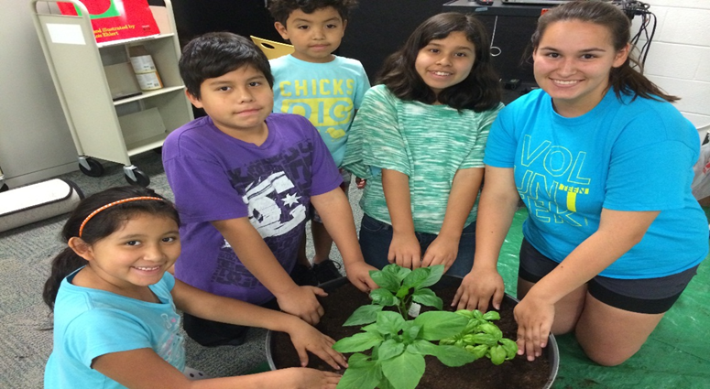
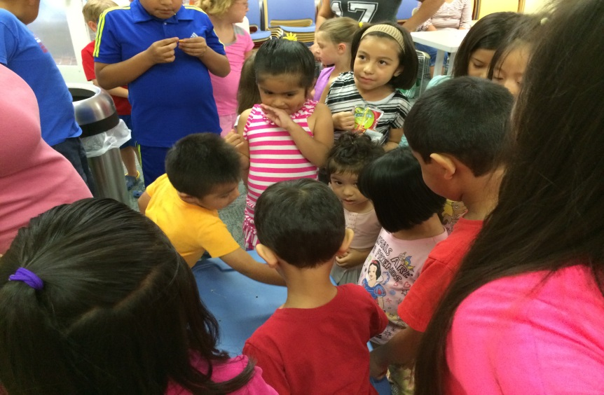
Intended Outcomes
Alleviate hunger
Increase in library program attendance
Provide a positive experience @ the library
Staff development
Notes:
Here are the outcomes we hoped to achieve.

Slide 11
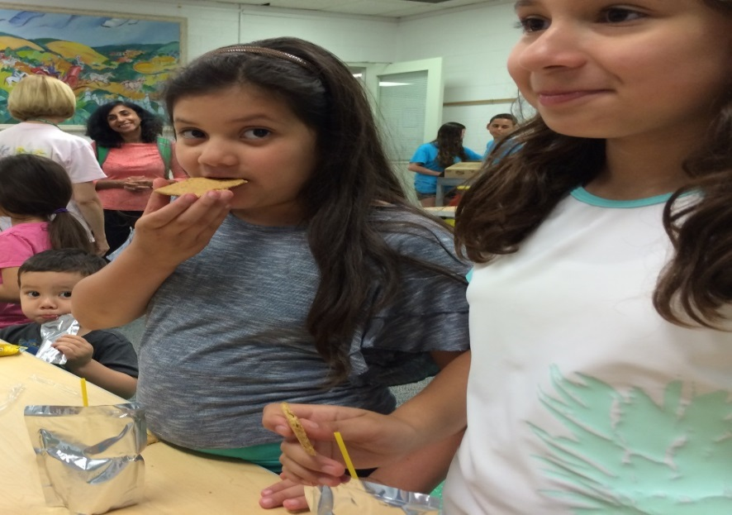
Becoming a Summer Food Service Site
Who are eligible participants?
Children 18 years of age and younger
Persons 19 years of age or older with mental or physical disability who participate during school year in public or private non-profit school program

Slide 12
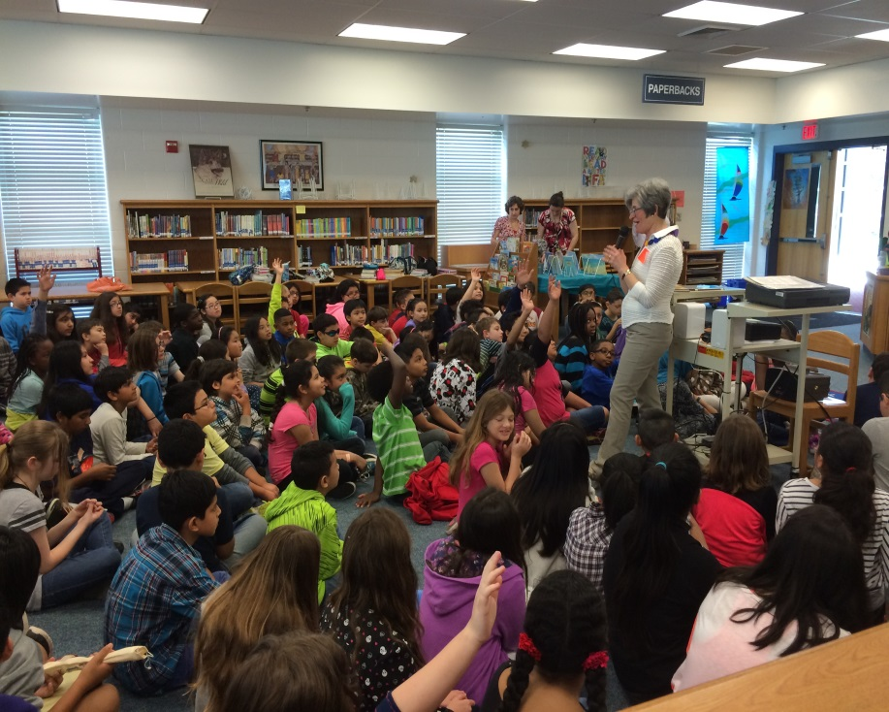
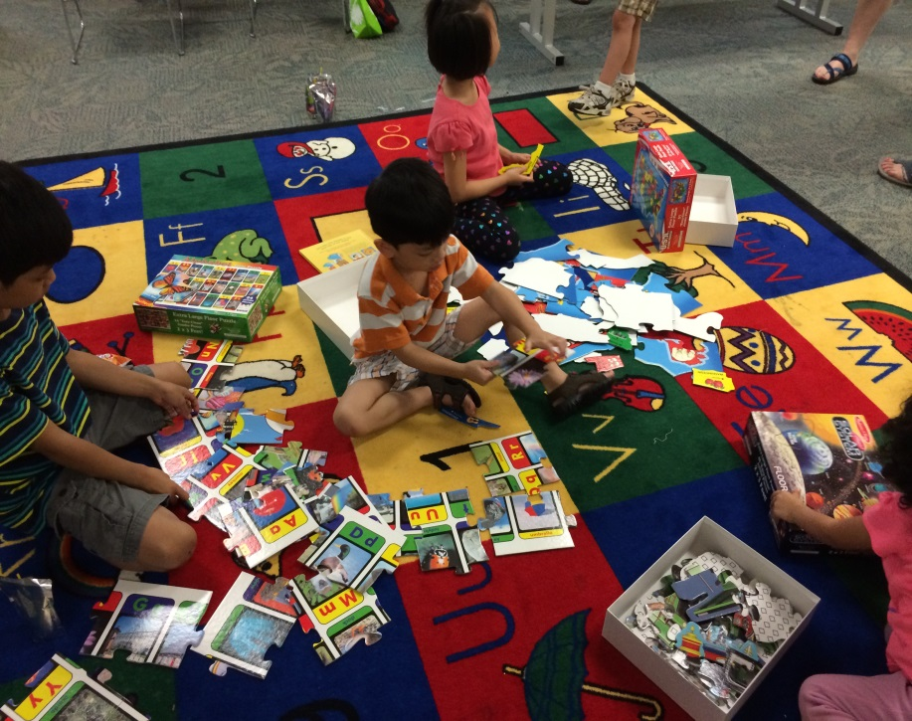
Becoming a Summer Food Service Site
Closed Site vs. Open Site
ONLY Enrolled children
ALL children in community
Notes:
Closed enrolled sites are established for a specific group of children who enroll in an organized activity program or who do not reside in an eligible low income area. The site becomes eligible for SFSP if at least half of the enrolled children qualify for free and reduced-price meals. Because the site is not open to the community, meals are served free only to enrolled children.
Open sites operate in low-income areas where at least 50 percent of children residing in the area are eligible for free and reduced-price school meals, based on local school or census data. The meals are served free to any child at the site on a first-come, first-serve basis.

Slide 13
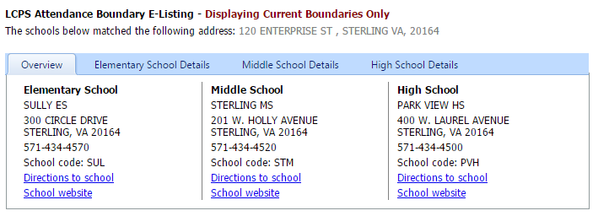
Becoming a Summer Food Service Site
What documentation is needed?
  Open Site: at least 50% of the children in the site’s school attendance area are eligible for free or reduced price school meals.
  School meal data from school attendance area in which site is located.
Print this out. This is required documentation.
Notes:
First, determine your site’s school attendance area using the library address.
Contact the school district directly or
Visit the school district’s website.
There is another method that uses Census data, but the school free & reduced eligibility data is the easiest method to utilize. You can learn more about using Census data from the USDA website.

Slide 14
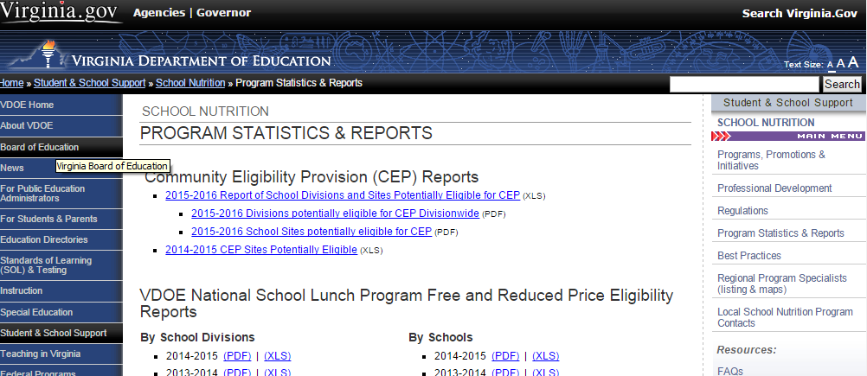
Verify Free and Reduced Percentage
Notes:
Remember at least 50% of students must qualify for f & r meals
Go to the Virginia Department of Education website, this is where the National School Lunch Program Free and Reduced Price Eligibility Report can be found.
Download the most recent version “By Schools” report in the desired format.

Slide 15
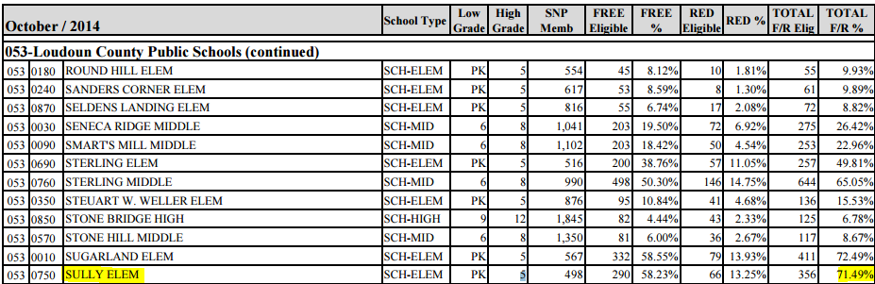
Verify Free and Reduced Percentage
Print the report, highlight your library’s qualifying school.
This, along with a print out of the school attendance area verification, serves as adequate documentation of eligibility.
Notes:
3. Find the school in your library’s attendance zone and verify that the F & R percentage is at least 50%.

Slide 16
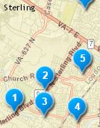
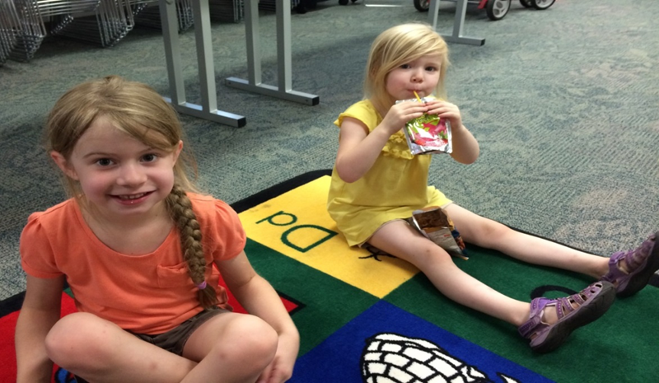
Location Requirement
Open sites must be located more than ¼ mile from each other.
If they are located within a ¼ mile, meals are served at the same time.
Notes:
If located closer, you can submit written justification especially if there is a physical barrier that prevents children from getting to a site (river, freeway, etc.)

Slide 17

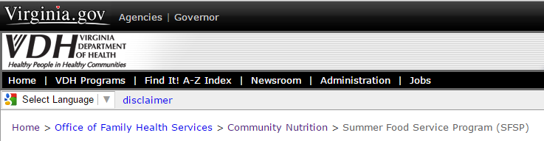
Finding a Sponsor
Notes:
The Virginia Department of Health will put you in contact with a sponsor in your area.

Slide 18

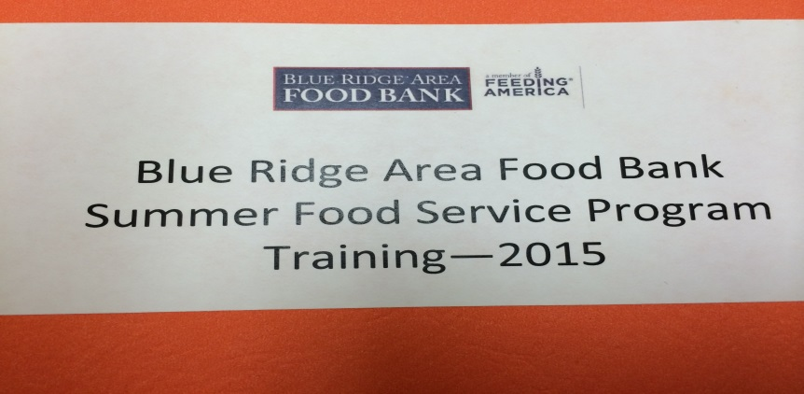
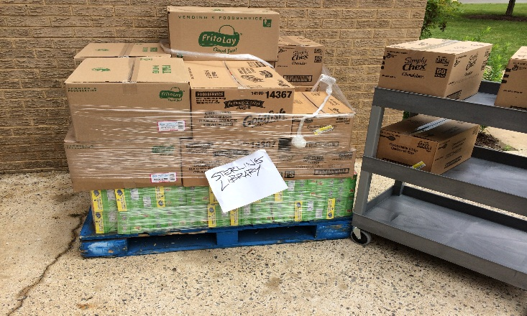
Sponsor
Will have you complete a Site Enrollment Survey and collect your eligibility information
Provides training for Site Supervisor(s)
Provides you with all required forms and instructions for weekly reporting
Provides the food
Will inspect your program twice during operation
Notes:
The Site Enrollment Survey is completed in April for the upcoming summer.
It includes the library address, contact information, the name of the nearest school, open or closed site, Site Supervisor(s) information, and program information.

Slide 19
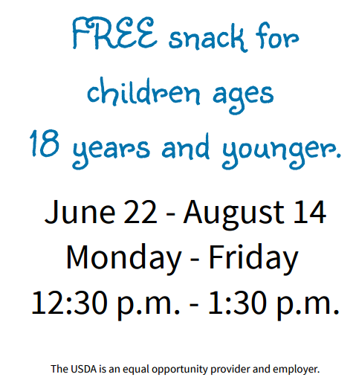
Other Open Site Requirements
The Sponsor must provide a media release stating location; start & end dates; start & end serving times; and include a civil rights non-discrimination statement.
The Sponsor must notify the Health Department of the same information.
Notes:
Be sure to include the USDA statement on any flyers and/or posters.

Slide 20
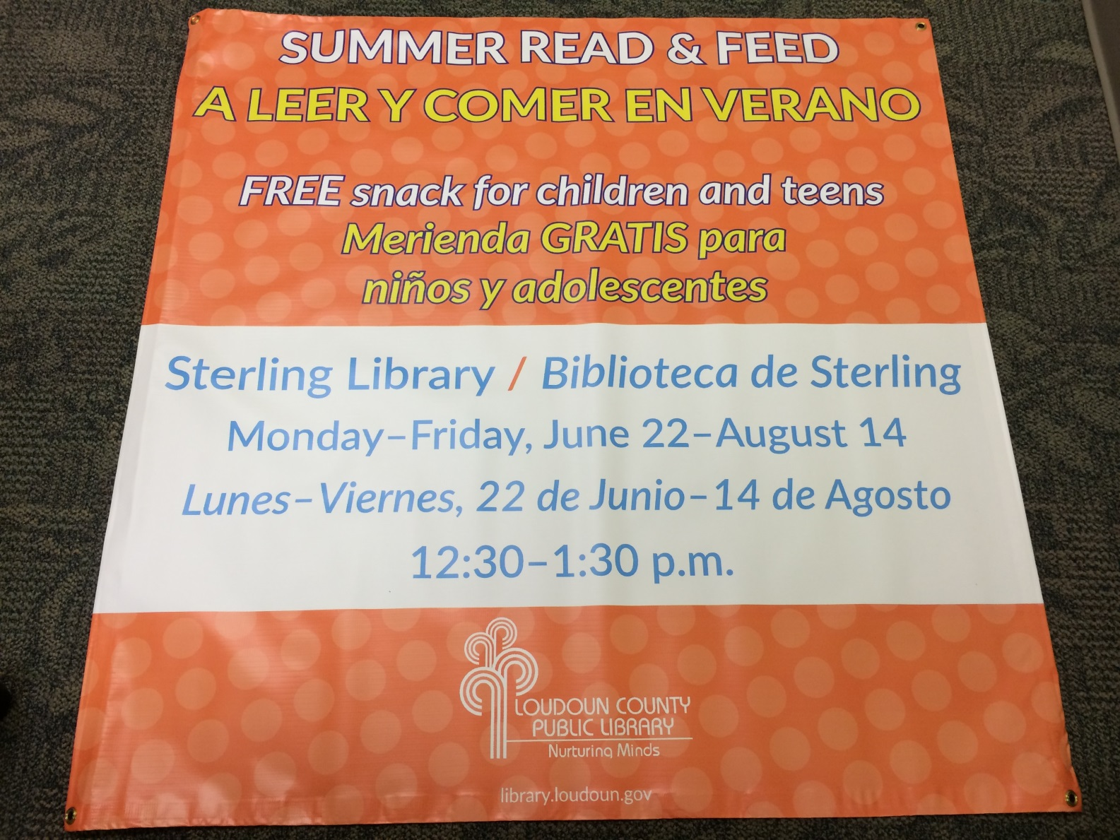
Other Open Site Requirements
Notes:
Must have a banner or poster outside of the site to advertise the program

Slide 21
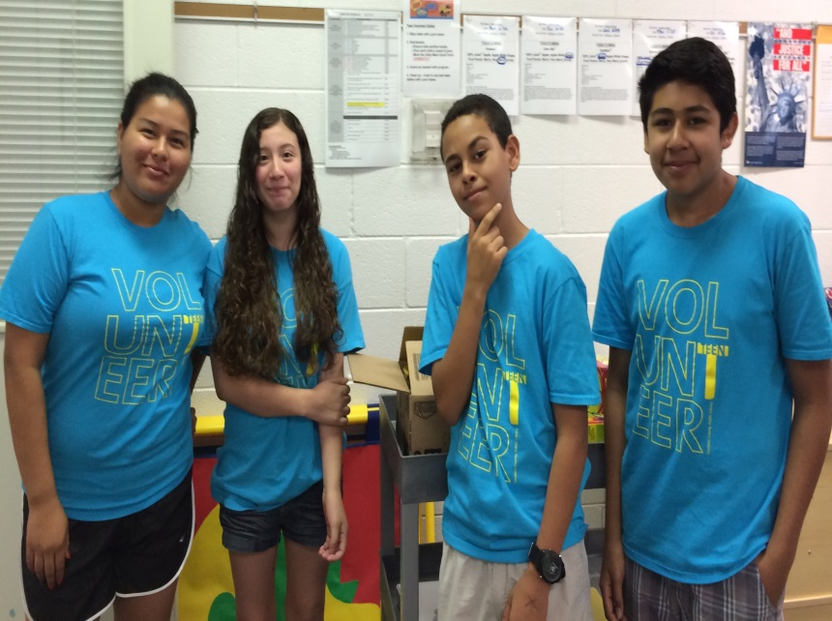
Volunteers
Teen Volunteer Duties
1. Wipe tables with Lysol wipes
2. Distribution
Ensure kids sanitize hands.
Give each child a snack & juice
Mark the Daily Meal Count Form
3. Assist as needed with program
4. Clean up – trash in can and wipe tables with Lysol wipes
Notes:
We utilized Teen Volunteers. Many of them also participated in the activities with the children, some teens just came for the snack.

Slide 22
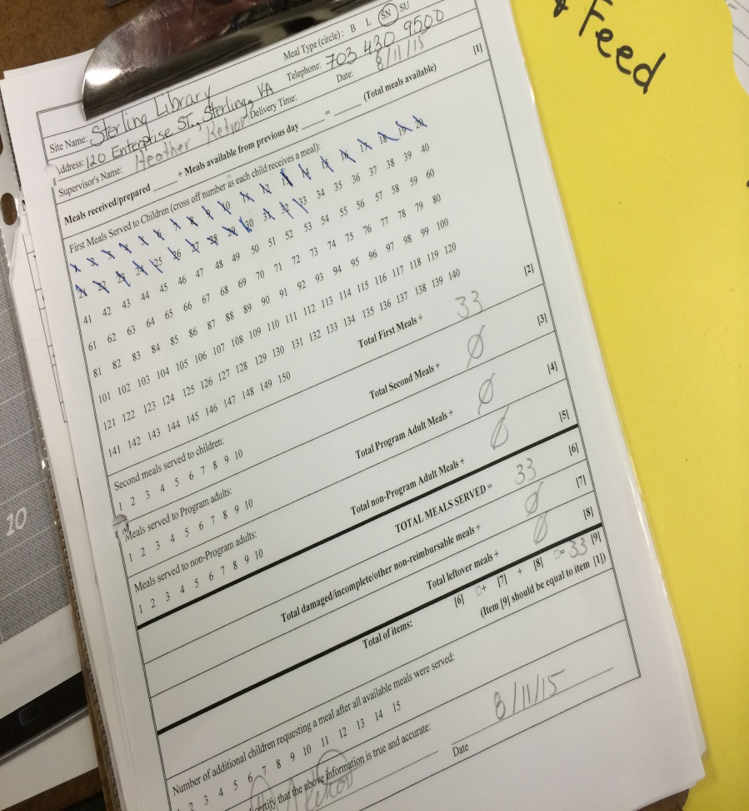
Record Keeping
Post
  Non-Discrimination Statement
  Daily Menu
  Civil Rights Complaint Form
Fax records weekly
  Daily Meal Counts
  Daily Menus
  Consolidated Weekly Meal Count
  Inventory

Slide 23
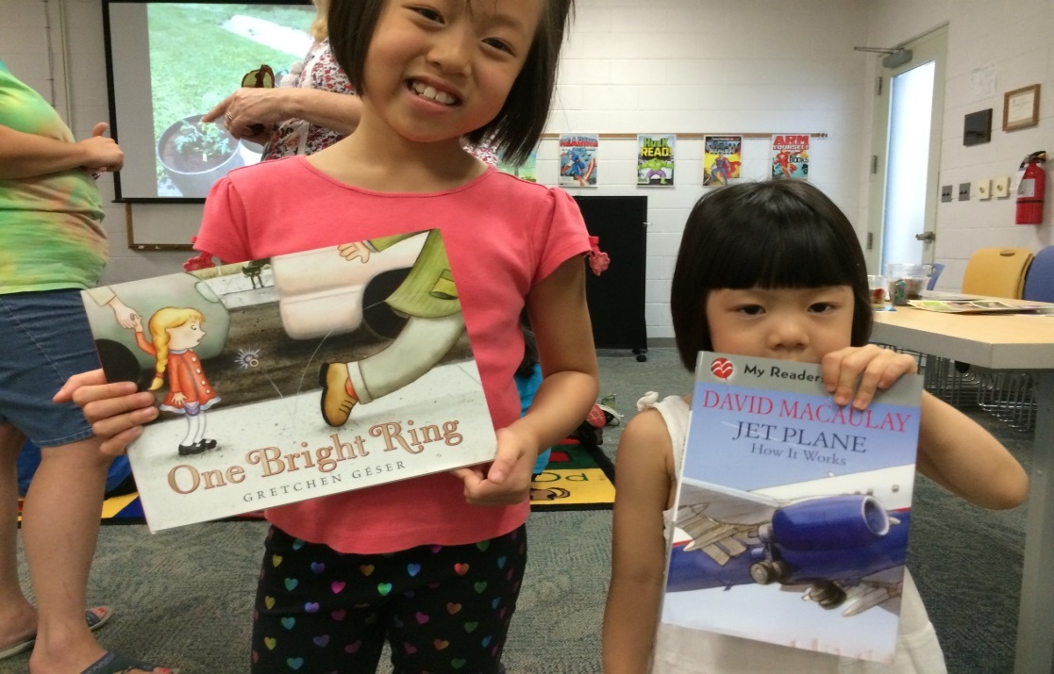
Programming
Each day a different program
Read book, viewed BookFlix, or DVD segment while eating
After reading, activities!
Notes:
Each weekday during the 8 week period, a different program was presented. Out of the 10 total staff members working this past summer, 7 presented programs sometime during Summer Read & Feed. (in keeping with out core values)
As the children ate their snack, they either listened to a staff member read a book or viewed a BookFlix or an educational segment from a DVD. Because the program is for all ages, we planned a variety of activities.

Slide 24
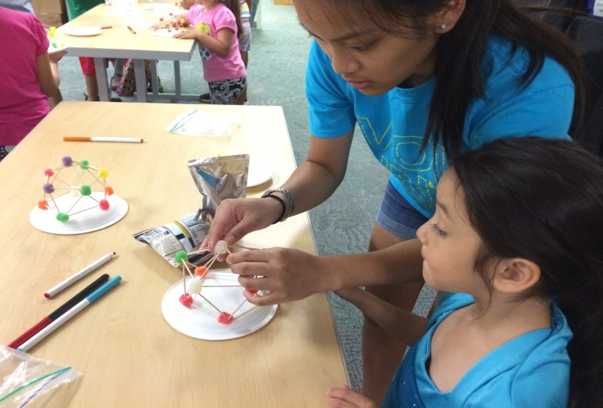
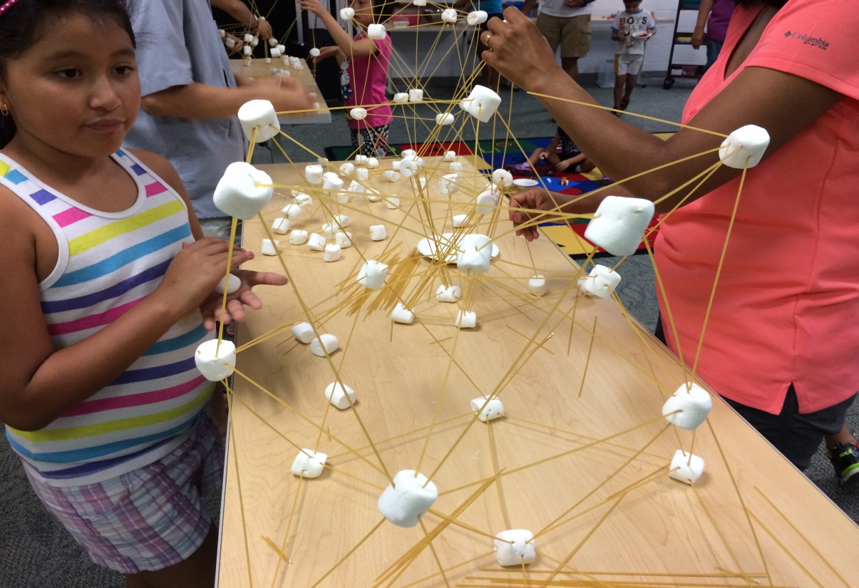
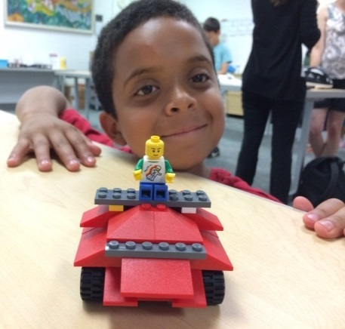
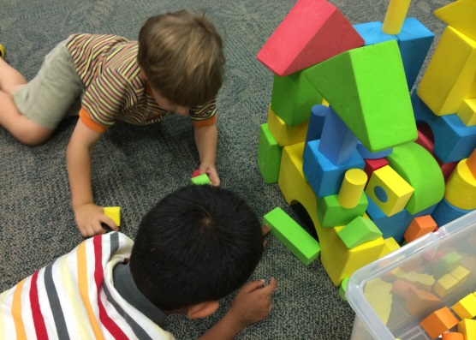
Monday = Building, Engineering
Notes:
On Mondays, it was a “maker” day with an emphasis on structures, building and architecture.
We viewed segments of DVDs: Bill Nye ; Roller Coasters; Domes; and Skyscrapers. We always offered materials for younger children and even our teens participated in building with legos, gumdrop domes, marshmallow & spaghetti towers, cards, cups any material we had available!

Slide 25
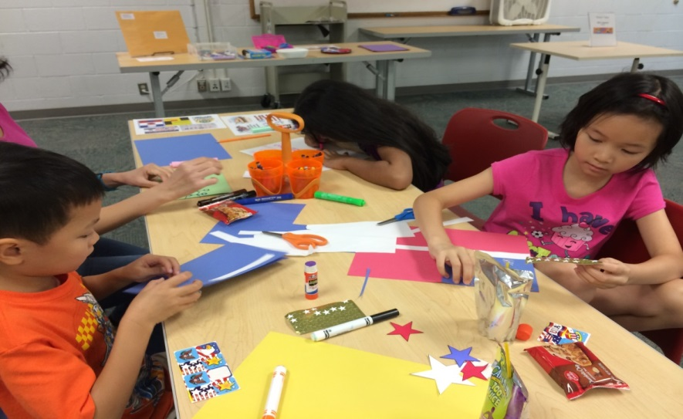
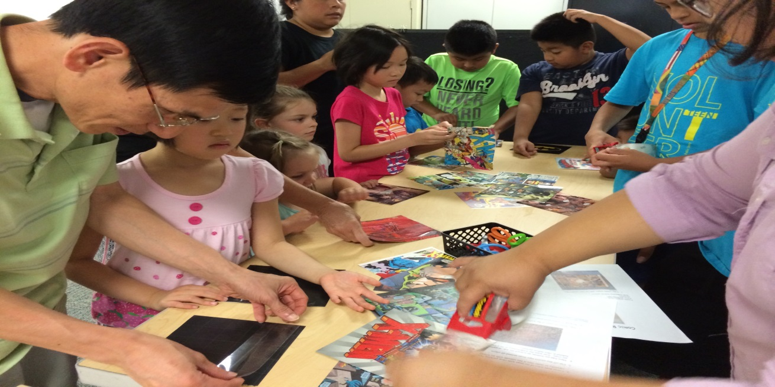
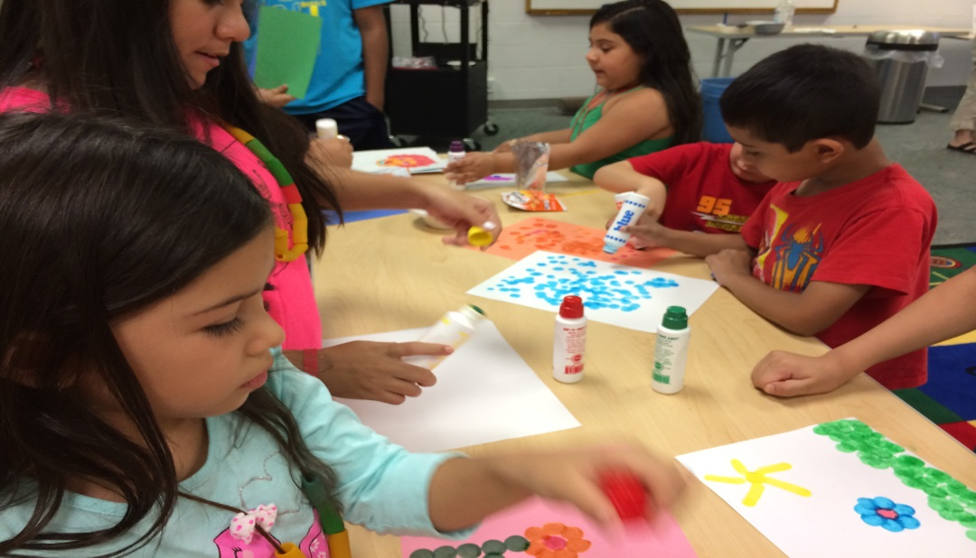
Tuesday = Arts & Crafts
Notes:
Tuesdays were arts & crafts day. Any and every activity we did was well received.

Slide 26
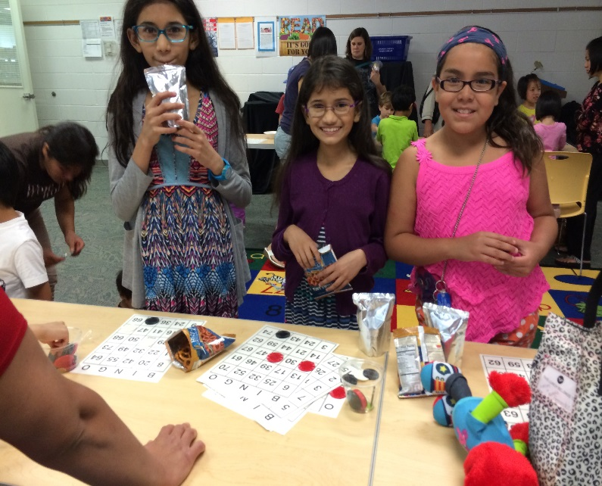
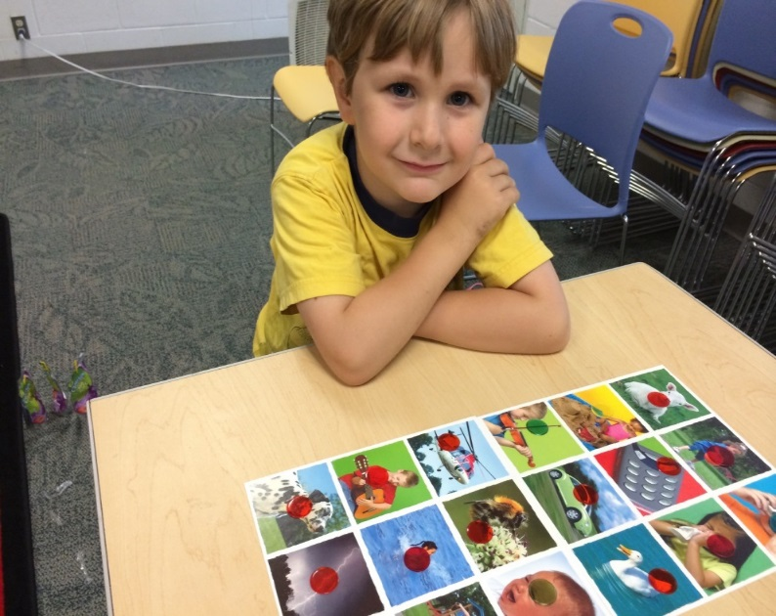
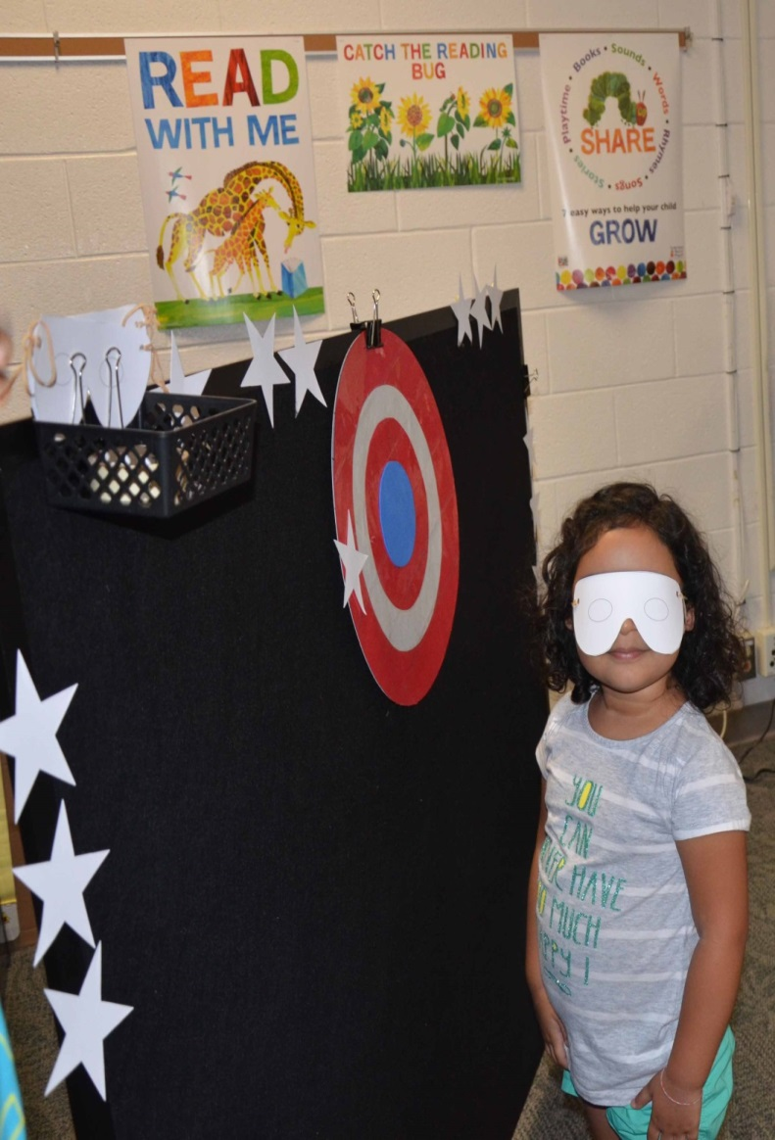
Wednesday = Games

Slide 27
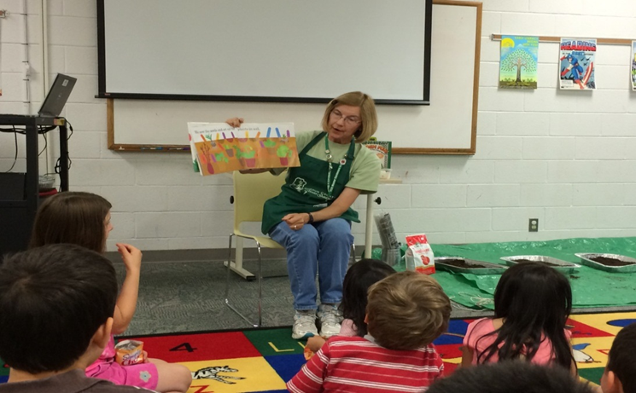
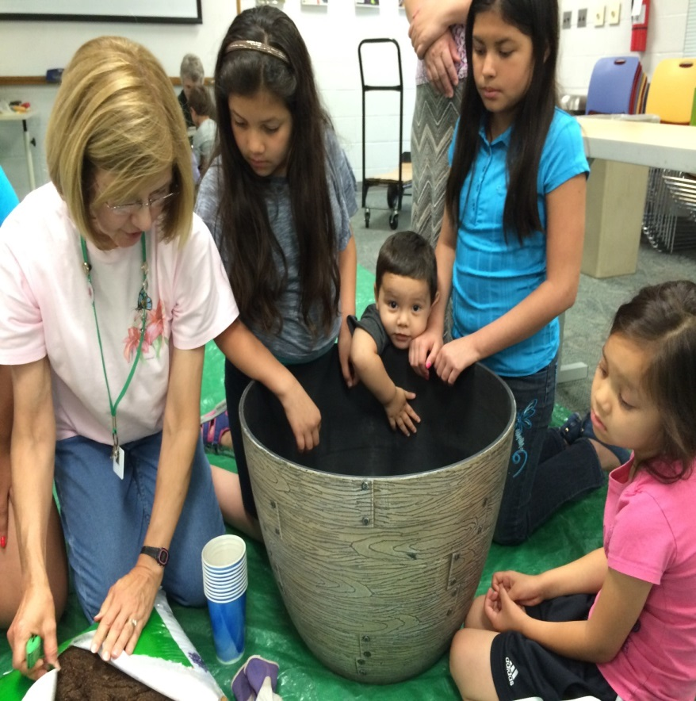
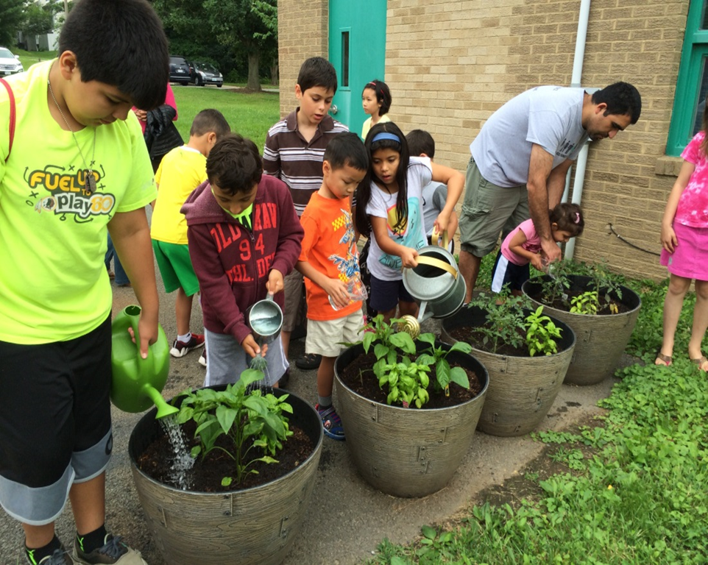
Thursday = Gardening,
Loudoun Master Gardeners
Notes:
A very special treat this summer was a partnership the Loudoun Master Gardeners. Master Gardener volunteers worked with staff to co-present 6 gardening programs.
We enjoyed a story
planted and cared for a container garden.

Slide 28
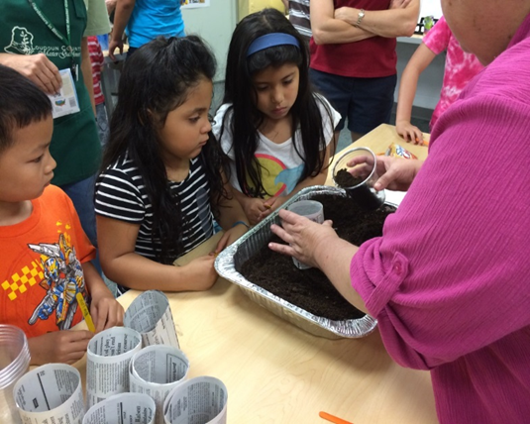
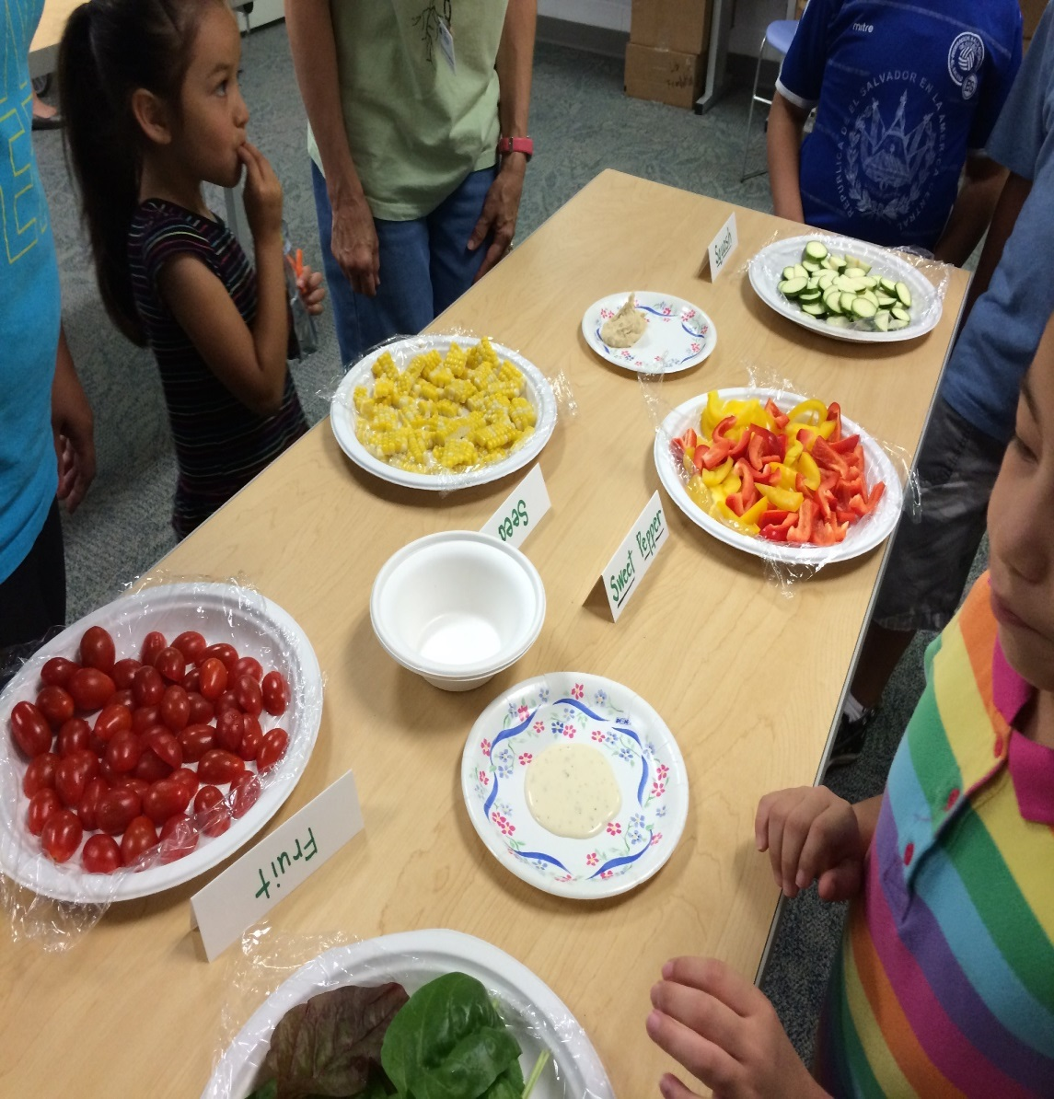
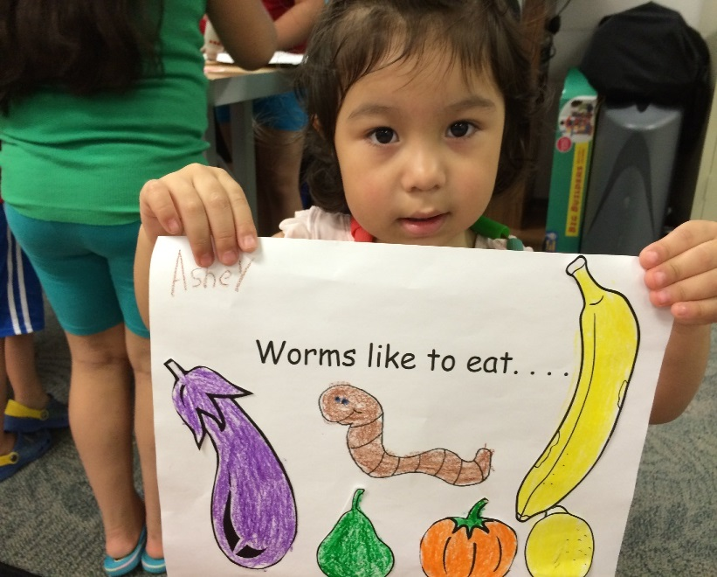
Loudoun Master Gardeners
Notes:
We also learned how to make paper pots
about
worms
Pests and pals in the garden
Parts of plants that we eat and then we ate some during a tasting party

Slide 29
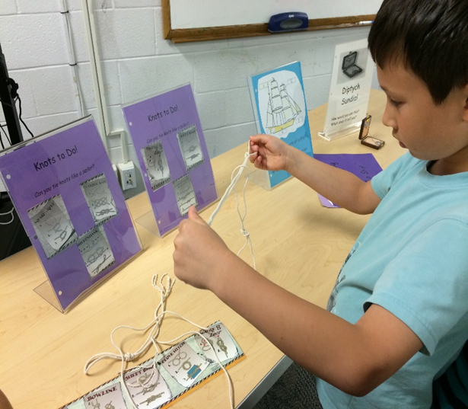

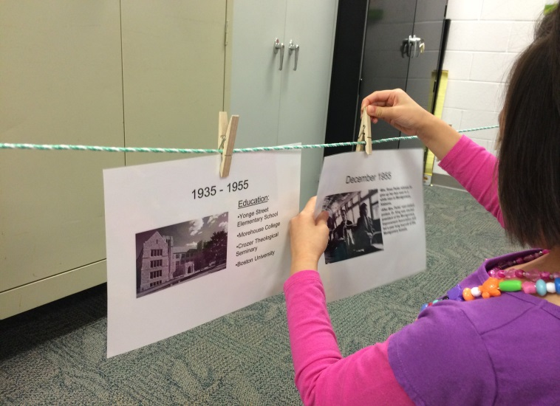
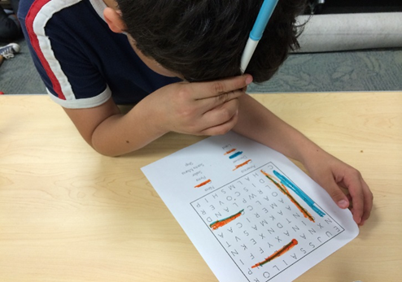
Friday = BookFlix & Puzzlers
Notes:
In keeping with the SRC Super Hero theme, On Fridays we viewed a BookFlix biography of “super” person , completed the accompanying Puzzler activity,
then children could complete word puzzles, crosswords and about a variety of hands-on & jigsaw puzzles.
Famous people we learned about this year included:
Christopher Columbus
Johnny Appleseed
Martin Luther King, Jr.
Rosa Parks
Abraham Lincoln
Snowflake Bentley
Harriet Tubman

Slide 30
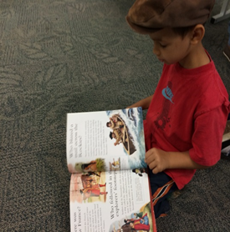
Outcomes
1. Alleviate hunger
Over 1,500 snacks served
2. Increase in library program participation
Monthly program attendance increased
July 2013 = 1,562
July 2014 = 1,905
July 2015 = 2,989
Notes:
We have been working for the past 2 years to increase program attendance and Summer Read & Feed played a role in this goal.

Slide 31
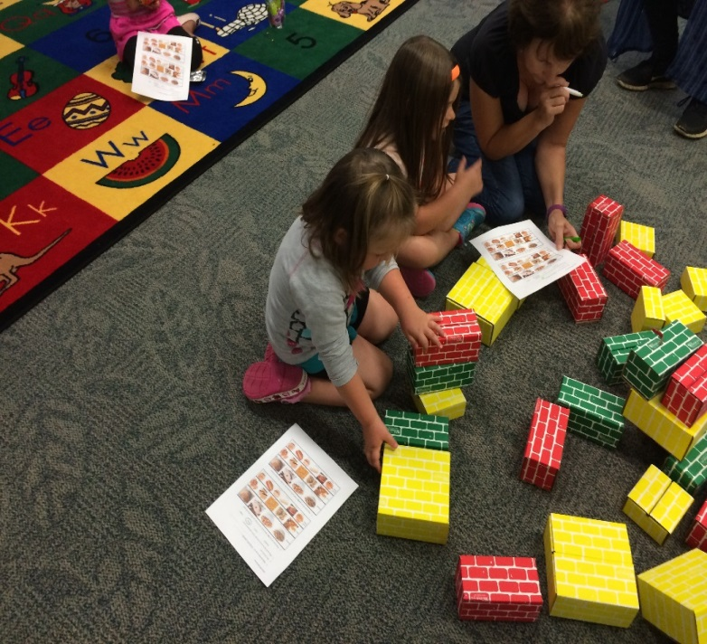
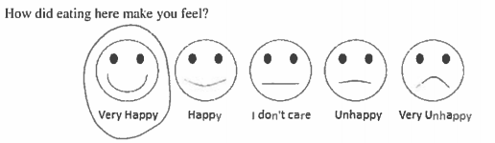
Outcomes
3. Positive experience @ the library.
Survey
80%
20%
Notes:
We also had the participants complete a survey about the program, and the results were positive.

Slide 32

Outcomes
4. Staff development
  “Having a variety of staff participate is good cross-training.”
  “I like collaborating with my co-workers in the accomplishment of our library’s mission”
  “Creating a program with specific goals is fun!”
  “Having tangible results is rewarding for both children and staff!”
  “Having a program that provides daily nourishment of the body and enrichment of the mind is the perfect summer program for our community.”
Notes:
Staff comments included suggestions for next summer but also demonstrated that they understand we are here to serve our community and one another.

Slide 33

Lessons Learned
Relationships – “What set Summer Read & Feed apart from all our other programs was that you could build relationships with children and their parents.”
Partnership with schools
Publicity
Notes:
• Students came to meet their teacher over the summer and that brought more students in to participate during read and feed.
• Partner with the teachers/schools. Most of the teachers had never been to our branch. Most of the teachers did not know about our Read and Feed.
• Possibly visit the schools right before summer begins to promote summer reading and to let them know about Read and Feed.
• Get the information into the school newsletter or send with the student’s report cards in English, Spanish and other languages
More publicity. Word of mouth was our only way of notifying the public and that was only to patrons who happened to come in the library during the summer.

Slide 34

Webcasts and information about Summer Food Service Program (SFSP)
http://www.fns.usda.gov/sfsp/summer-food-service-program-sfsp
Frequently asked questions
http://www.fns.usda.gov/sfsp/frequently-asked-questions-faqs
Virginia Department of Education Eligibility Reports
http://www.doe.virginia.gov/support/nutrition/statistics/index.shtml
Virginia Department of Health SFSP
http://www.vdh.virginia.gov/ofhs/dcn/sfsp/

Slide 35


