Slide 1
Let’s Work Together!
Building a School/Public Library Partnership
Angela Critics - Teen Librarian
Jefferson-Madison Regional Library
IdaMae Craddock
Librarian, Burley Middle School

Slide 2
Some Background
A Dance of Collaboration with a wide range of possibilities
“We should work together and create a partnership.” But what did we each mean? What would the collaboration look like? In the end, we just took the plunge!

Slide 3
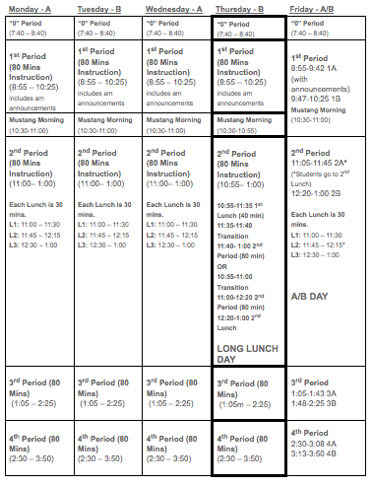
How it worked at the school
When?
Remediation / Extension Block - Mustang Morning
Before School
After School
Lunch

Slide 4
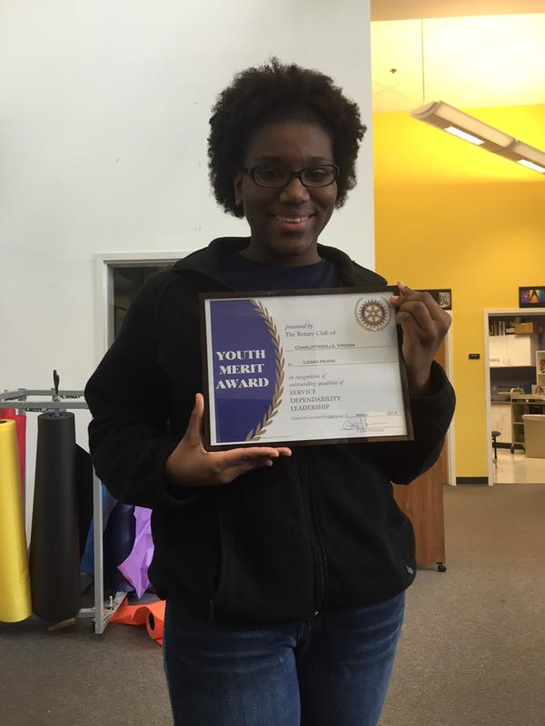
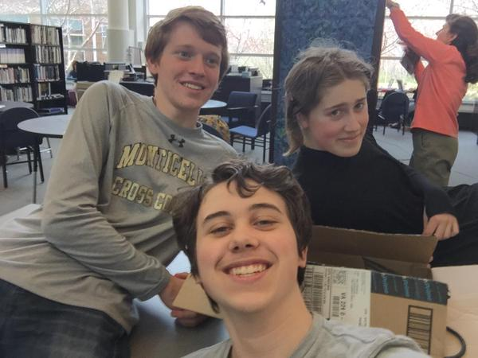
Who?
Who?
English Honors Society
National Honors Society

Slide 5
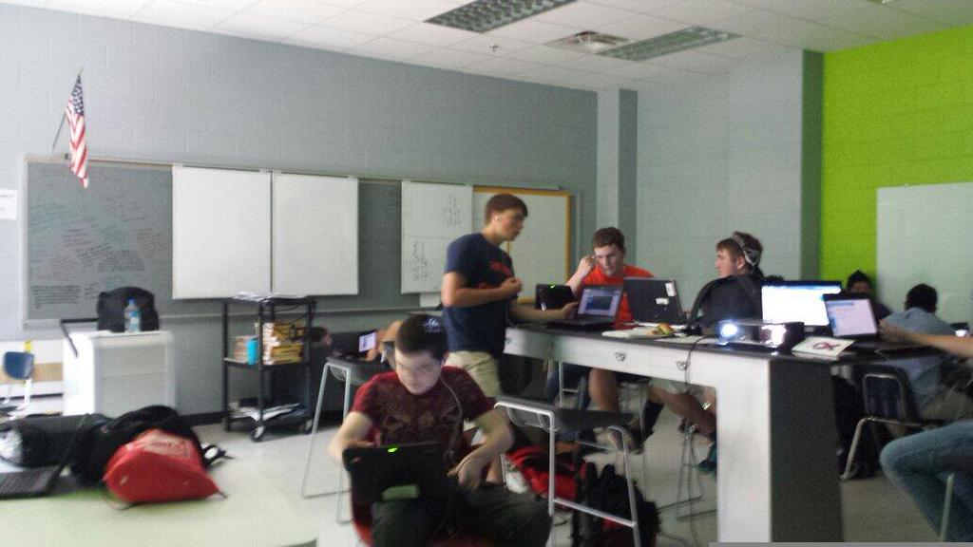
Where?
Classroom to the side of the library.
Sound muted
White board
Internet Connectivity

Slide 6
How it worked for the public librarian
Much like a regular Teen Advisory Board
Needs assessment - what do the students want?
Come prepared with concrete proposals and projects
Flexibility is key!
Teen schedules are a constant challenge
Limited window to catch their interest
Needs to be a clear benefit to the student for investing their time

Slide 7
Things that were great about it
Students were able to earn service hours Brought teens to the public library who had rarely or never been there. Public librarian gets feedback and input on library programs and services from a broader group. Space for sharing books in a non-academic way - celebrating love of reading Increased awareness of the public library
Greatest success: Life-sized Candyland event at the Central Library planned, prepared, and run jointly with the regular Central Teen Advisory Board

Slide 8
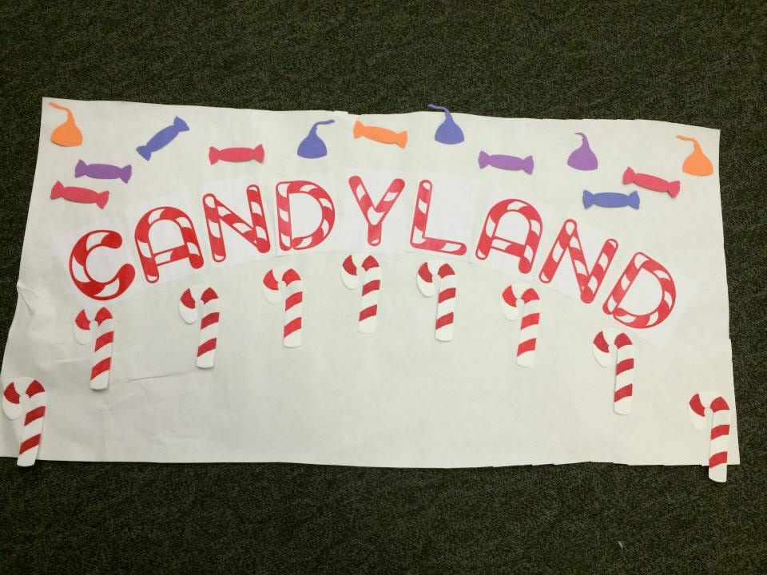
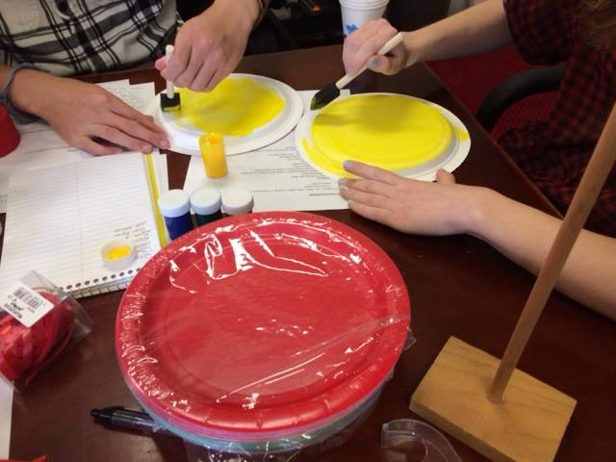
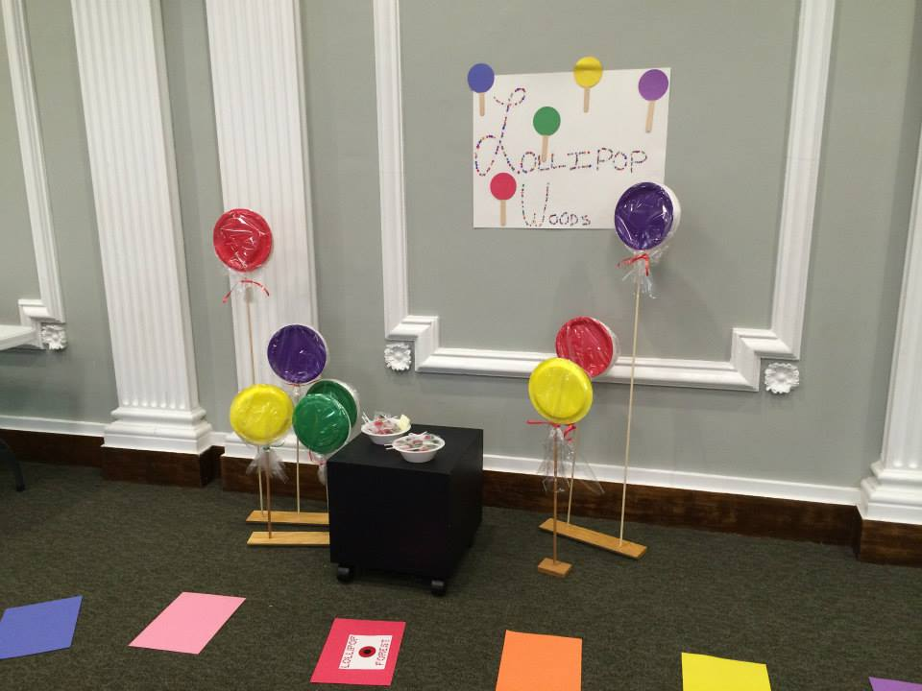

Slide 9
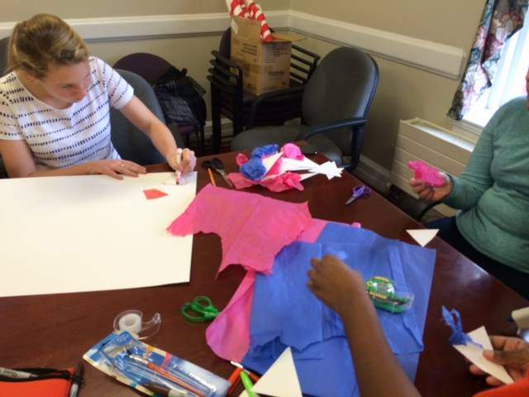
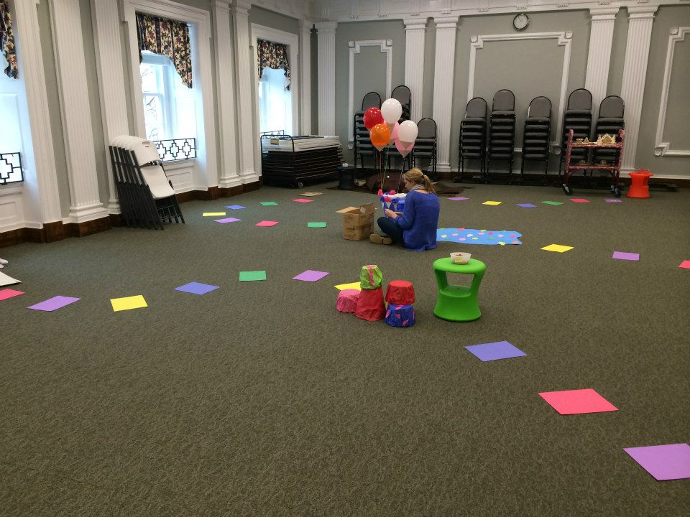
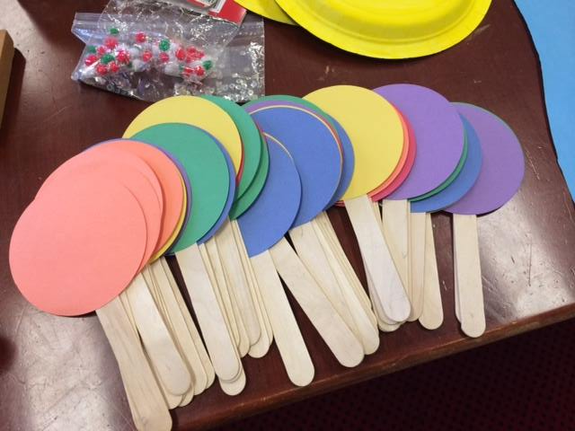
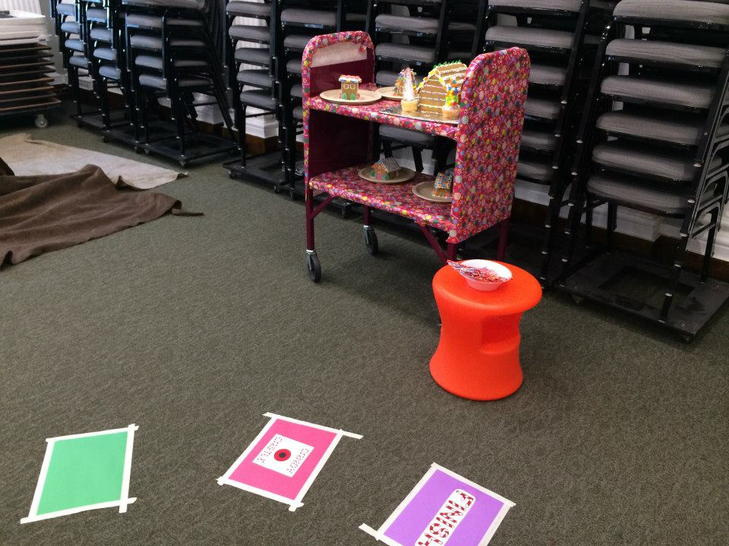

Slide 10
Things that we struggled with
Scheduling
Consistent attendance - constantly changing group Other commitments
Offering opportunities for students who could not get to the public library. Lack of follow through on self-directed or virtual opportunities
Staffing changes Communication outside meetings

Slide 11
Lessons Learned
If we were to start over, what would we do differently?
Clarify goals for the partnership. What does each side bring to the table, and what does each hope to gain? How do students benefit?
Go in with more set events or projects.
Would be easier to start at the beginning of the year - but don’t let that stop you!
Coordinate more with faculty, especially advisors for clubs and Honor Societies.

Slide 12
The Future?
Prompted Angela to reach out to other school librarians, expanding into another high school and middle school.
Gave Angela a starting point for reaching out to school librarians, teachers, and other community organizations
Prompted Mae to reach out to her new public librarian as well. Luckily, I was just added to Angela’s area!

Slide 13
How can you get started?
As a public librarian:
Reach out to the school librarian, even if you’ve done so before
Offer to come to them to meet
Offer specific ideas while also asking what would help them
Reach out to Key Club and Honor Society sponsors
Offer to have a table at school events like Back to School nights
Be prepared to start small - take any opening you can get

Slide 14
Contact information
IdaMae Craddock
Librarian, Burley Middle School
Charlottesville, VA
@imcraddock
Angela Critics
Young Adult/Reference Librarian
Jefferson-Madison Regional Library
Charlottesville, VA
acritics@jmrl.org

