Slide 1


Slide 2
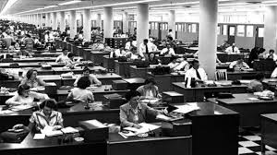
ALA WASHINGTON OFFICE
. . . THE VOICE OF LIBRARIES IN WASHINGTON FOR OVER 70 YEARS

Slide 3
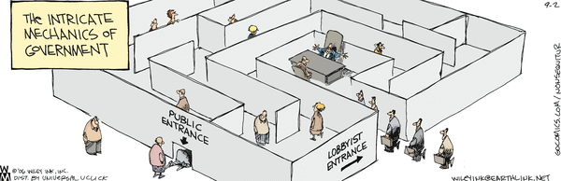

Slide 4
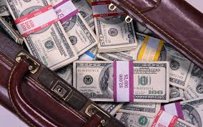
LOGIC . . .

Slide 5
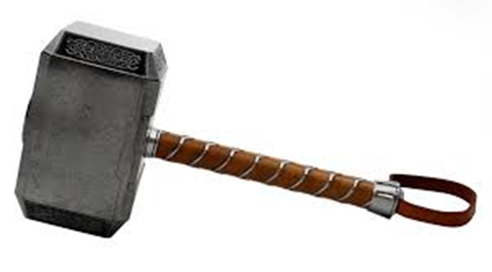
LOGIC . . .
. . . PERSUASION

Slide 6
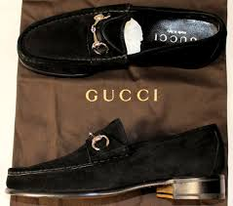
LOGIC . . .
. . . PERSUASION
SPECIAL EQUIPMENT . . .

Slide 7
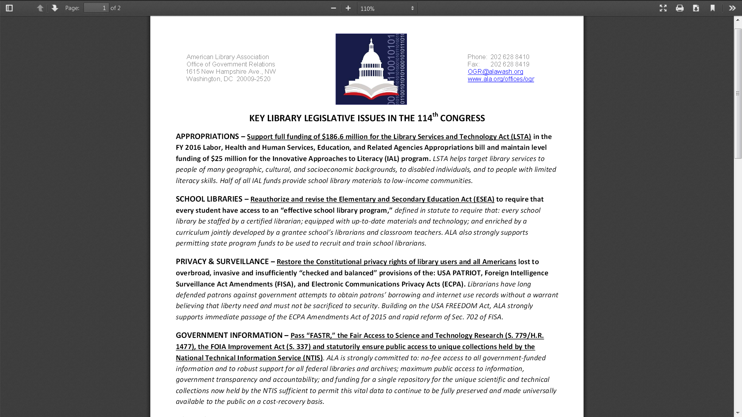

Slide 8
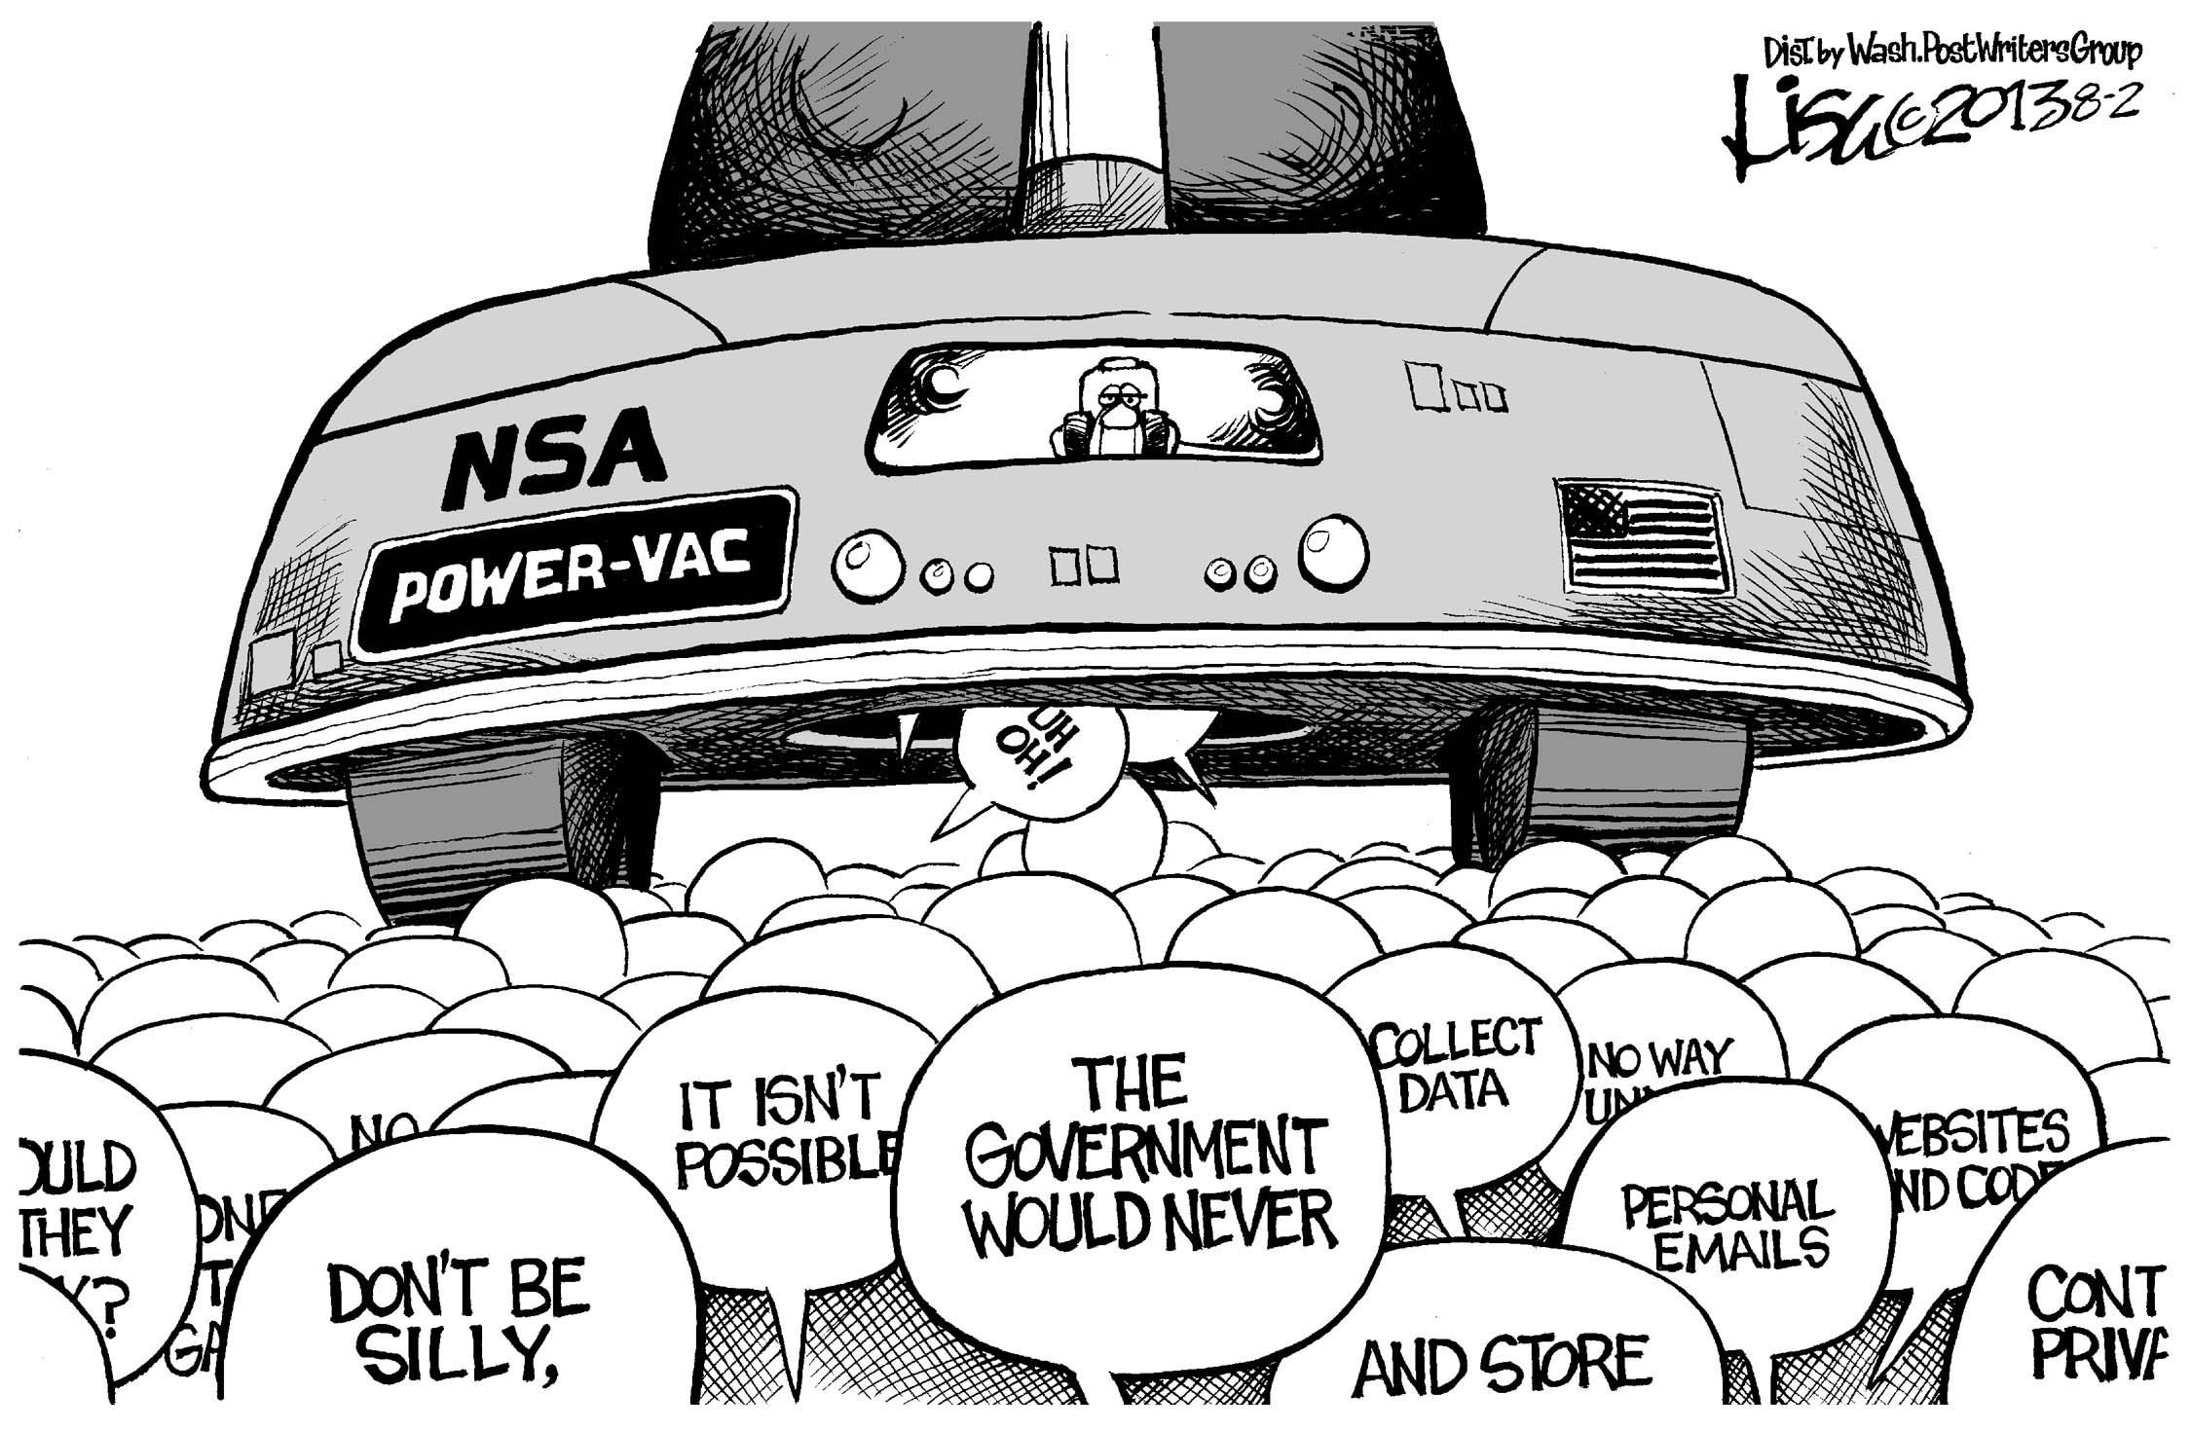
PRIVACY & SURVEILLANCE

Slide 9
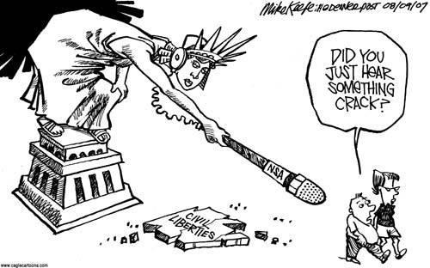

Slide 10

After being dogged by librarians and other protesters during a cross-country tour to boost support for the Patriot Act, Mr. Ashcroft last month accused librarians of being "duped" by liberals, and for two days running accused them of "hysteria."
Wall Street Journal
October 28, 2003

Slide 11
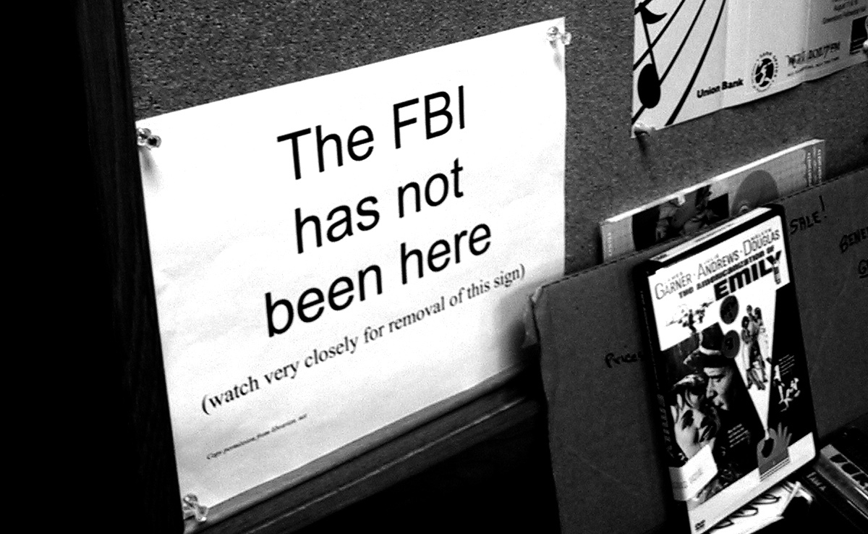

Slide 12
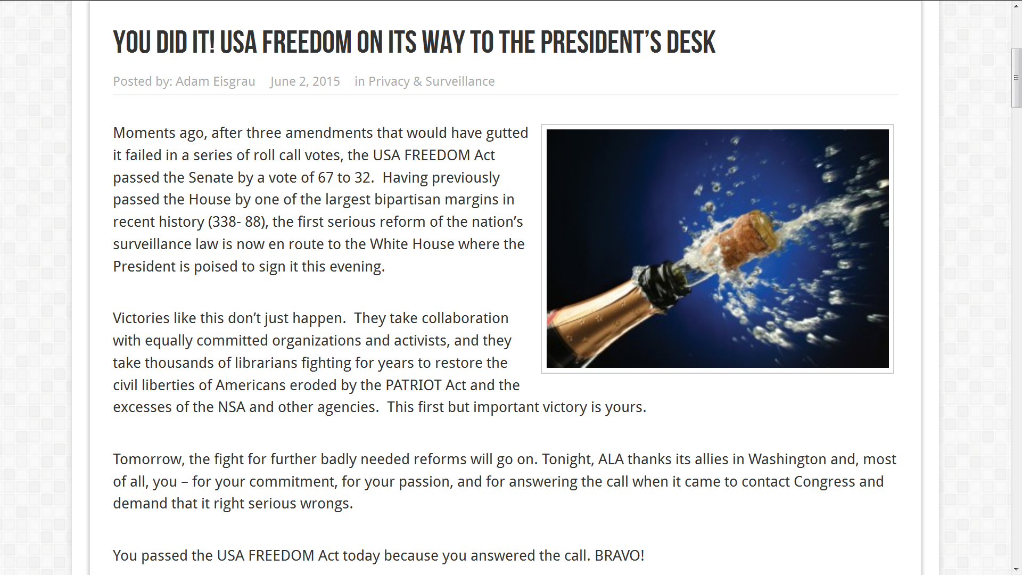


Slide 13

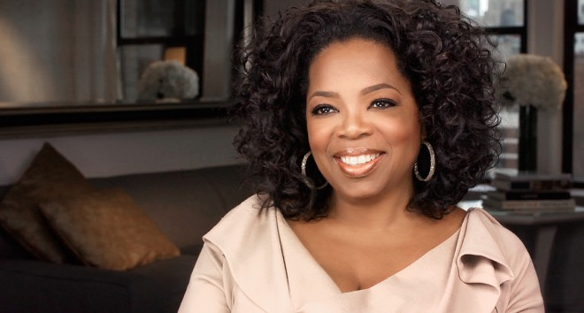
ECPA overhaul way “Oprah”-due
September 15, 2015

Slide 14
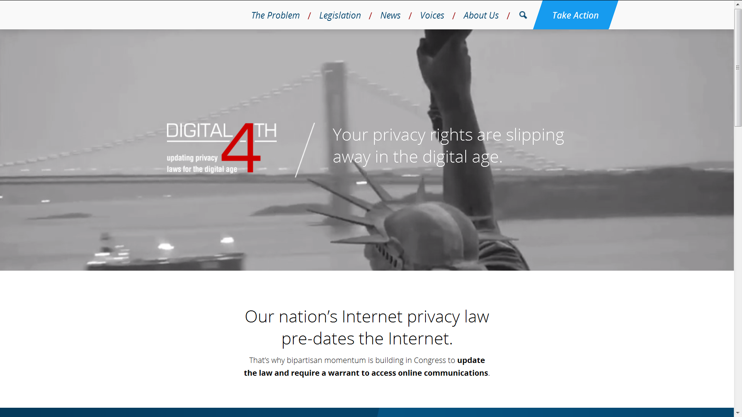

Slide 15
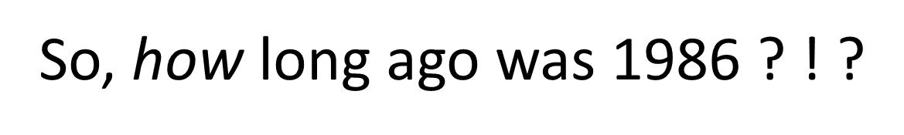
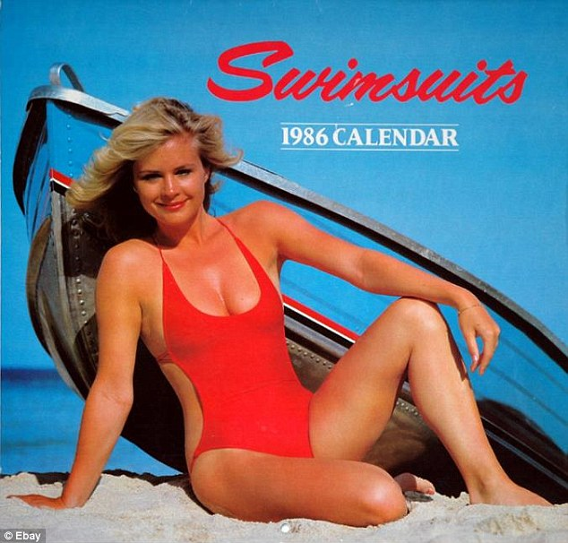

Slide 16
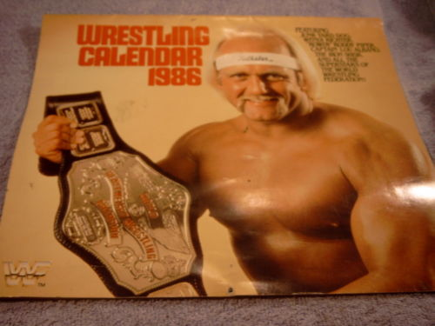

Slide 17
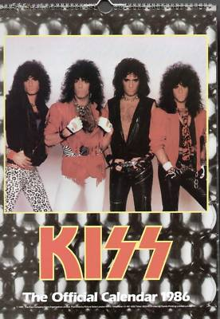

Slide 18
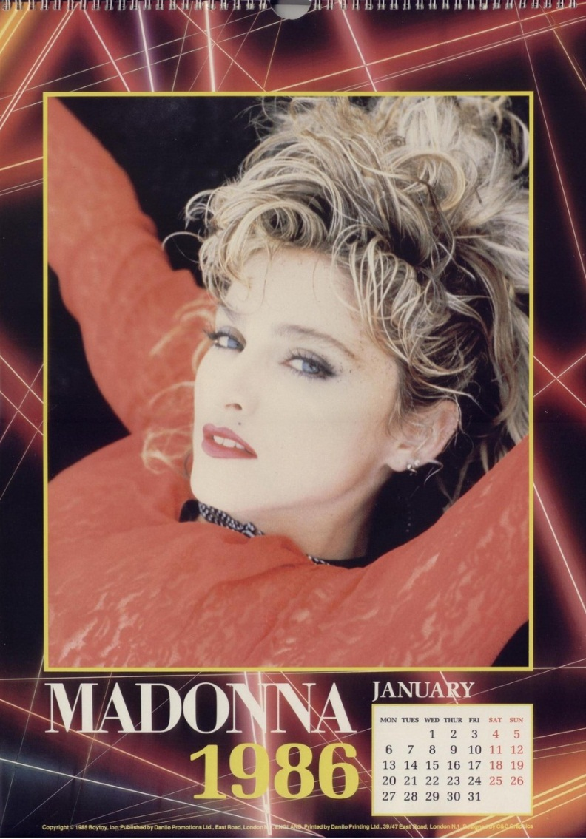

Slide 19
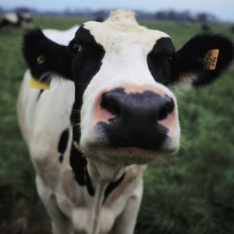
So, how long ago was 1986 ? ! ?

Slide 20
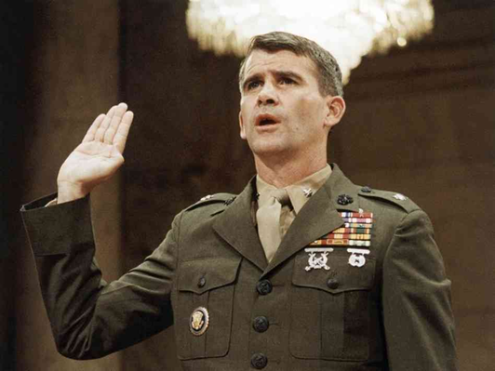
So, how long ago was 1986 ? ! ?

Slide 21
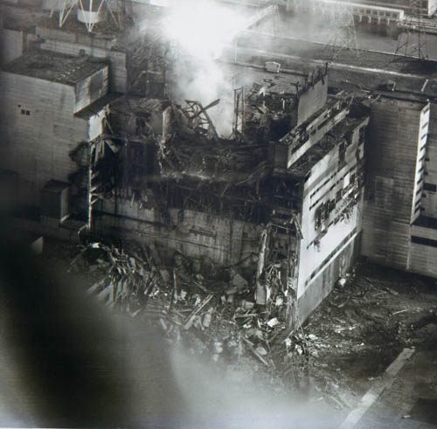
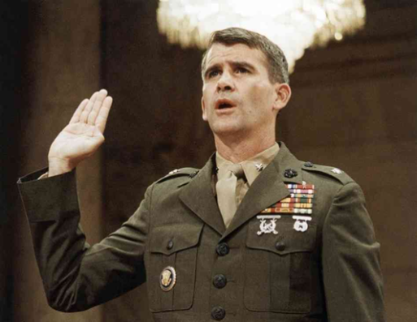
So, how long ago was 1986 ? ! ?

Slide 22
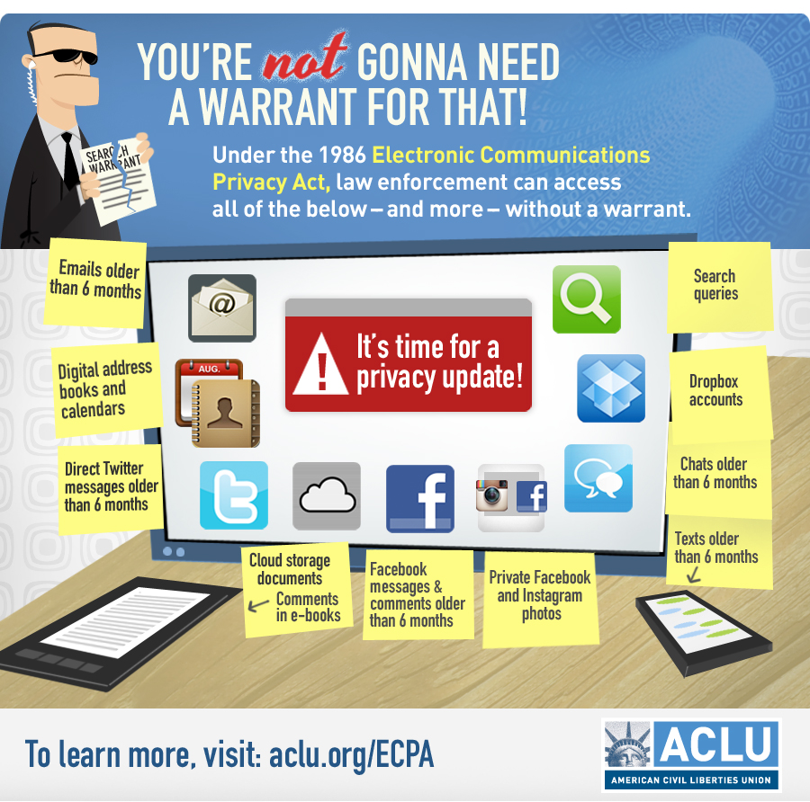

Slide 23
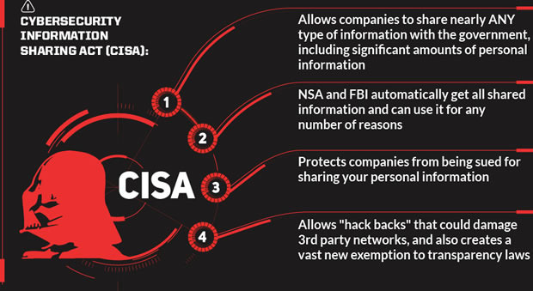

Slide 24
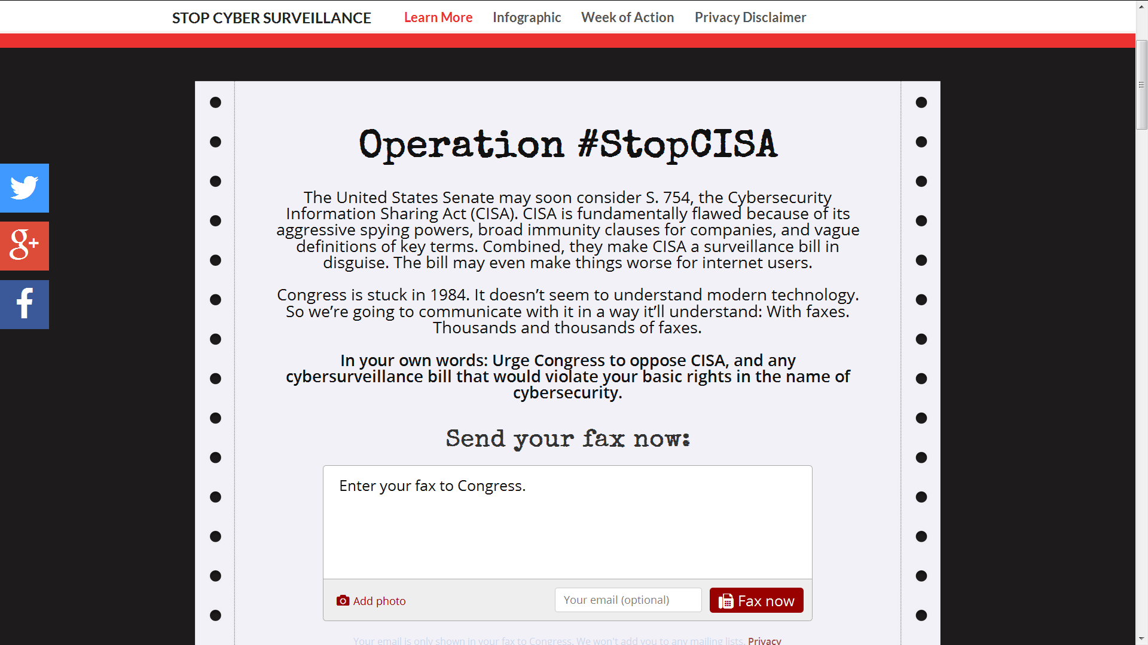

Slide 25
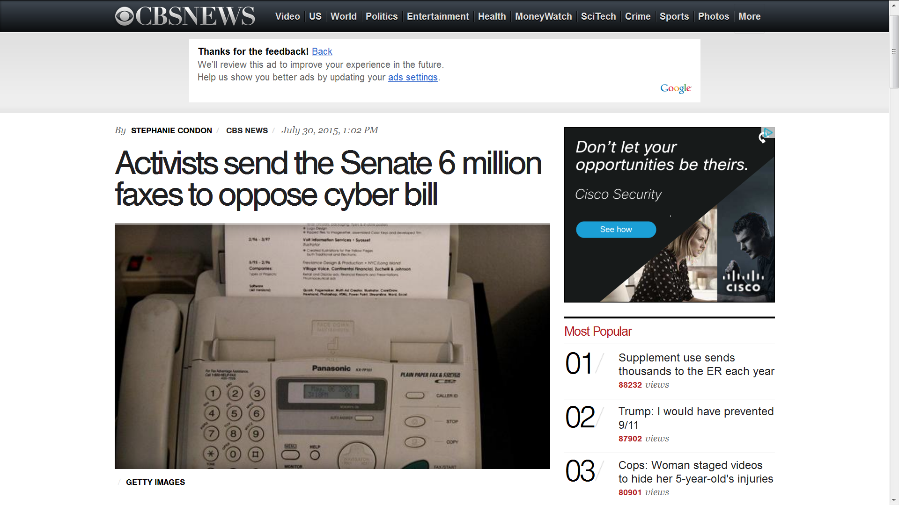

Slide 26

ALA president urges senators to join
Wyden, Paul and Sanders in opposing CISA
“When librarians oppose a bill with ‘information sharing’ in its name you can be sure that the bill is decidedly more than advertised. In fact, as Sens. Wyden, Paul and Sanders have courageously pointed out in opposition to it, the Cybersecurity Information Sharing Act would dramatically over-share the personal information of tens of millions of Americans who depend upon library computer networks, and could function, as a practical matter, as a new warrantless surveillance tool. ALA calls on all Senators to stand with Mr. Wyden, Mr. Paul and Mr. Sanders in keeping this privacy-hostile bill from the Senate floor until it is critically reformed.”
ALA President Sari Feldman
October 14, 2015

Slide 27
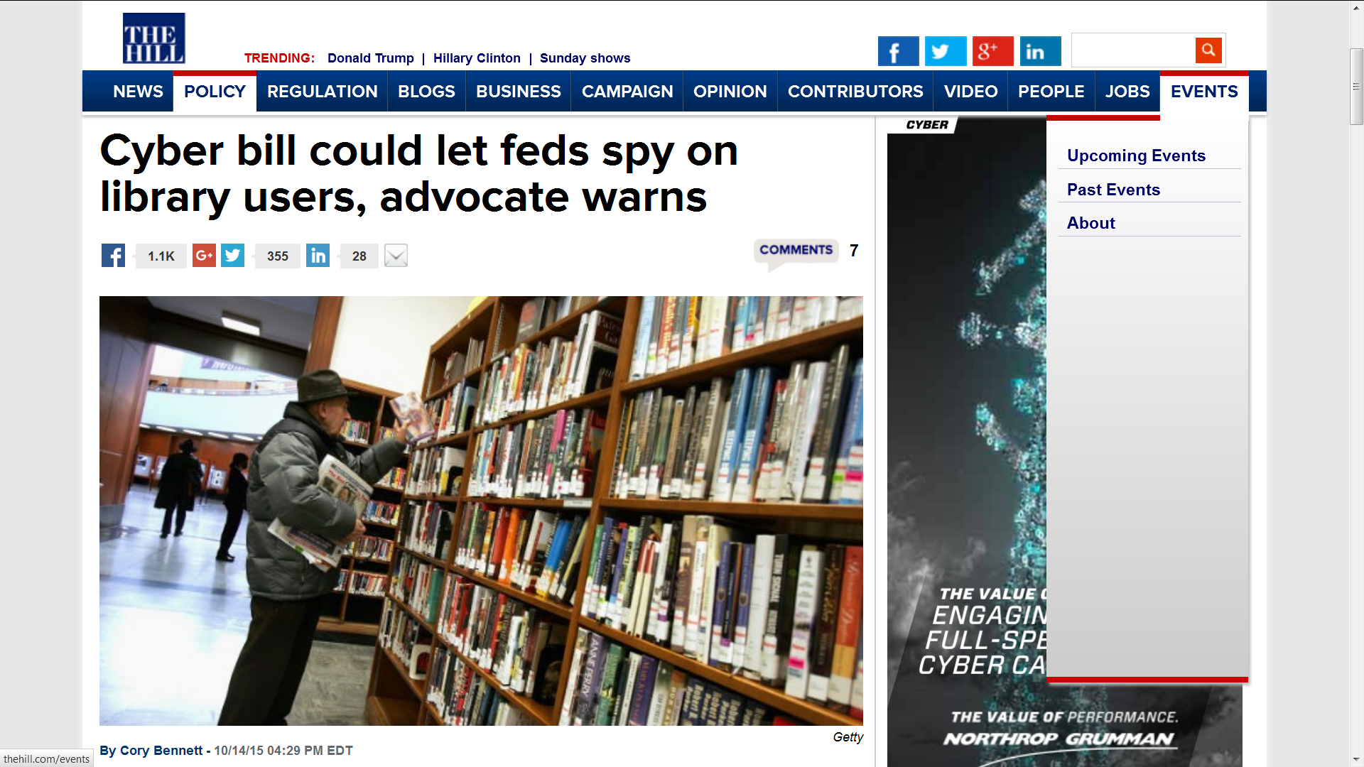

Slide 28
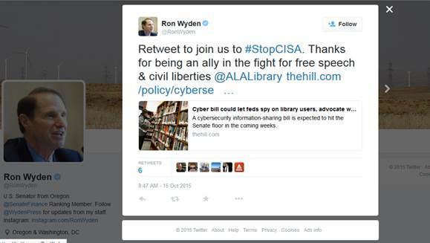

Slide 29
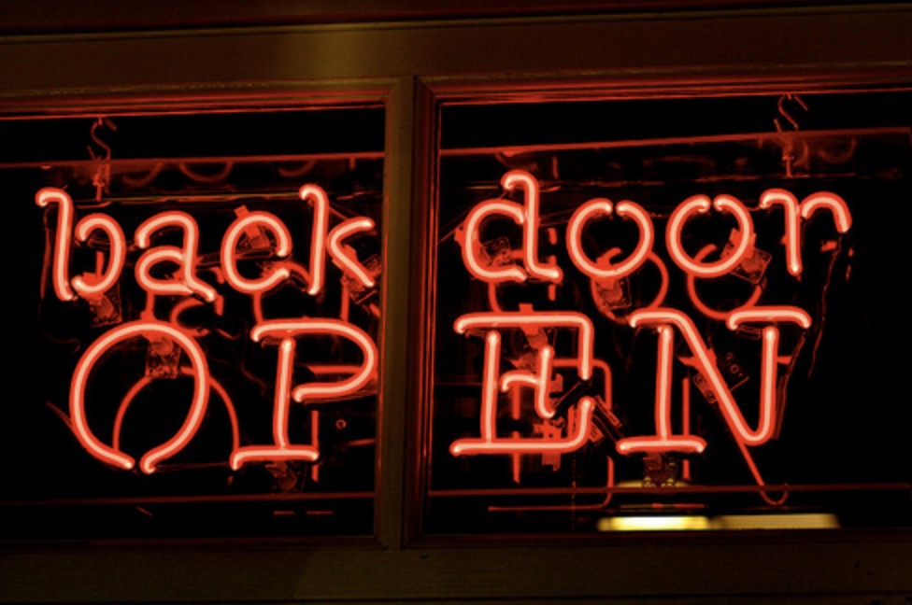

Slide 30
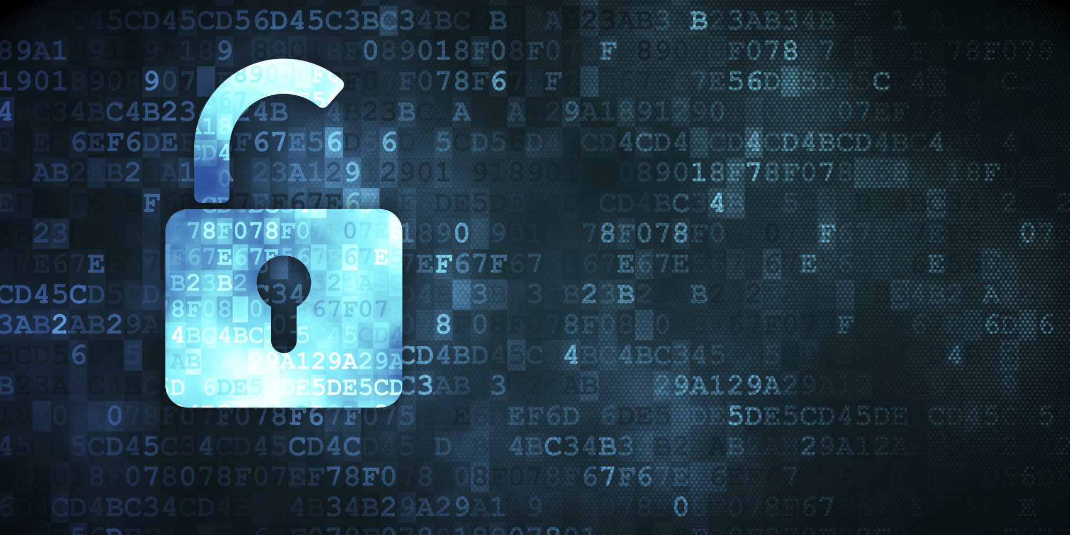

Slide 31
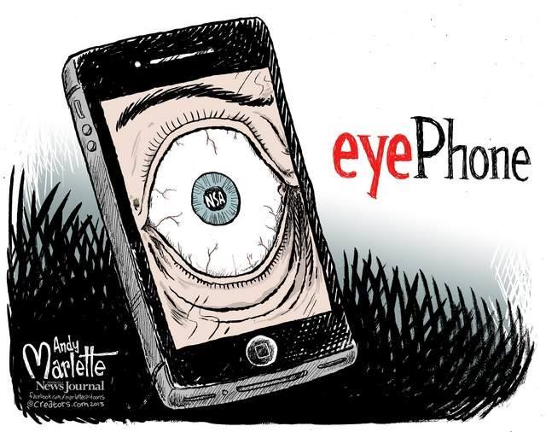

Slide 32
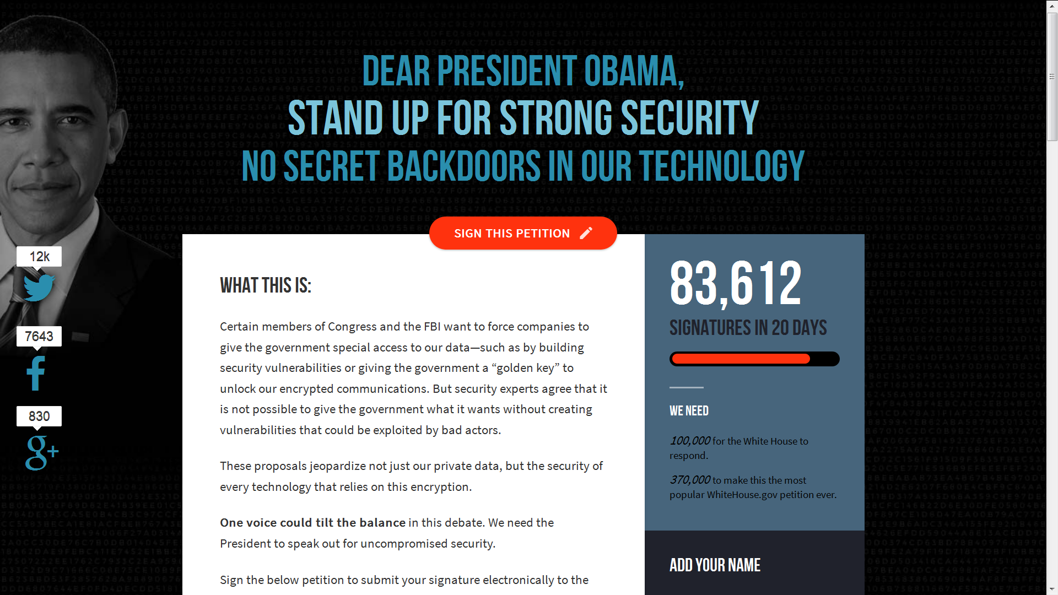
SAVECRYPTO.ORG

Slide 33
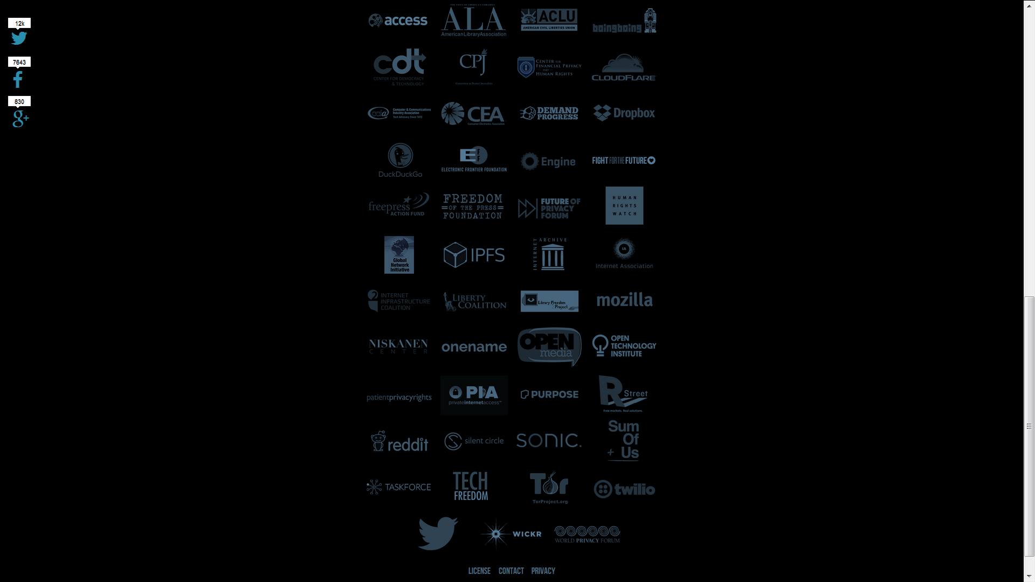

Slide 34
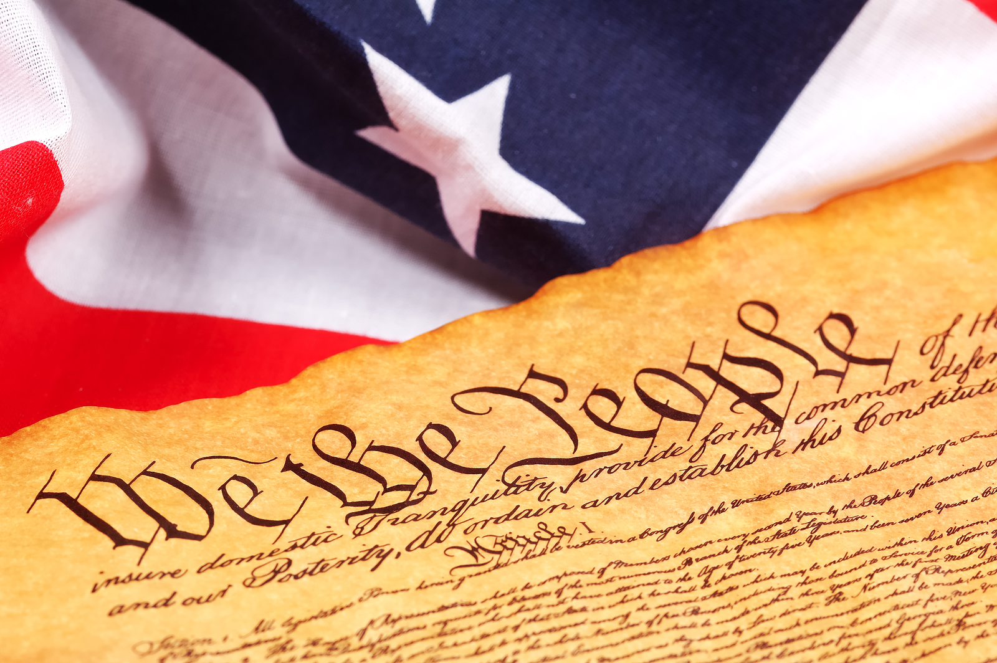

Slide 35
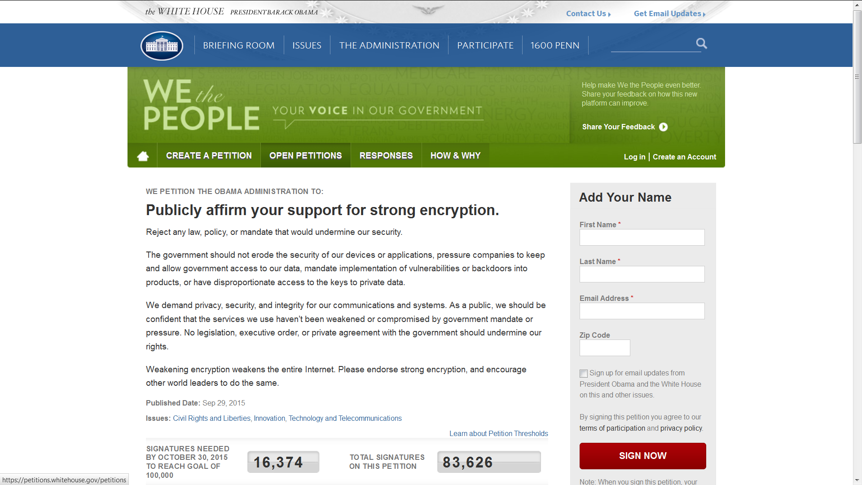

Slide 36

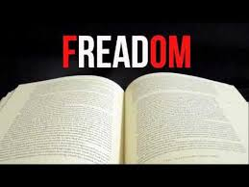

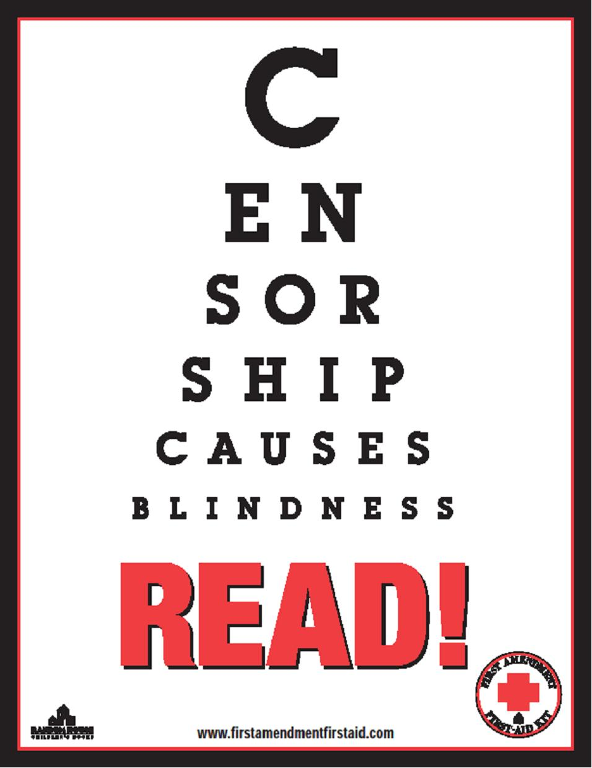





Slide 37
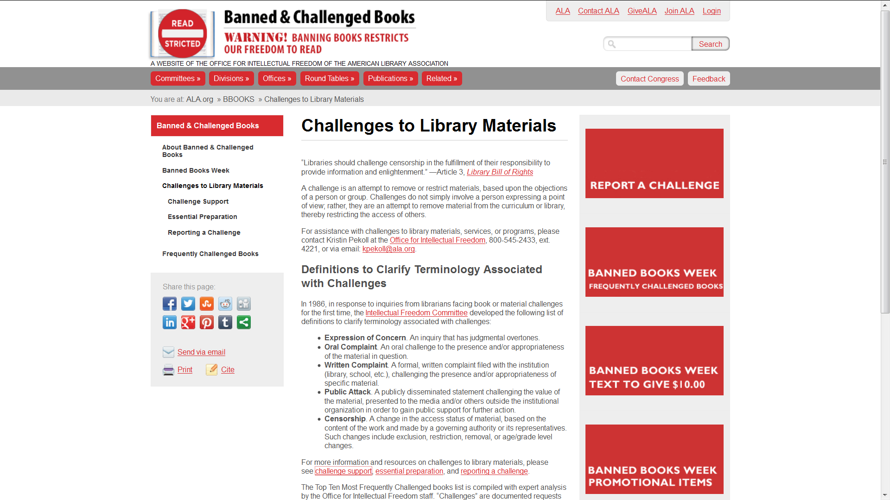

Slide 38
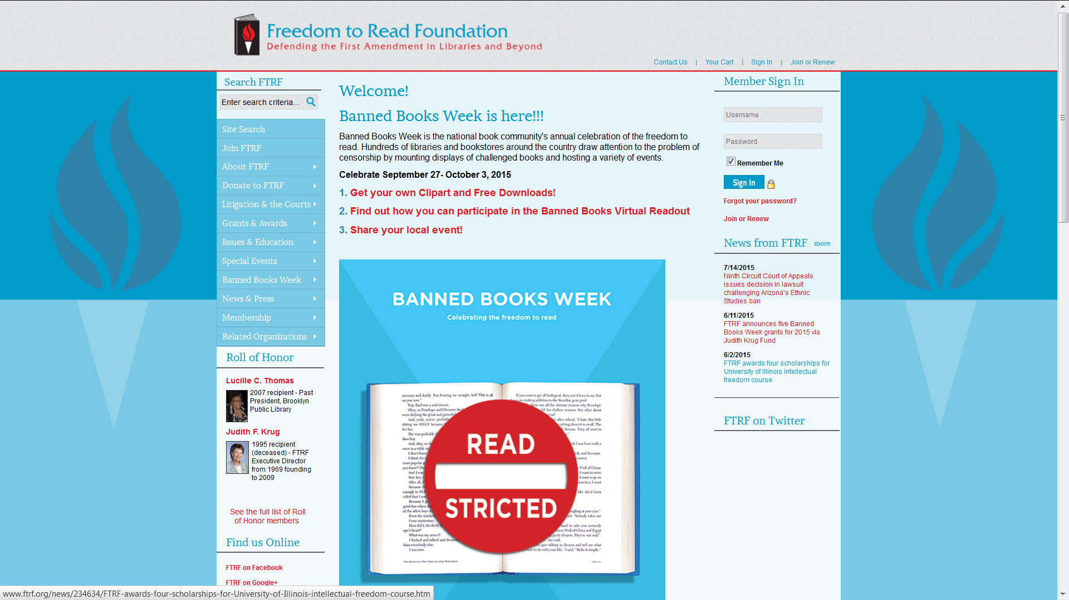

Slide 39
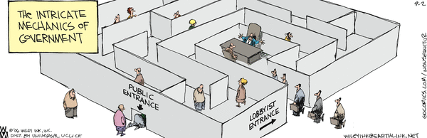

Slide 40


Slide 41
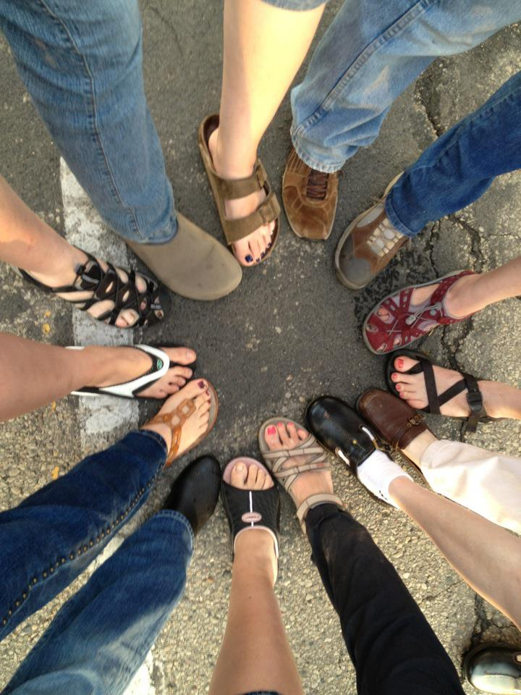

Slide 42
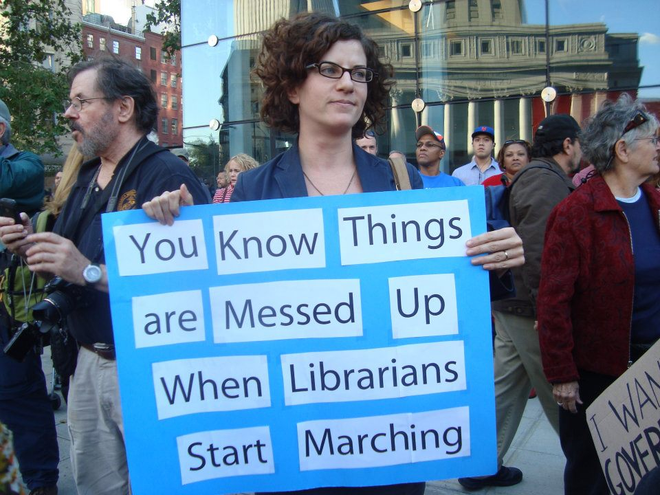

Slide 43


The Switch - Librarians won’t stay quiet
about government surveillance
By Andrea Peterson October 3, 2014

Slide 44

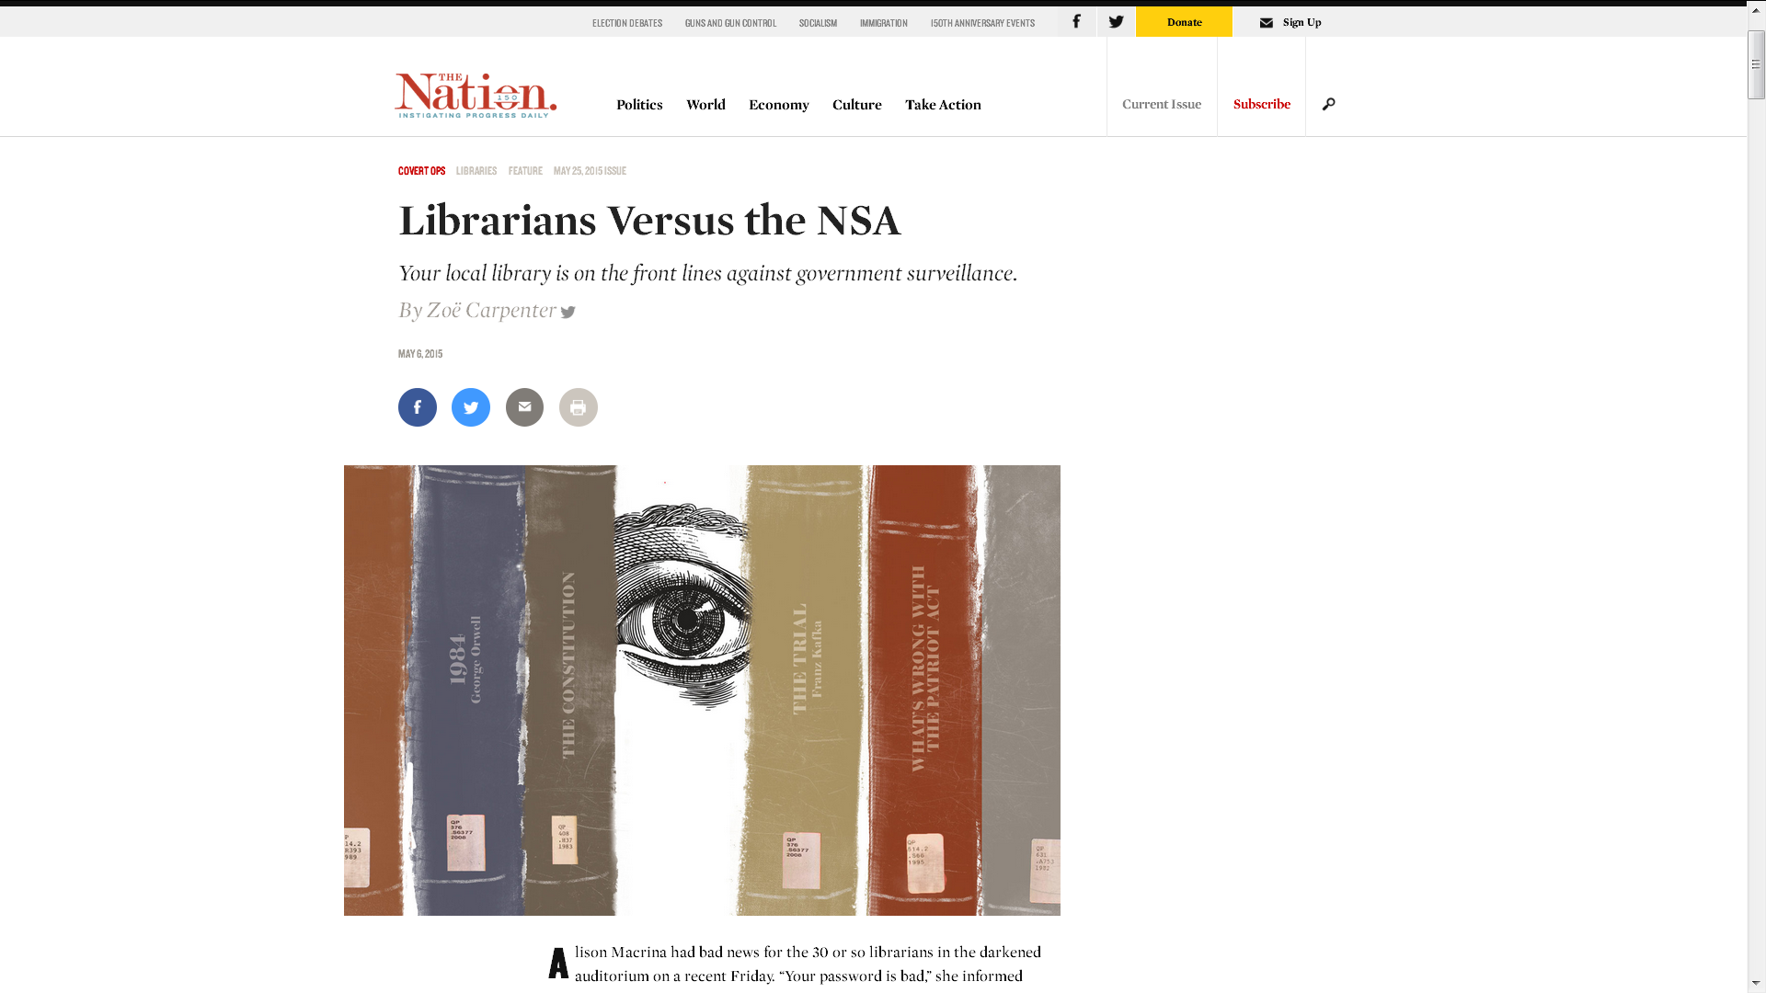
May 25, 2015

Slide 45

NATIONAL LIBRARY LEGISLATIVE DAY
CAPITOL HILL
WASHINGTON, DC
MAY 2 – 3, 2016

Slide 46
WWW.DISTRICTDISPATCH.ORG

Slide 47
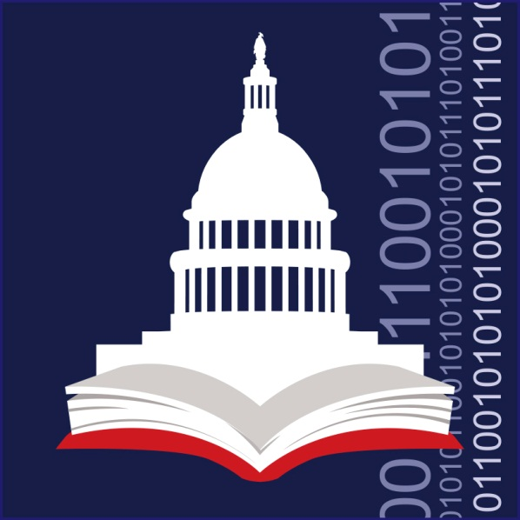
WWW.ALA.ORG/ogr
800-941-8478

Slide 48

© 2015 NSA, All Data Retained

