Slide 1
Opening Up the “Closed” Stacks: What Archives & Special Collections Can Do for You & Your Patrons!
Kira A. Dietz
VLA Annual Conference
Richmond, VA
October 22, 2015

Slide 2
Archives & Special Collections
A little bit of terminology:
  Archives
  Special collections
  Primary sources
A little bit about archives & special collections (generally):
  Missions and goals
  Commonalities and differences
  Crash course in our activities

Slide 3
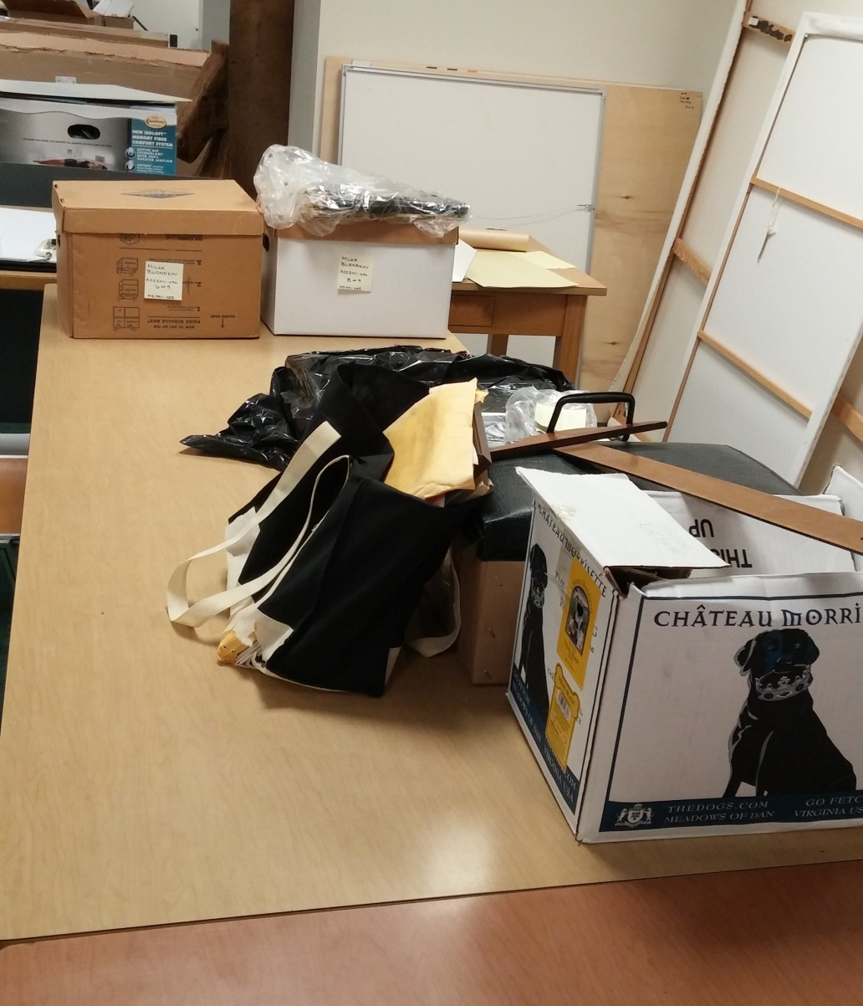
In other words, some of what we do is going from this…

Slide 4
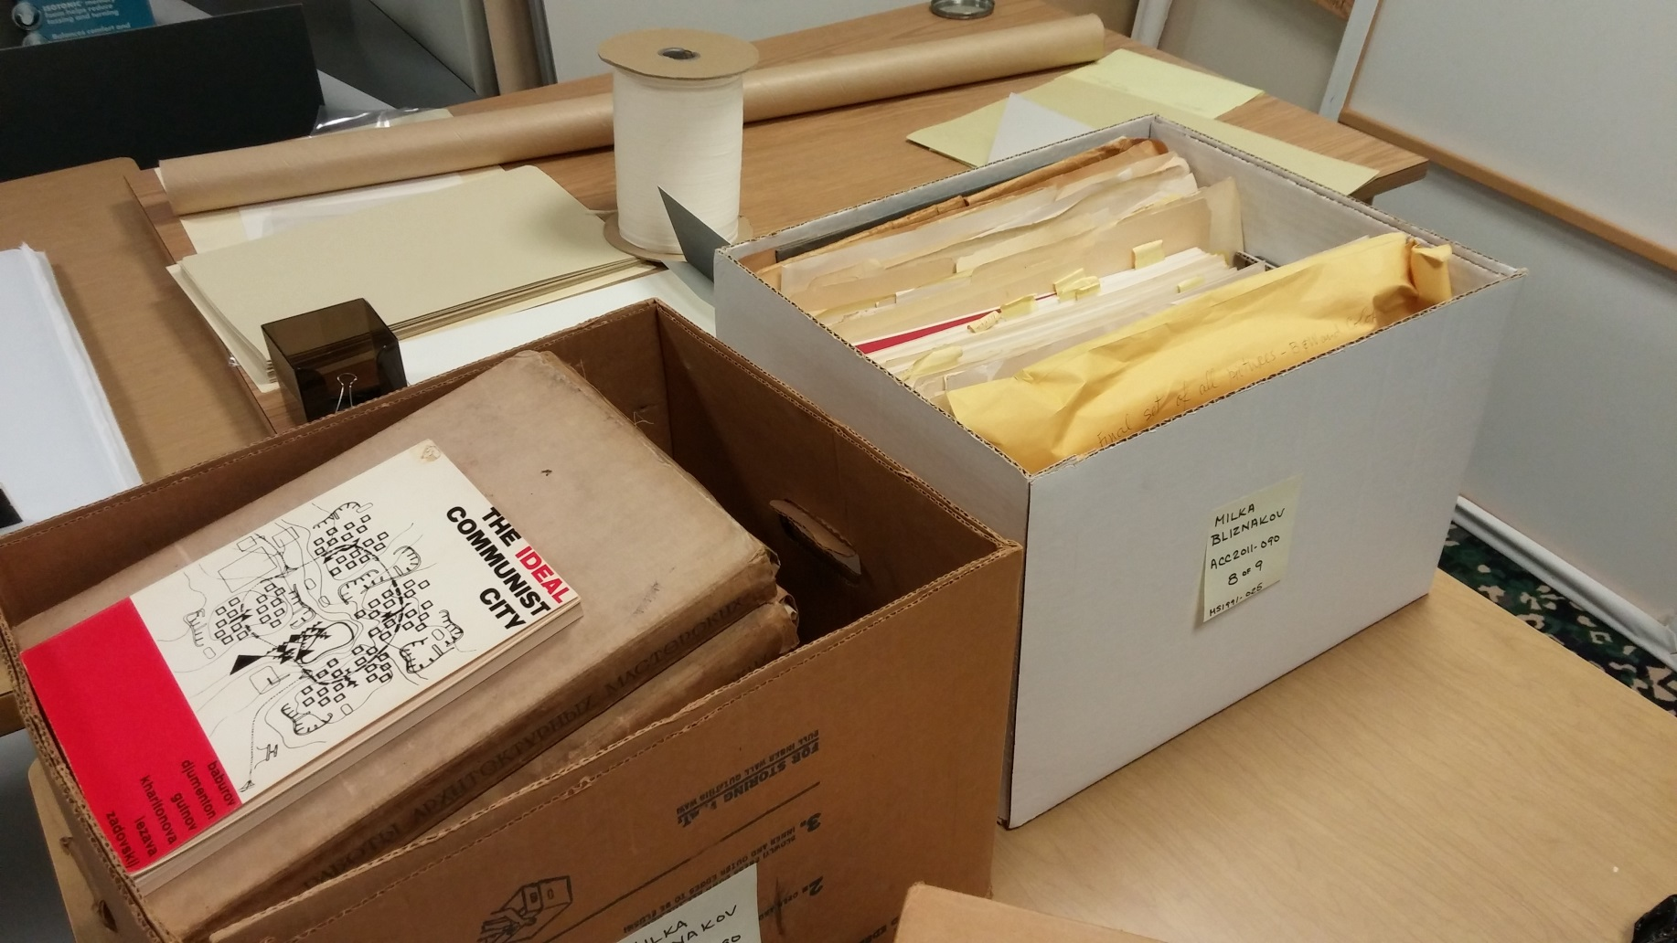
…and this…

Slide 5
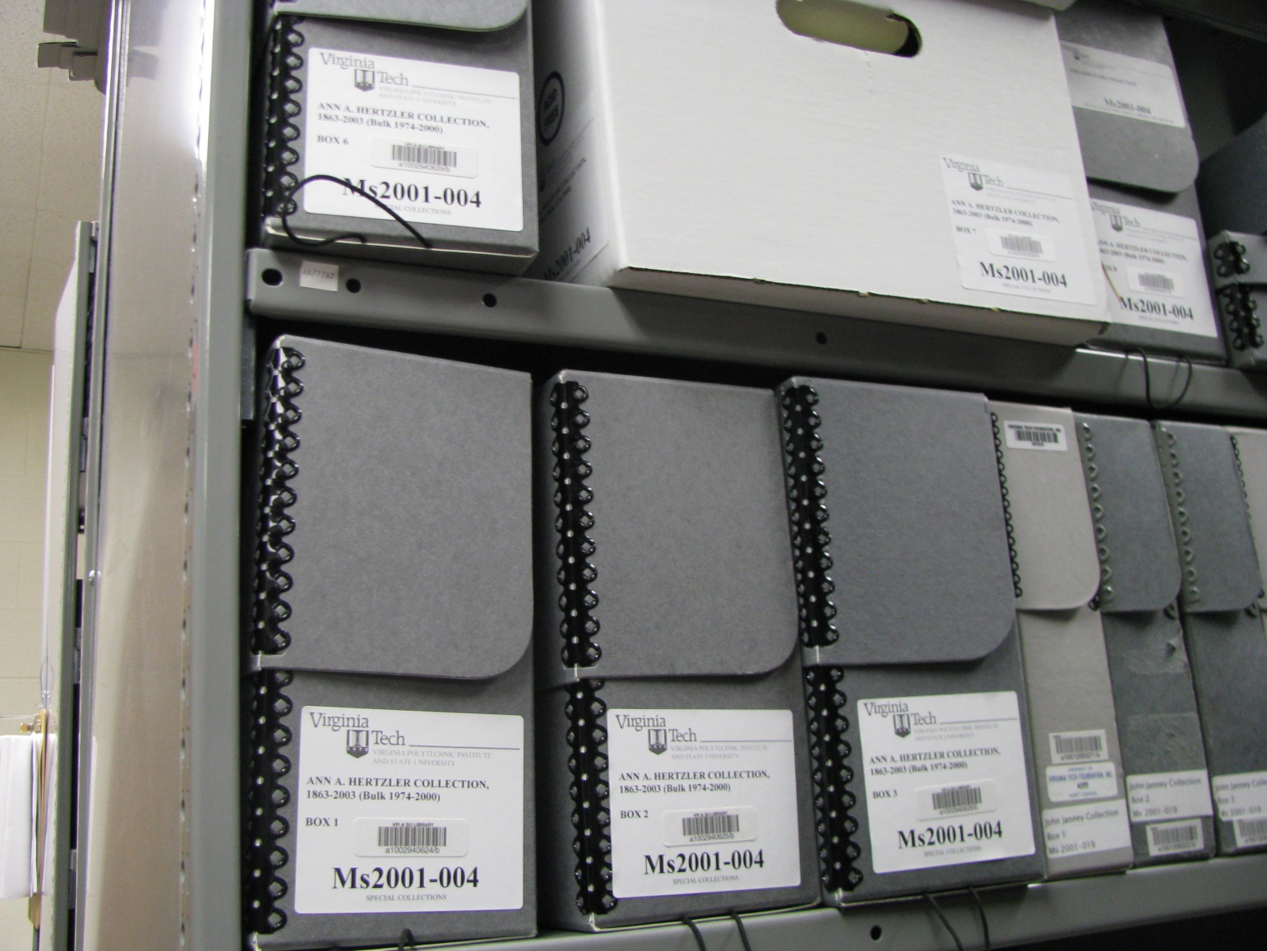
…to this…

Slide 6
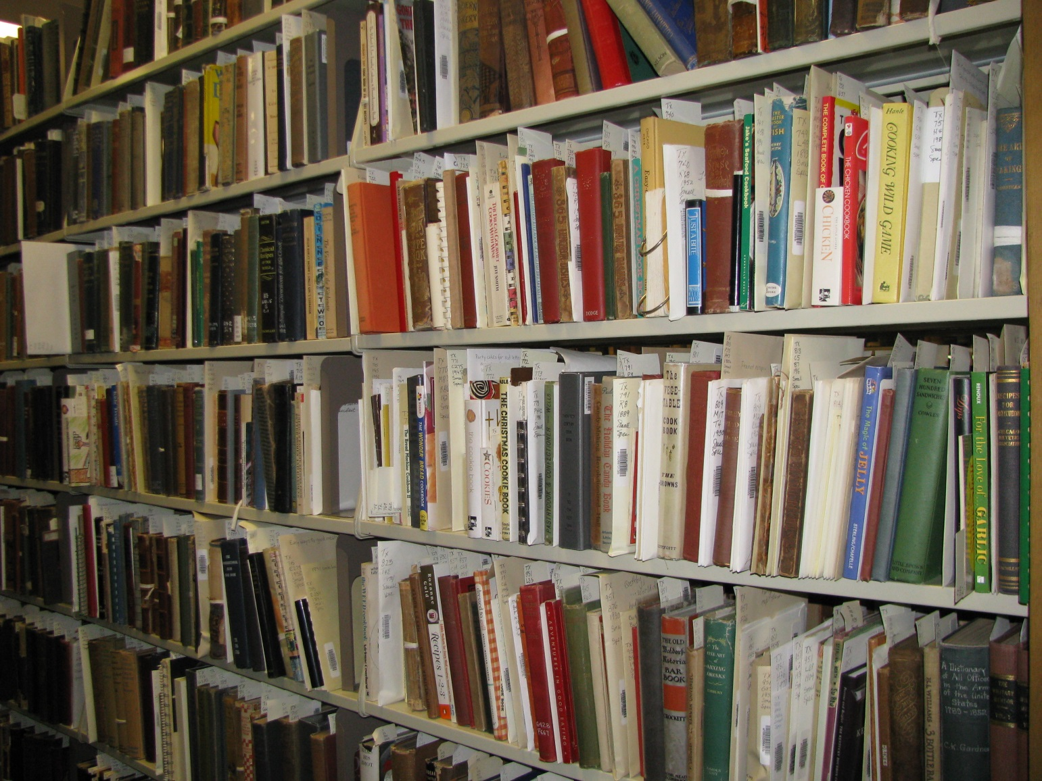
…and this…

Slide 7
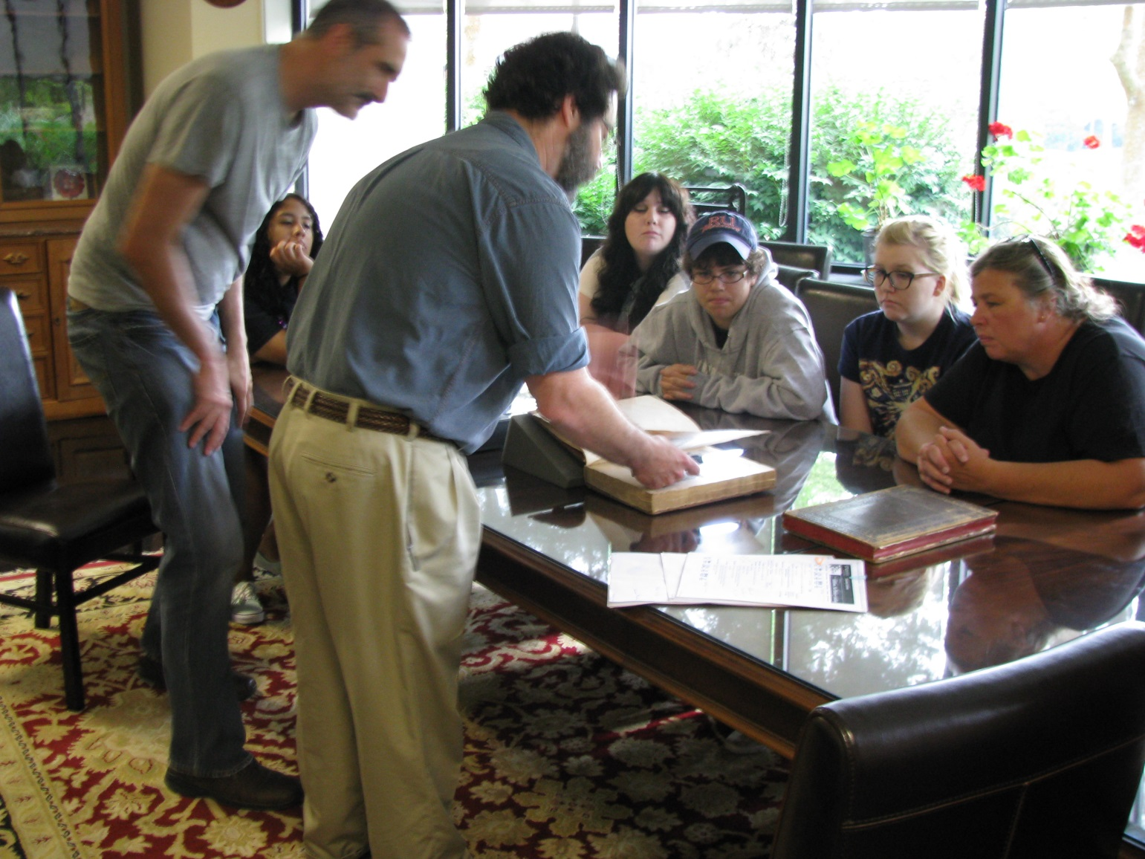
…and this!

Slide 8
What Will You Find on Our Shelves?
Any ideas?

Slide 9
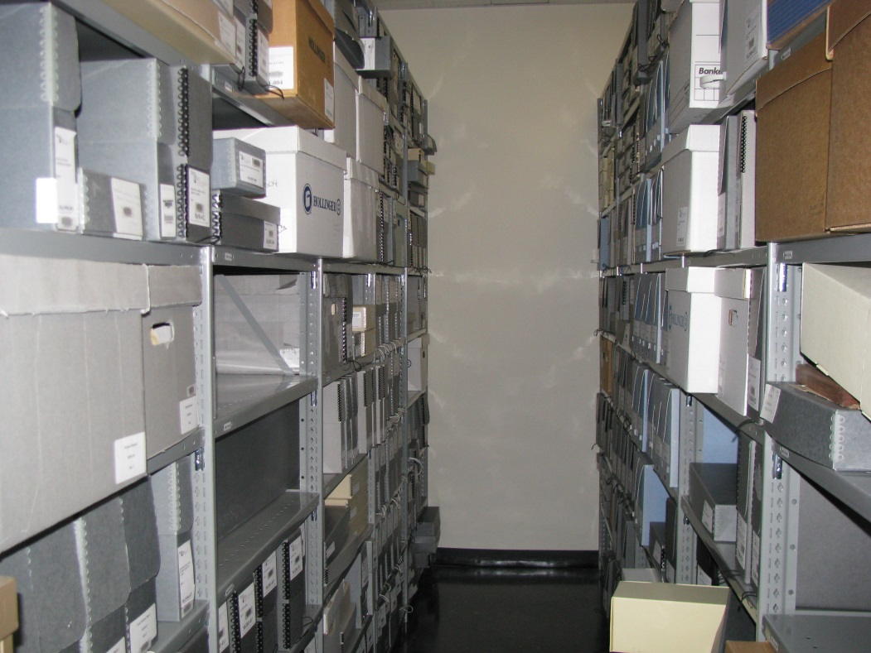
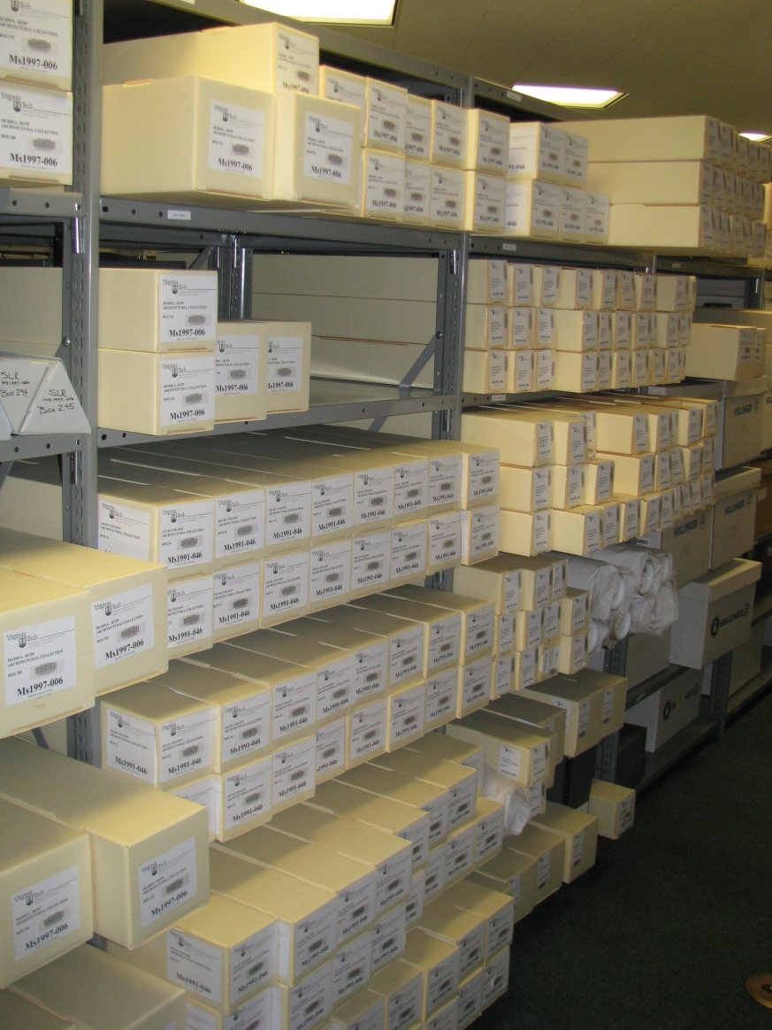
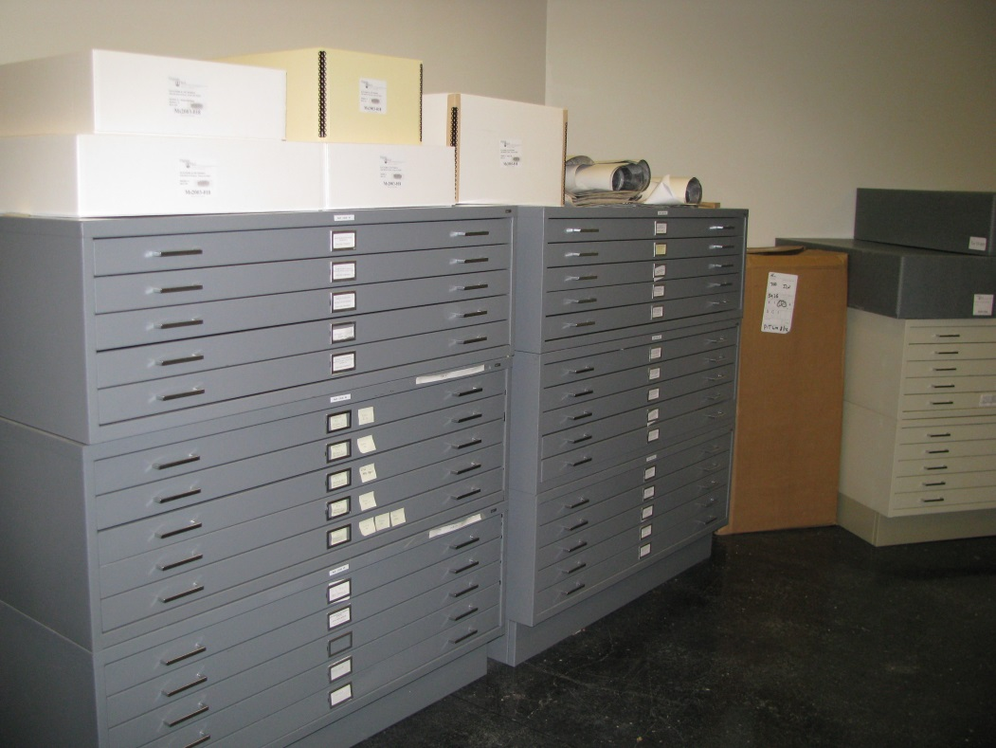

Slide 10
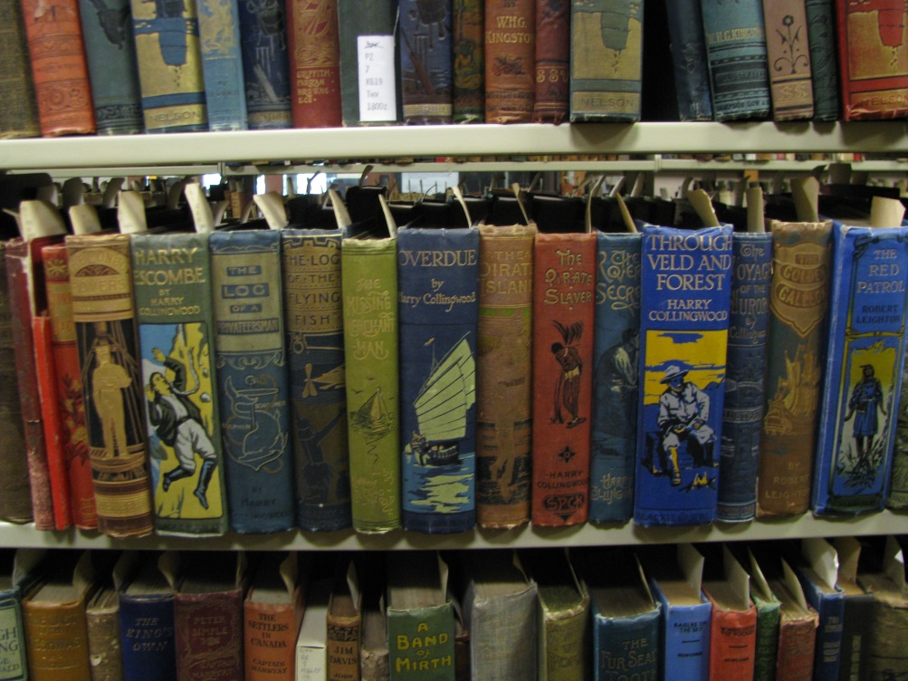
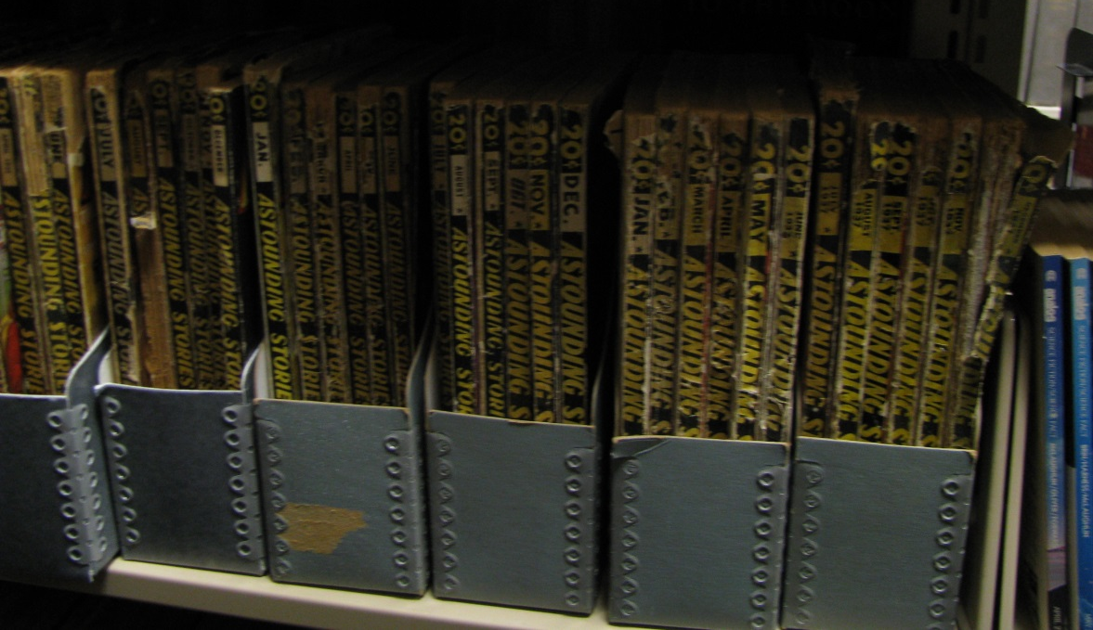
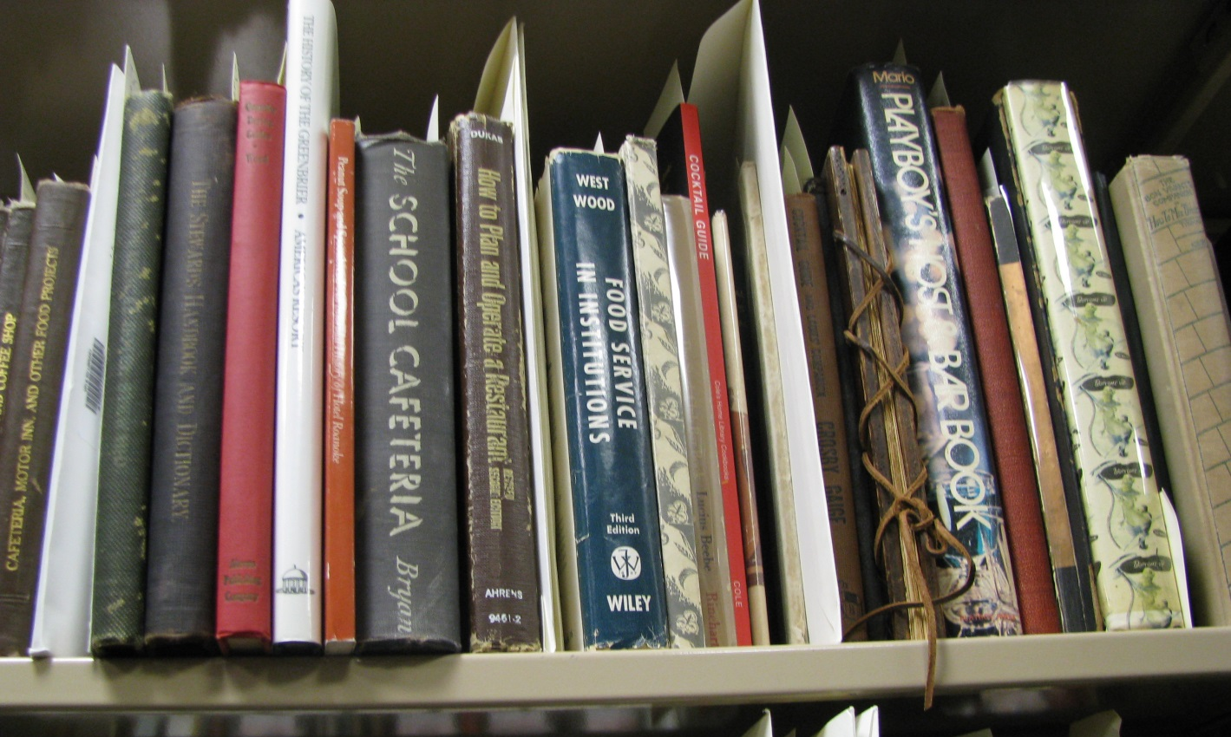

Slide 11
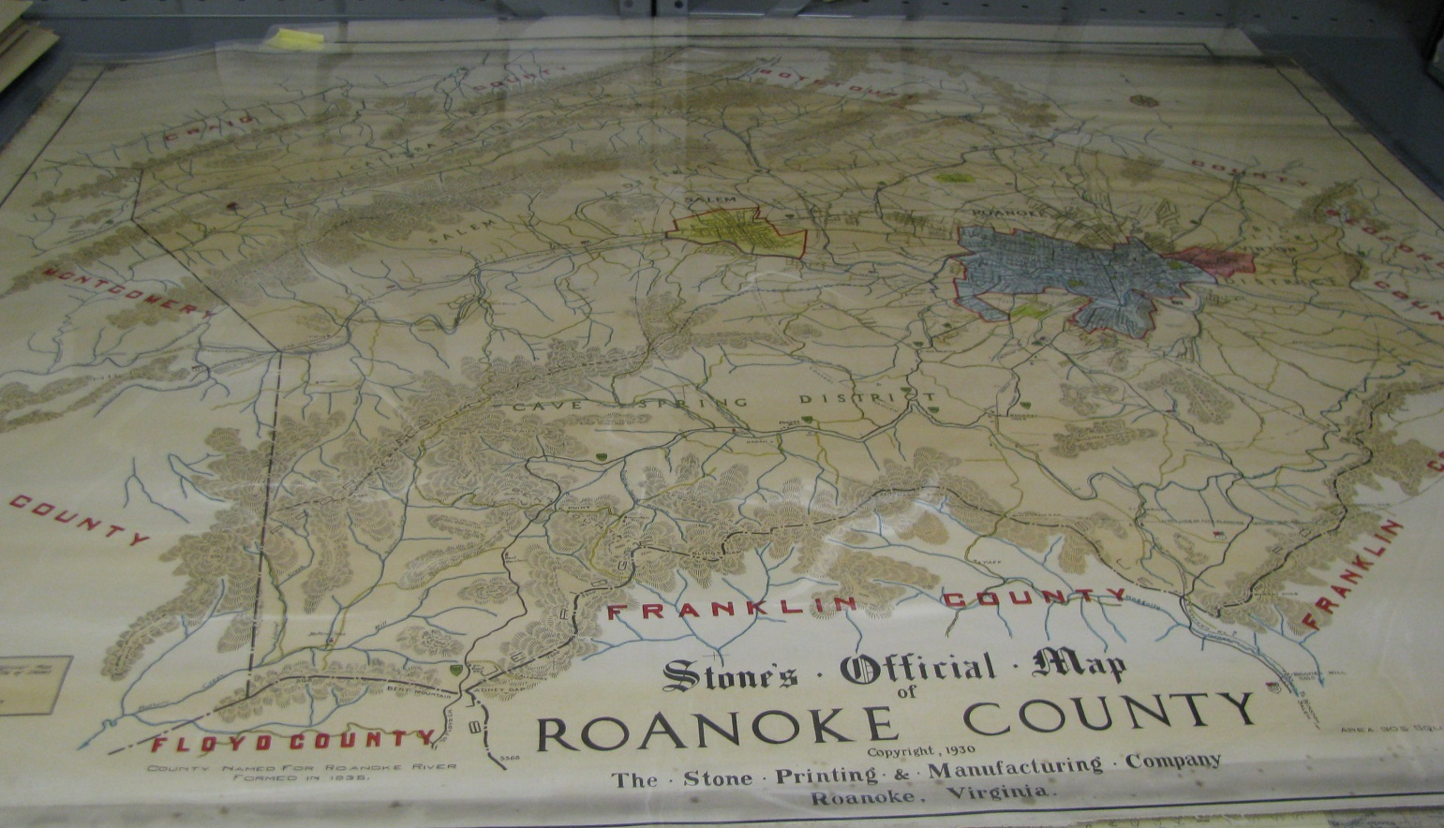
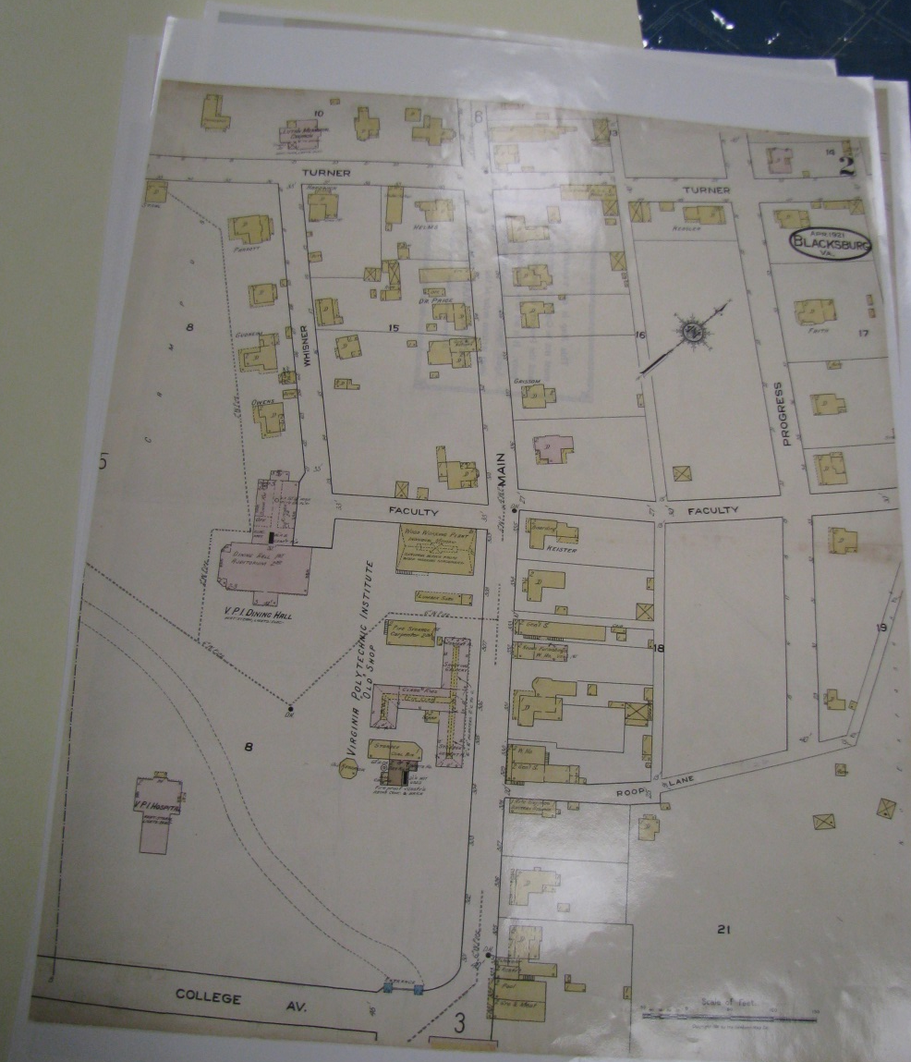

Slide 12
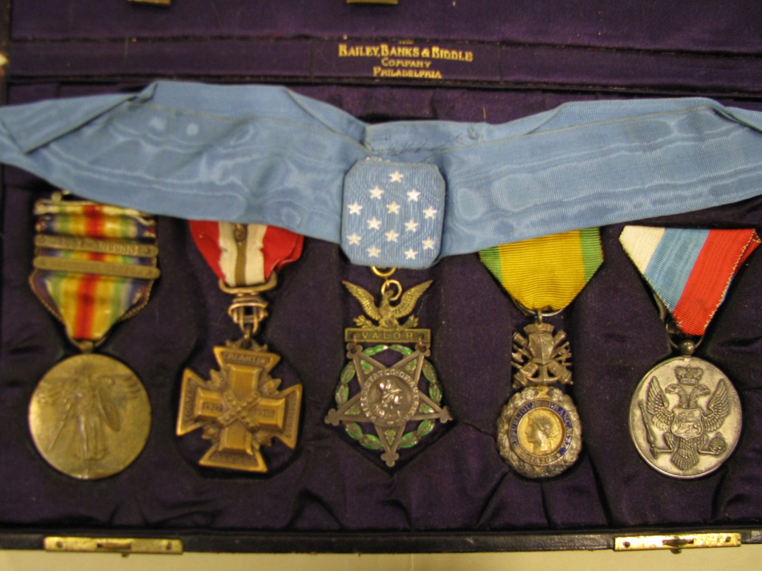
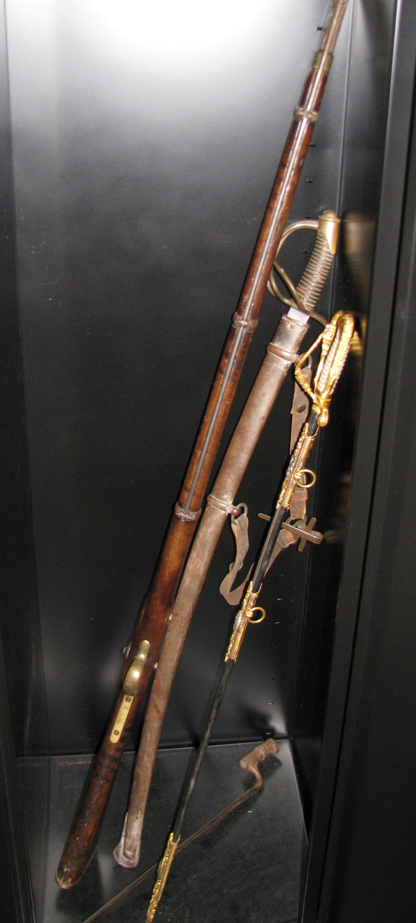
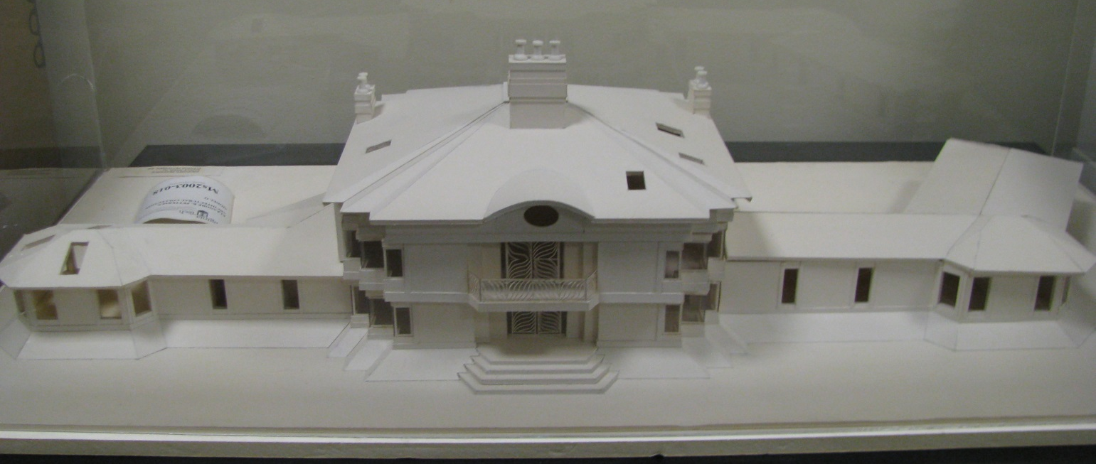

Slide 13
Why Should You (or Your Patrons) Care?
Who are our patrons in academic archives?
  Students (K-12, undergraduate, and graduate)
  University faculty/staff
  Alumni
  Researchers/scholars of all ages & skill levels
  The public
Why do they contact or visit us?
  Research
  Curiosity
  Donations
  Serendipity

Slide 14
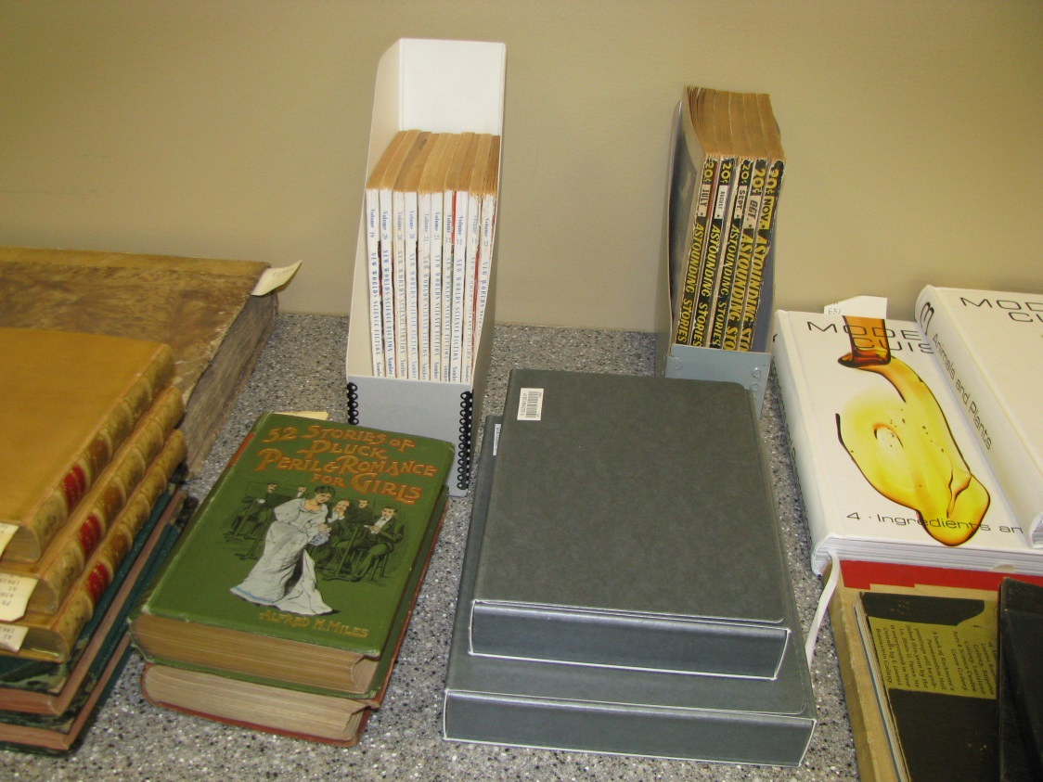
“Typical” Services
Reference
Instruction
Reproduction/digitization
Outreach/tours

Slide 15
Discovering Resources
Tools for discovery
  Finding aids
  Catalog records
  Discovery systems
  Subject/resource guides
  Asking your friendly special collections librarian or archivist (trust me, we LOVE to talk about our collections!)

Slide 16
Discovering Resources
Example Institution or State Discovery Tools
  Virginia Heritage (state-wide finding aid consortium with 36 members)
  Virginia Tech Special Collections LibGuide
  Virginia Historical Society Catalog
Example National or Global Discovery Tools
  ArchiveGrid (OCLC discovery tool for finding aids and catalog records of manuscript materials)
  WorldCat
  Social Networks and Archival Context (SNAC) (Note: this is an in-development project that is laying the groundwork for a sustainable international cooperative program for archival description.)

Slide 17
Hey, it’s not ALL analog!
A FEW sample digital collections (and there are a LOT more!)
  Special Collections Online (Virginia Tech)
  Virginia Memory (LVA)
  DigitalNC
  Los Angeles Public Library Menu Collection
  Digital Public Library of America (DPLA)
  National Archives and Records Administration’s
  Access to Archival Databases (AAD)

Slide 18
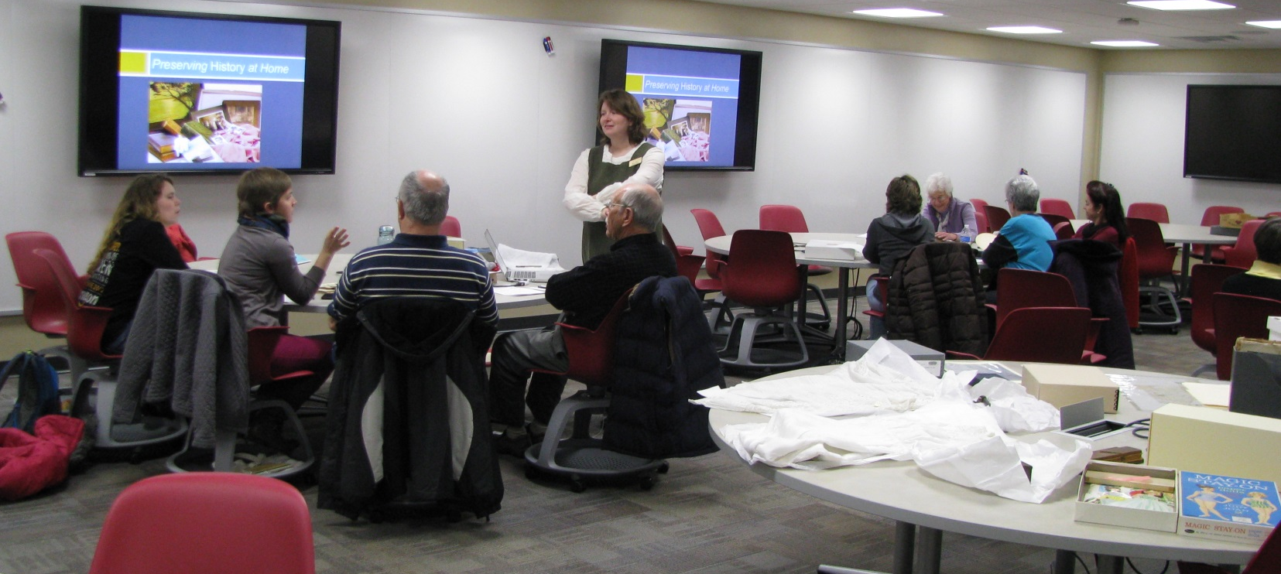
Why Collaborate?
Partnerships, whether project-based, education-based, or otherwise, can help libraries, staff, and patrons learn more about available resources and community needs
Plus, archivists and special collections librarians aren’t just those weird people hanging out in the basement—we’re actually pretty fun!

Slide 19
So, You Wanna to Partner Up?
How do you find partners?
  Ask your colleagues! (If they don’t want to work with you, maybe they know someone who does)
  Get out there, literally and virtually! (on campus, in the community, in your organization)
  Establish relationships when you can. Even if you don’t have something in mind, take opportunities to cultivate relationships with community groups, campus groups, instructors…Keep people in mind for down the road.
  Serendipity! (if you’re lucky, some people might find you)

Slide 20
We’ve Got Partners,
Now What?
What can we do together?
  Instruction
  Displays/exhibits
  Digital displays
  Open houses
  Community events

Slide 21
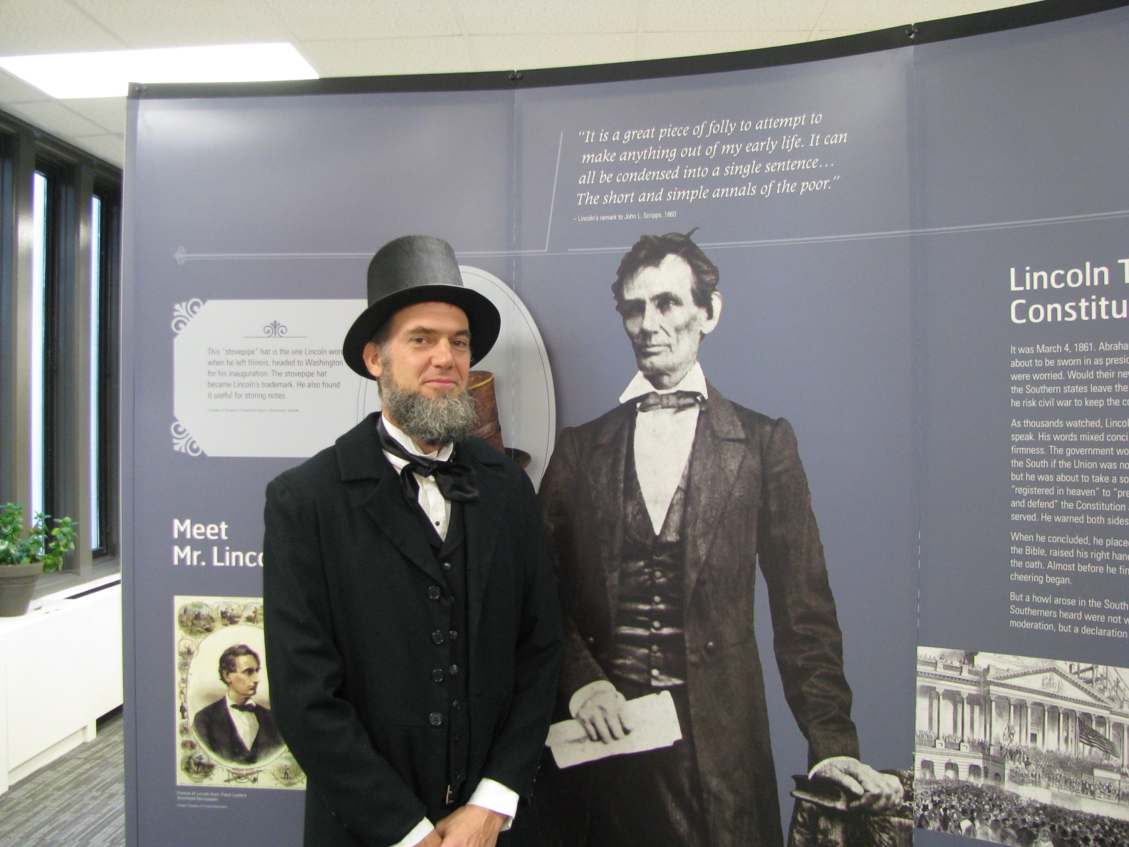
Traveling NEH Lincoln Exhibit in Newman Library, Fall 2013

Slide 22
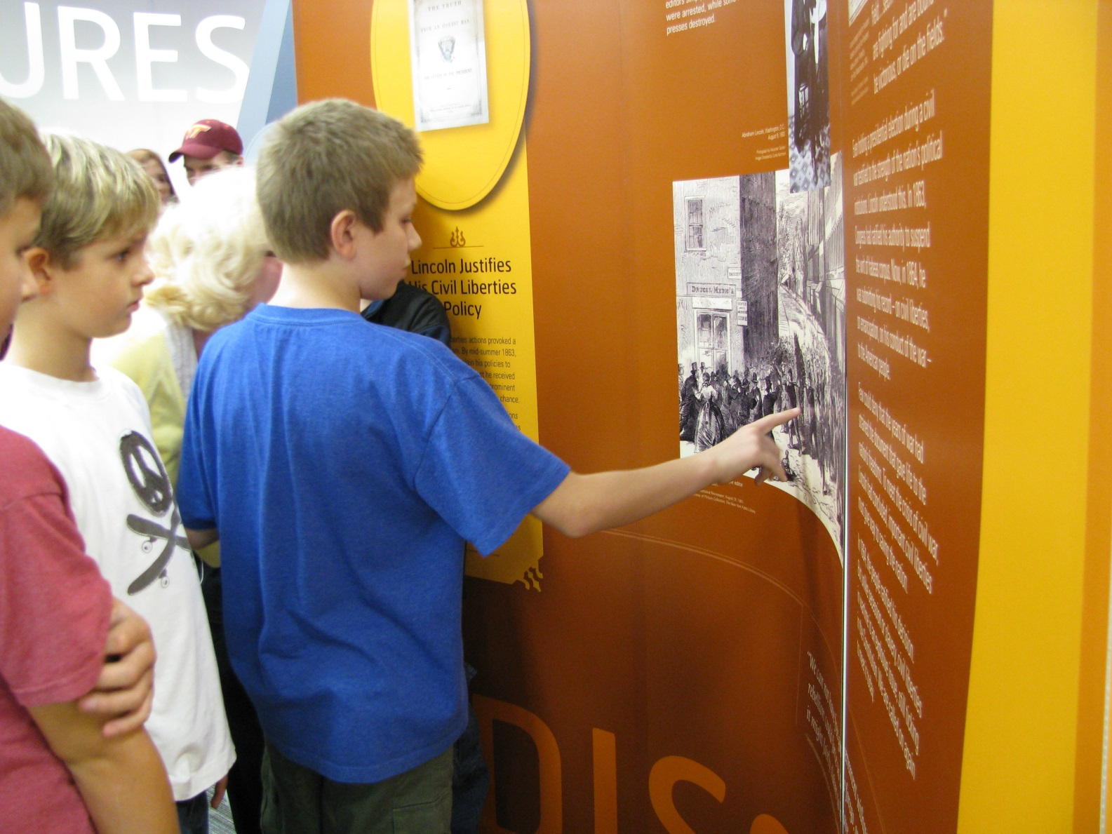
Traveling NEH Lincoln Exhibit in Newman Library, Fall 2013

Slide 23
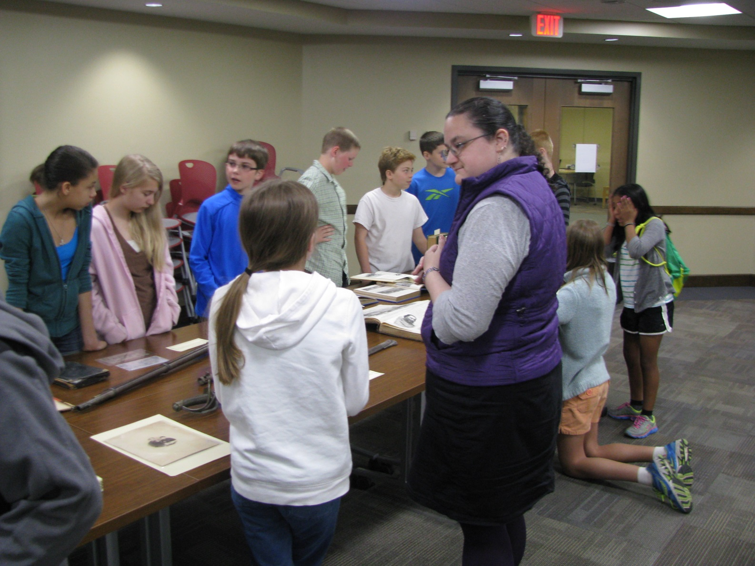
Blacksburg Middle School students visiting Special Collections to go “hand-on” with Civil War history, 2014

Slide 24
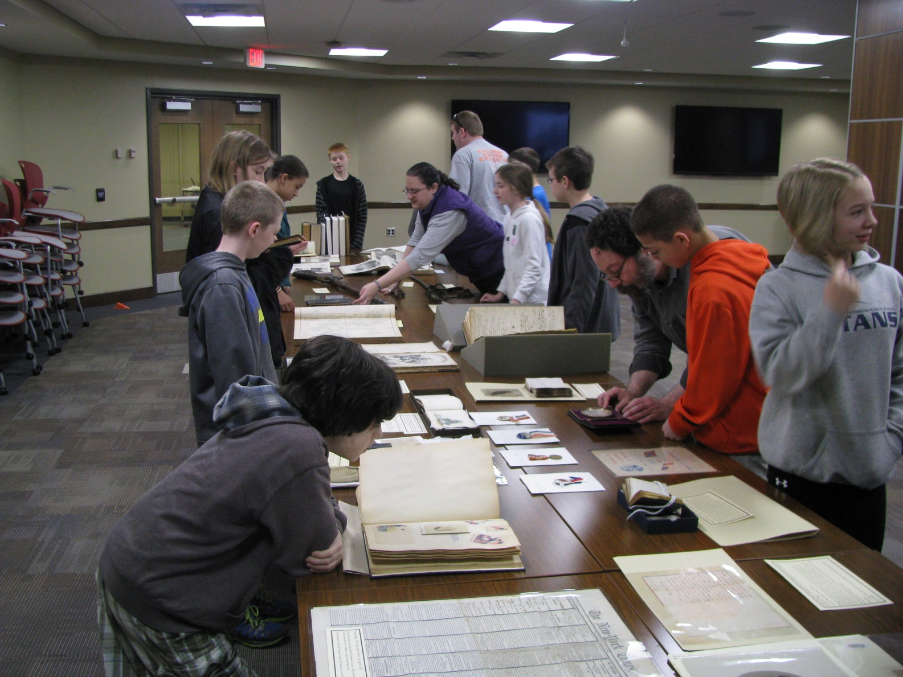
Blacksburg Middle School students visiting Special Collections to go “hand-on” with Civil War history, 2014

Slide 25
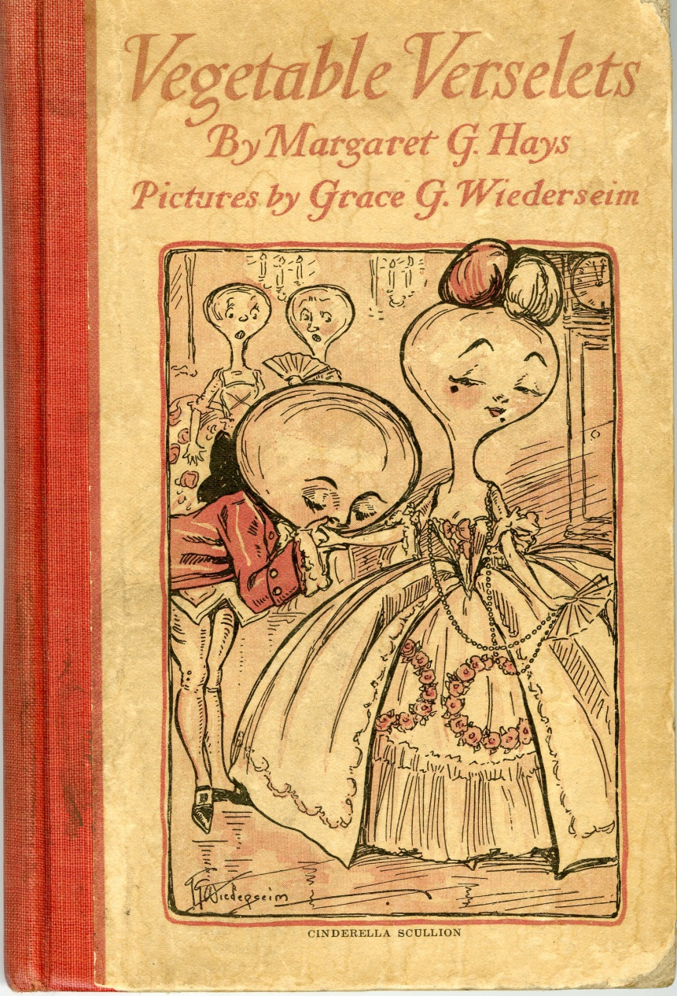
Vegetable Verselets:
A Song Cycle
Vegetable Verselets for Humorous Vegetarians by Margaret G. Hays; with illustrations by Grace G. Wiederseim.
Philadelphia; London: J. B. Lippincott, 1911.
(Yes, it out of copyright and available in its entirety online!)

Slide 26
How a Song Cycle is Born
Serendipity
+ An archivist and a pianist
+ A composer and a soprano
+ A bunch of people with a great sense of humor
= “Vegetable Verselets” (A Song Cycle)

Slide 27
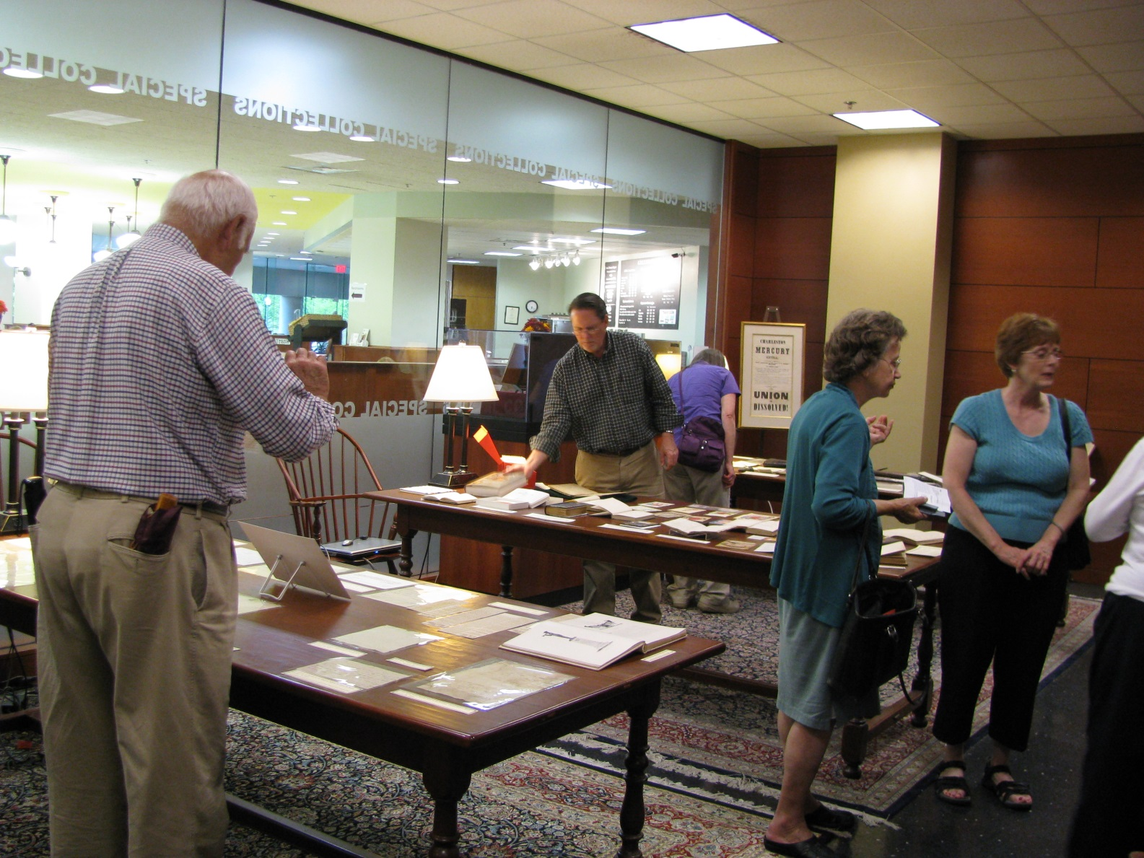
Visitors to the Special Collections reading room during the Vegetable Verselets reception, 2012

Slide 28
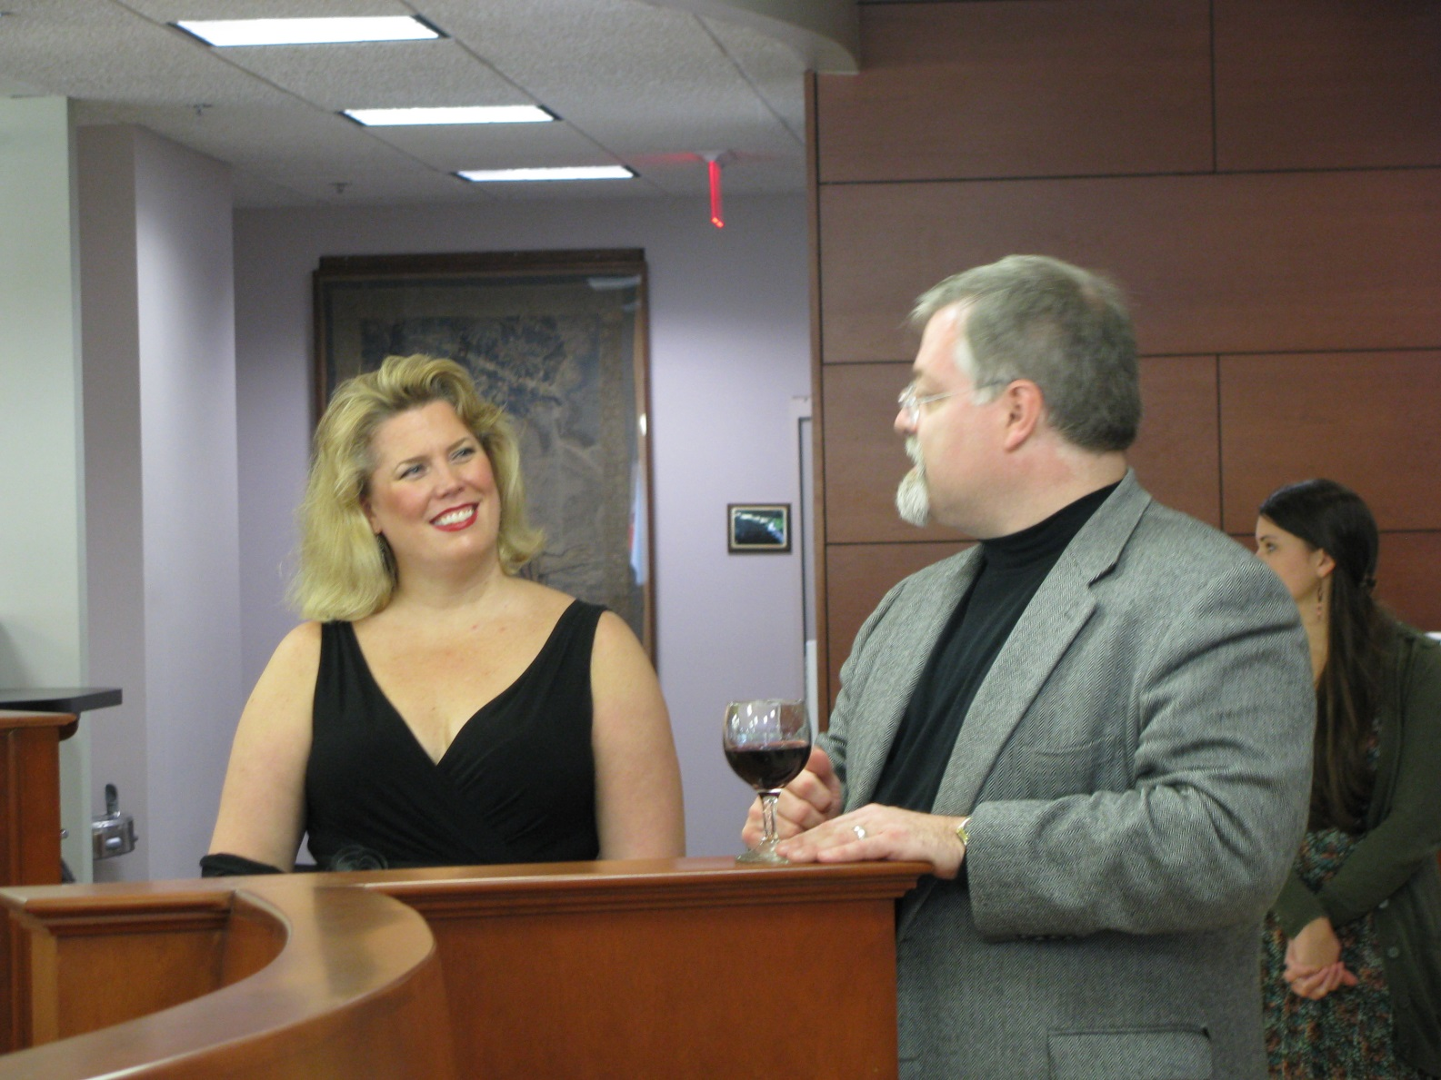
Soprano Caroline Worra and composer Daren Hagen at the Vegetable Verselets reception, 2012

Slide 29
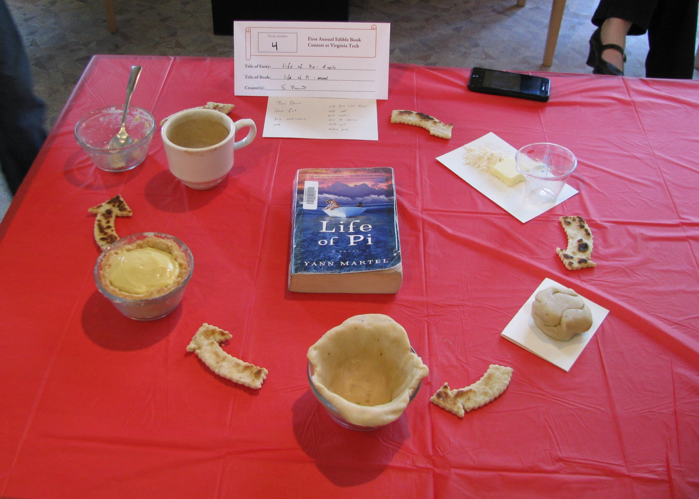
2013 Contest Website: http://tinyurl.com/aebc2013

Slide 30
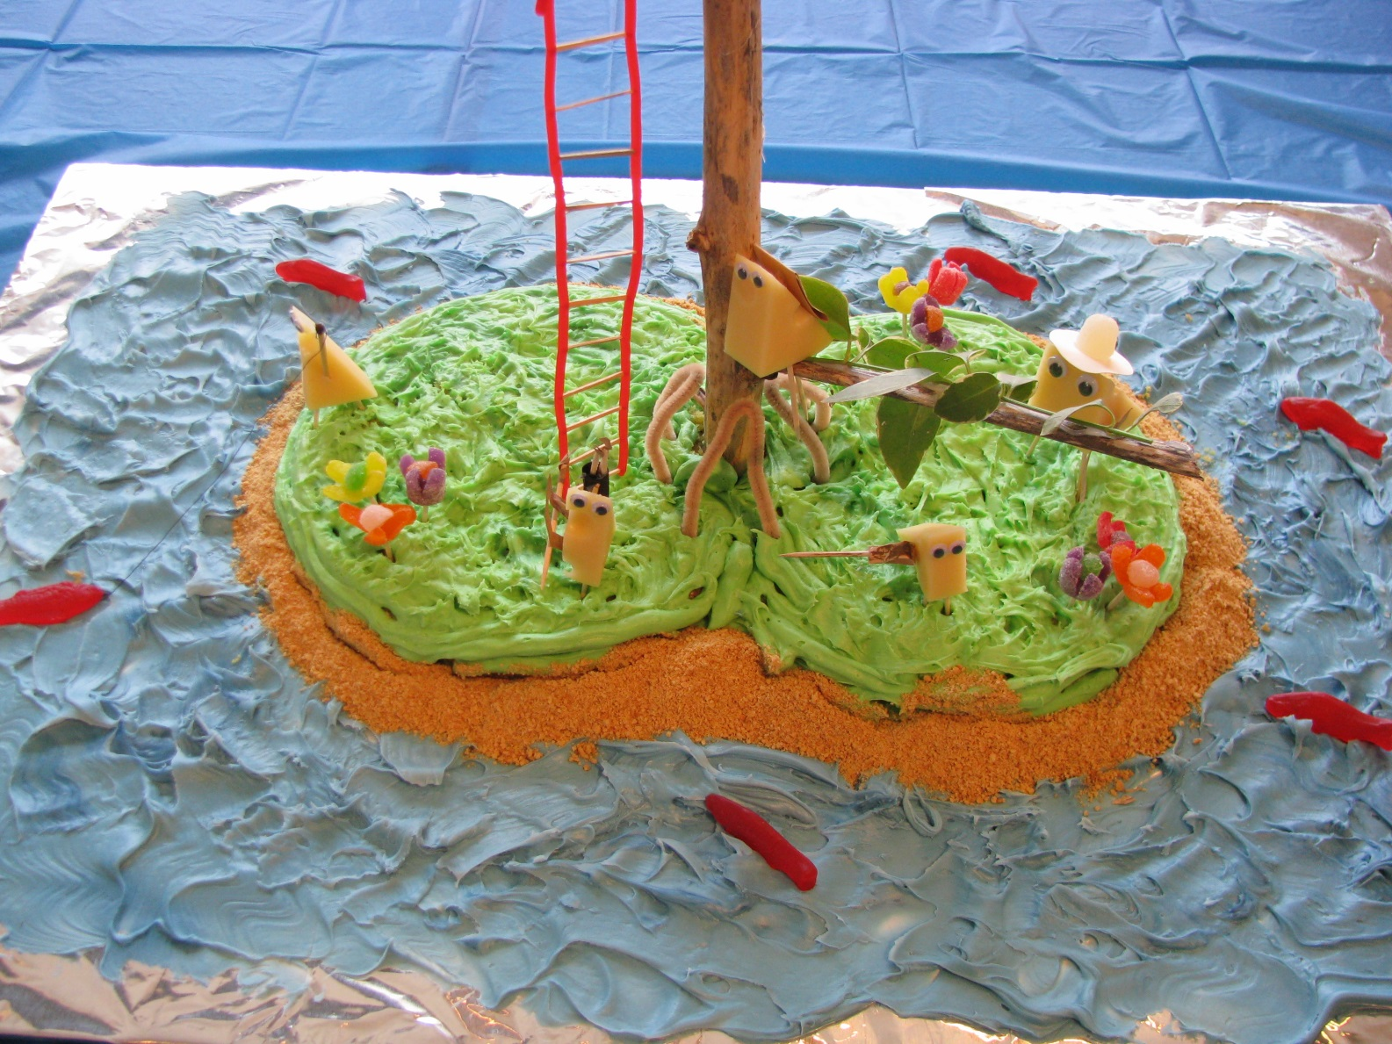
2013 Contest Website: http://tinyurl.com/aebc2013

Slide 31
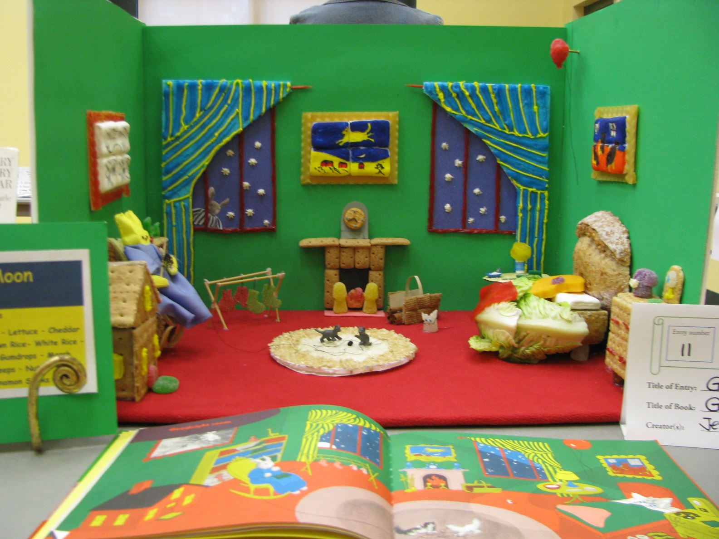
2014 Contest Website: http://tinyurl.com/aebc2014

Slide 32
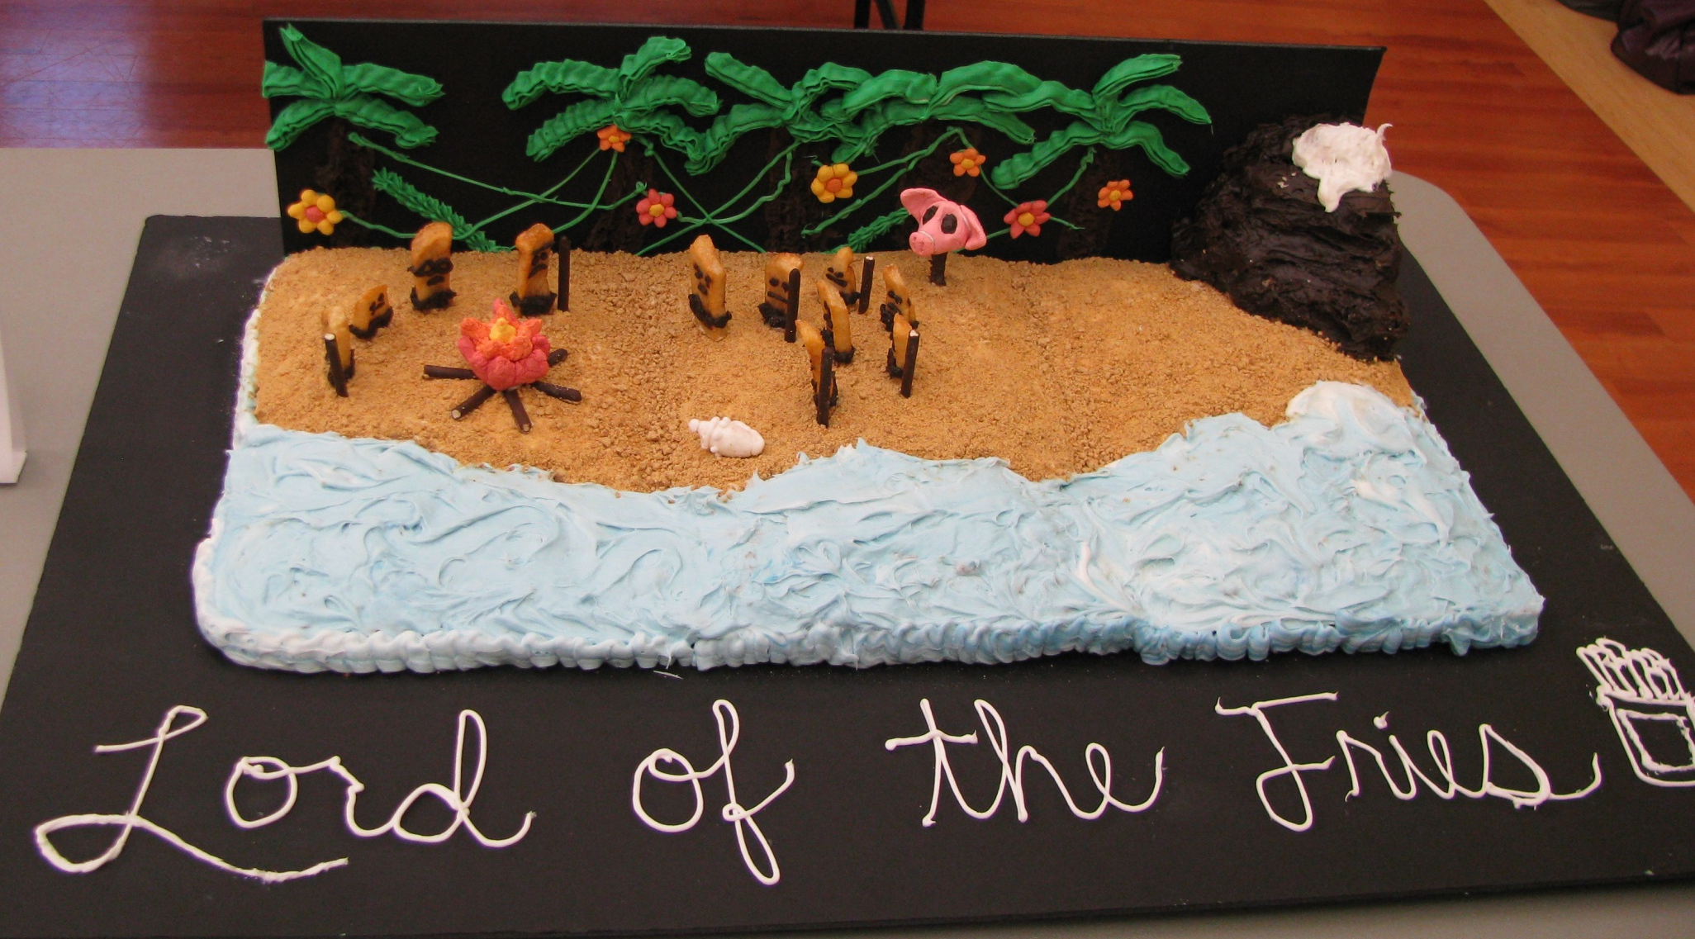
2014 Contest Website: http://tinyurl.com/aebc2014

Slide 33
Got Any Advice for New Collaborators?
  Educate your partners about what you bring to the table!
Brainstorm ideas!
  Know your limitations (time, people, money, space, etc.)…
  But think big (or at least, think BOLD)!
  Plan, plan, plan (in order words, be organized)…
  But be ready to adapt!
  Have a sense of humor! (I CANNOT stress this one enough!)

Slide 34
In Conclusion…
Questions? Comments?
Ideas for the group?
Link to the presentation & resource guide: https://goo.gl/l5ChpK

Slide 35
Contacting Me!
Kira A. Dietz
Acquisitions and Processing Archivist
Special Collections, University Libraries
Virginia Tech
kadietz@vt.edu
@archivistkira
About.me/kiradietz
Slideshare.net/archivistkira

