Slide 1
It’s Time for a Redesign…
Now What??
By Adriana Puckett
Sr. Web Developer
Central Rappahannock Regional Library

Slide 2

LibraryPoint.org
Redesigned Dec. 2014
Took about 8 months overall, 4 months steady
Upgraded to Drupal 7
Responsive design
Sept. 2015 compared to Sept. 2014:
41% increase users
26% increase in sessions
23% decrease in bounce rate
57% increase in mobile sessions

Slide 3

Move from this….
“The Sphinx and the Great Pyramid of Giza” by Ian Robertson, http://tinyurl.com/pmn68g5, CC BY

Slide 4
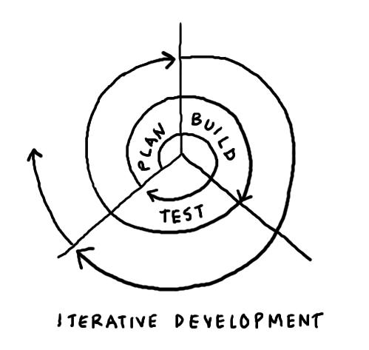
To this!
Image by Dave Gray, http://tinyurl.com/psrpn9w, CC BY

Slide 5
Think Iteratively
No more “BIG” redesigns IF....
….a solid design and framework is in place already (e.g. a content management system with design, content, and code separated).
…and your website is responsive, working on all devices.
Why? Less jarring to users, better change experience overall.
See Jakob Nielsen and Aaron Schmidt for more on iterative redesign.
“Before you throw out the old and bring in the new, make sure you have solid evidence that doing so is necessary to achieve user-centered goals….Customers are extremely task-oriented and care much more about a usable website than a pretty one.”
-Hoa Loranger
“Radical Redesign or Incremental Change”
http://www.nngroup.com/articles/radical-incremental-redesign/

Slide 6
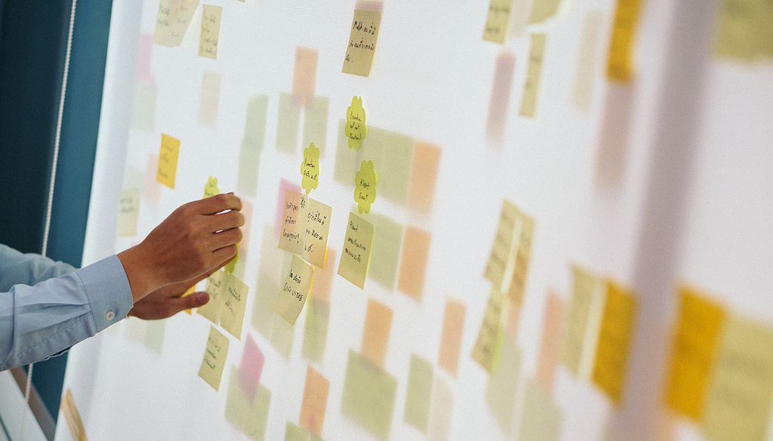
Prioritize Your Changes
“Prioritize User Story” by Hatoriz Kwansiripat, http://tinyurl.com/nzavh6w, CC BY

Slide 7
Improving the process
Maybe: Consider pros and cons of gathering feedback from general staff going into the redesign.
Definitely: Include key decision-makers early on. No surprises!
Create lo-fi wireframes on paper, digital sketches, or software like Balsamiq.
Use a test server to build out changes, demo, and get feedback.

Slide 8

Ready to Launch?
“Launch” by Don McCullough, http://tinyurl.com/p9a7o2s, CC BY

Slide 9
Consider…
Decide on your MVP – Minimally Viable Product. What can’t you live without?
Form a Beta Testing team of people from different departments and skill sets. Create a task list and ask for feedback.
Address necessary changes and then soft launch.
Assess feedback from staff and public and fix high-priority issues.
Publicize the launch with pride!
Conduct usability testing and watch analytics.

Slide 10

Back to the Beginning!
Dirk Jan-Traan, http://tinyurl.com/ptwcx7x, CC BY

