Slide 1
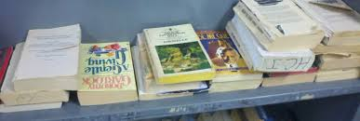
Jail Library Projects: A Public Library Partnership Opportunity
Elizabeth J. Gregg
Virginia Library Association Annual Conference, 2015
October 23, 2015

Slide 2
Objectives
Examine Fontana Regional Library’s partnership services to jailed populations at Jackson and Macon County Detention Centers
Look at examples of other service models: Loudoun County Public Library, D.C. Public Library
Examine challenges, best practices, and lessons learned

Slide 3


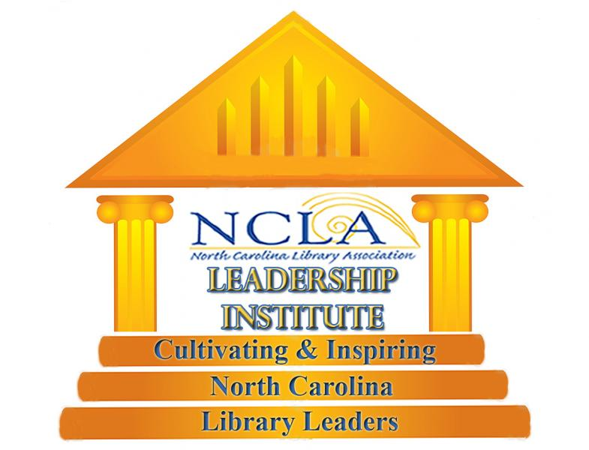


A Thank you before we begin
North Carolina Library Association & the NCLA Leadership Institute
Fontana Regional Library System
Western Carolina University
Loudoun County Public Library
Virginia Library Association
Danielle Zoller, DCPL Librarian

Slide 4
Background
Based on research done by Jill Ellern and Karen Mason of Western Carolina University, “Library Services to Inmates in the Rural County Jails in Western North Carolina” North Carolina Libraries v 71, no. 1, 2013
Ellern approached FRL to see if there was potential for collaborating on service to the jails in the three counties that FRL serves (Jackson, Macon, & Swain).
In early 2013 we began managing the existing collections and placing new print materials in the Jackson County Detention Center and the Macon County Detention Center.

Slide 5
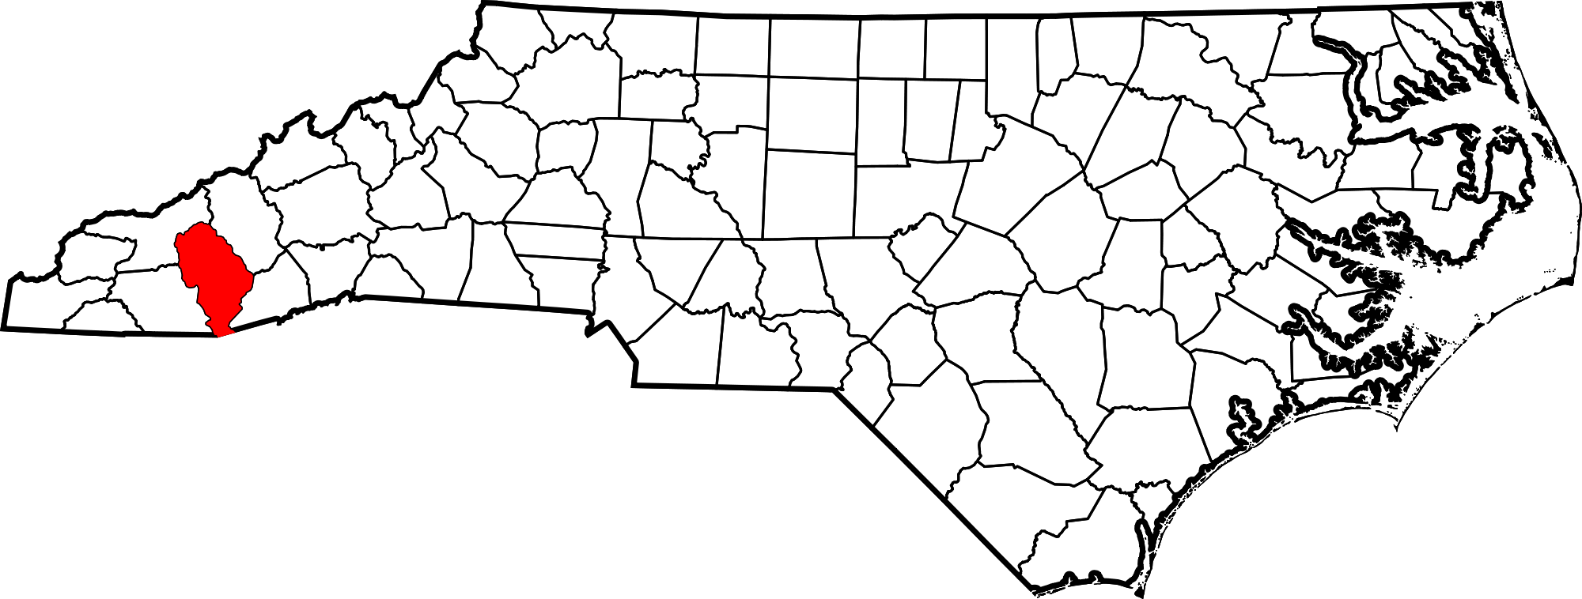
Where?
Jackson County

Slide 6
A Tale of Two Jails
Macon County: 75 inmates, all male
Admin: Jail Administrator
Philosophical
  Stewardship--“Happy inmates make better inmates”
Library services
  All jailors together
Jackson County: 72 inmates, male and female
Admin: Sherriff Dept.
Philosophical
  Safety and Security
Library services
  P/T nurse

Slide 7
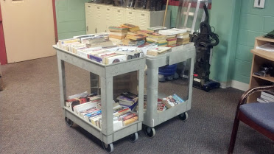
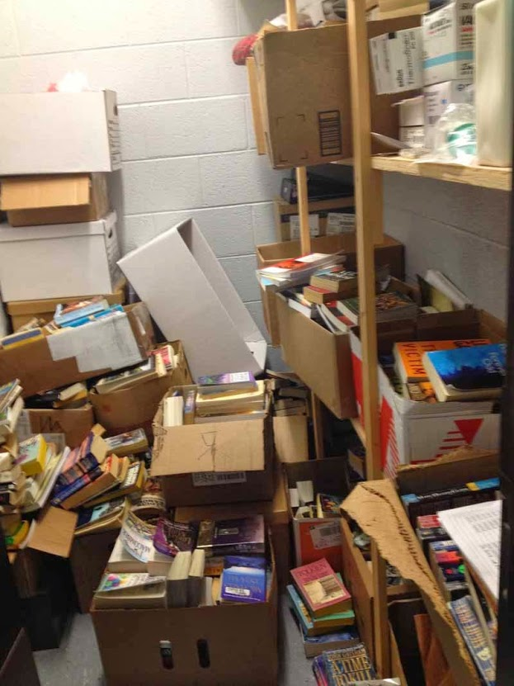
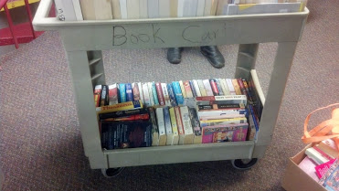
Initial state of the book collections
Macon County Detention Center
Jackson County Detention Center

Slide 8
Collection Development and Procedures
Macon: inmates could browse book carts and select materials as they liked.
Pod-style living quarters had communal bookshelves for sharing of materials
Bi-weekly distribution of books by correctional officers
Jackson: Inmates browsed a printed list of titles available and chose three
Selected books were hand delivered to inmates
Huge volume of materials but no organization
Access to materials relied on the availability of the part time nurse

Slide 9
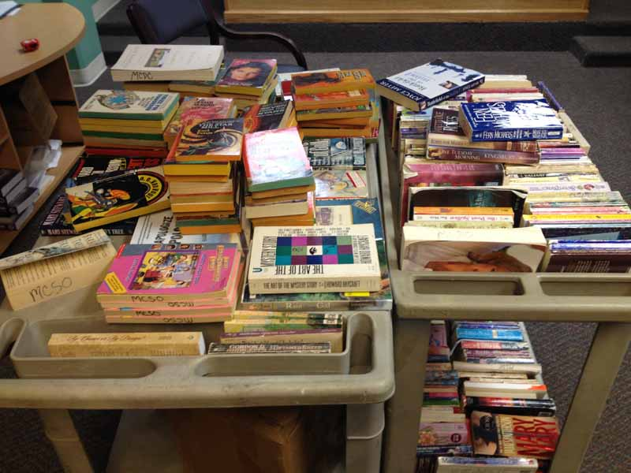
Initial Collection Contents
Nearly all material obtained by donation: , friends/family of inmates or DC staff
Majority paperback fiction titles
Older, less popular authors as well as duplicates of popular works
Very little non-fiction, mostly Religious self help
Romance, Western, YA

Slide 10
Locational Strategies
Macon County Detention Center:
update existing book collection: expand scope of genres and modernize with popular titles
Add newspaper subscription for local paper
Increase non-fiction materials
Jackson County Detention Center:
Review collection and pull damaged/duplicate materials
Increase non-fiction materials
Assist in organization of collection (physical space and catalog)

Slide 11
Managing Collections in LibraryThing
Decrease duplication in collections
Increased access to Jackson County DC Collection via printed materials list
Assist in long term maintenance and evaluation of projects
Creation of wish list titles for donors, FOL Groups
WNC Jails Profile Page
JDC Collection
MDC Collection

Slide 12
Challenges
Macon:
Provide consistent book donations on a scheduled basis
Increase community awareness and buy-in from stakeholders
Jackson:
Increase buy-in for project from jail supervisors
Create long term sustainability in the midst of organizational changes
Overall:
Burden is on detention center to facilitate day to day management of books
No way to evaluate user satisfaction of materials
Long term collection management is difficult

Slide 13
Engaging the Community
Local newspapers covered the project increasing awareness and prompting support of our efforts
Maintain blog to track project
State Library blogged about the project
2014 North Carolina Public Library Directors Association (NCPLDA) Service Innovation Project Award
WCU criminal justice class created short film for the 125th anniversary of WCU about the Jail Library Project
FOL organizations and local church groups provided substantial amounts of book donations
Jackson County Library donated old NC Statute books to the Haywood County Detention Center (JCDC did not have room)

Slide 14
2015 Status Update
Macon County
Delivery of 2 dozen books a month
No longer cataloging items in LibraryThing
Jailors discarding materials no longer readable
Added magazines to collection (staples removed)
Additional Library staff to work on project
Grant applications ready to provide graduate assistant for advocacy and research, and funds for core non-fiction collections by Jill Ellern, WCU Librarian
Current Jackson Country DC partnership is on hold

Slide 15
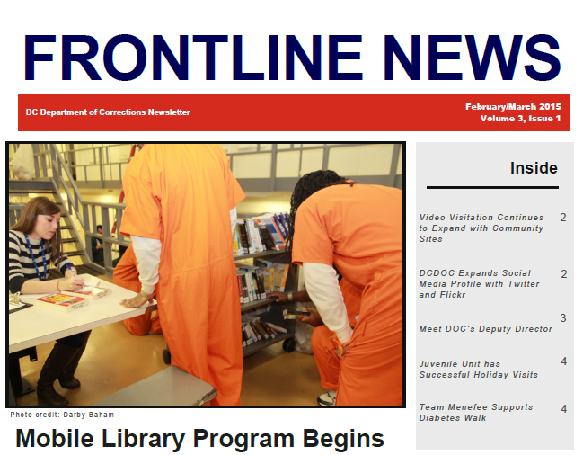
D.C. Public Library: An Onsite Service Model
Jews United for Justice began a campaign in 2013 to bring library services to the jail
Contacted libraries across the country to investigate options for services to inmates
Buy-in from City Council members

Slide 16
Collection Development and Procedures
Full Time staff member on-site as beginning 2/27/2015
Collection Development Policy created in concert with DOC
  Paperbacks
  Books only
  No glorification of drugs, sex
Mobile Library of 200 titles for general population to browse
Segregated individuals can complete a request form with genre listings
Librarian works with individuals in traditional reader’s advisory capacity to determine needs and interests

Slide 17

“We do business very differently than the jail does. We're all about openness and democracy, and everything goes. And the jail is about limits and rules and laws and regulations,” says DCPL Executive Director Richard Reyes-Gavilan. “But we had a similar goal, so I think in some ways we both adapted to the culture of the other to get this up and running.”
March 2015 Story on WAMU

Slide 18
Summer Reading Program 2015
First Summer Reading Program in 2015
Mirrored after DCPL’s general program
Worksheet tracks books for points
Prizes—
  2 points—thesaurus
  4 points—Certificate of Completion (a valuable document for court)
99 registered
21 completed the program
Book discussion and Visit from Rueben Castaneta, author of S Street Rising

Slide 19
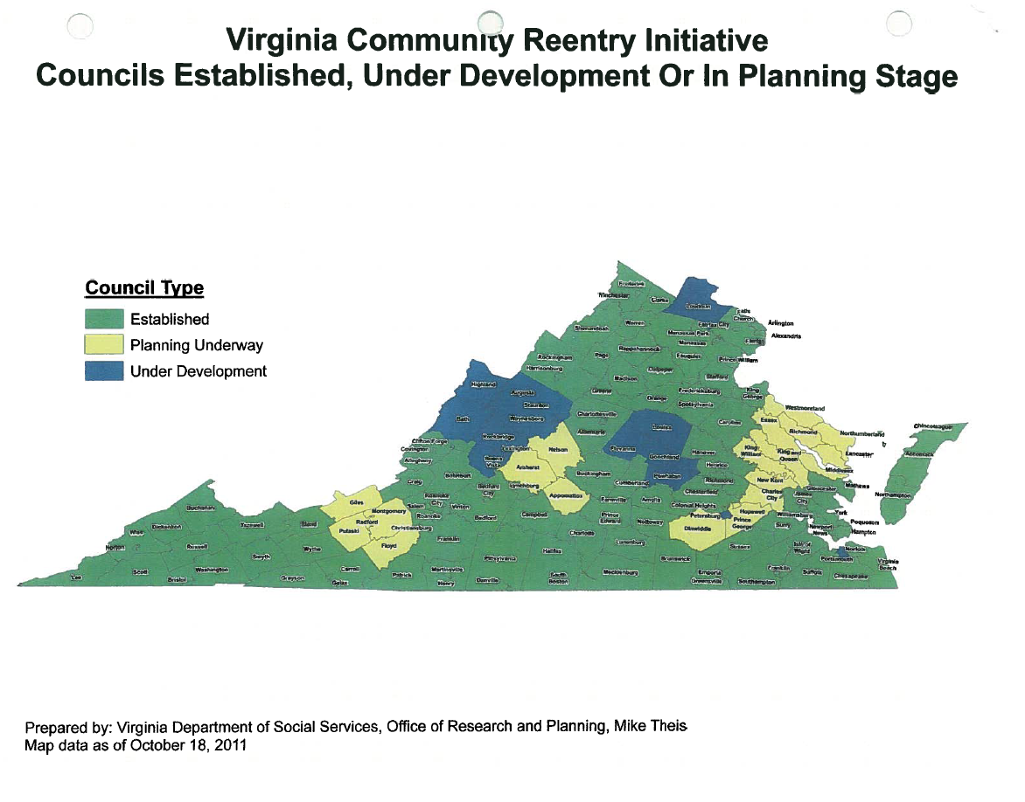
Loudoun County Public Library
Outreach Services Librarian Virginia LaRocque
Member of Loudoun Reentry Advisory Council: a coalition of agencies that share information about reentry services

Slide 20
LCPL Outreach Services cont’d…
Bi-monthly loans (from LCPL collection) to the Loudoun County Juvenile Detention Center
Selection of materials is done by Outreach/Teen Services staff OR by teachers at the JDC
Existing library on-site at JDC
Deliver 2-4 boxes of paperback books and magazines to the Loudoun Adult Detention Center
Materials selected by outreach services staff and boxes are sealed & marked to ensure suitability
LCPL Programming Department has provided programs for Juveniles and Adults

Slide 21
3 Service Models:
Fontana Regional Library
Materials selected from donations
Library staff deliver to DCs
DC staff facilitate delivery of items
No programming
Loudoun County Public Library
Materials selected from donations
Materials in library collection are loaned to the JDC
Staff actively participate in organizations to support re-entry, assist individuals as needed
provide programming for DCs

Slide 22
Service Models cont’d..
D.C. Public Library
Buy in from community stakeholders to support initiative
Formal partnership with Department of Corrections
On-site staff member
DCPL purchases new items for the collection
Programming such as SRP and author visits in conjunction with DCPL Programming at large
Funding
Fully invested in re-entry assistance and other programs

Slide 23
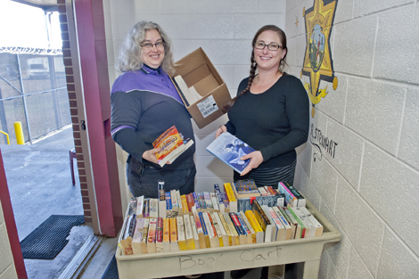
Why do this at your library?
Inmates are part of our community
Service is in line with mission/vision statements
Encourage reading and use of the library upon release
Increased awareness of library programs and services
Because they need it!

Slide 24
Tips for Success
Meet with Jail Administrators: listen to the needs they have
Tie project into your organizations mission & vision statements
Get community buy in—find stakeholders who support the work
Focus on the books/materials/services, not the incarcerated
Be prepared to get a “no” answer, but don’t let that stop you from asking again
Be realistic about resources and staff time available

Slide 25
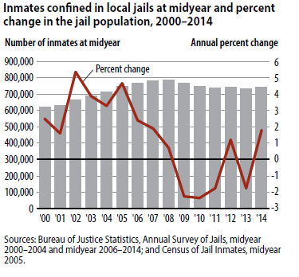
U.S. Jail Statistics
2014 report shows an average of 744,600 individuals in jail
6 out of 10 are not convicted but waiting on court action on current charges
4 out of 10 are sentenced/convicted offenders
Since 2000, 95% of the growth in inmate populations was due to the increase in unconvicted individuals

Slide 26
Other Jail/Prison Public Library Partnerships
New York Public Library’s Correctional Services Program
Hennepin County Library’s Freedom Ticket Program
Denver Public Library Programs & Resources for x-offenders

Slide 27
Questions?

Slide 28
Caledonia Prison Farm, 1953
Part of the Charles S. Killebrew Photo Collection

