Slide 1
Hands-On: Preschool Science
Kathi DuBois and Matthew Haddox

Slide 2
Introduction

Slide 3
How It All Began…

Slide 4


Slide 5
Keeping It Simple

Slide 6
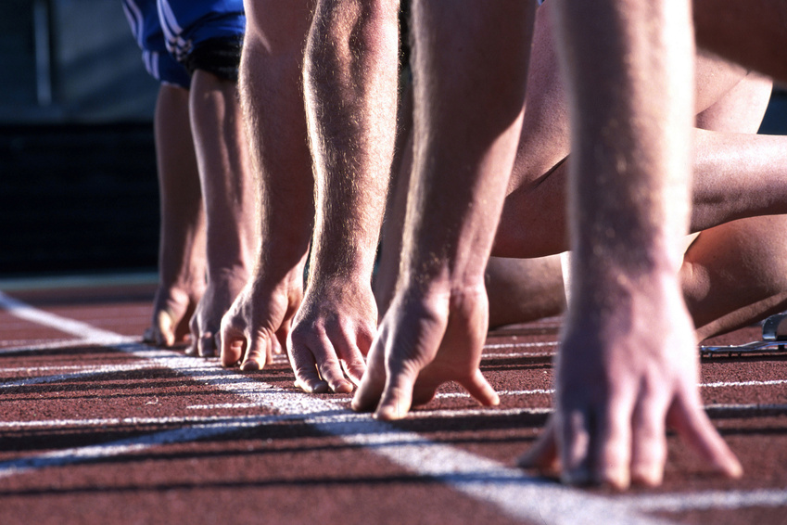

Slide 7
Choosing Topics

Slide 8
Finding Activities

Slide 9


Slide 10
How To Implement Your Ideas
Implementing Your Ideas

Slide 11


Slide 12

and Supplies

Slide 13
How To Implement Your Ideas
Typical Preschool Science Program

Slide 14
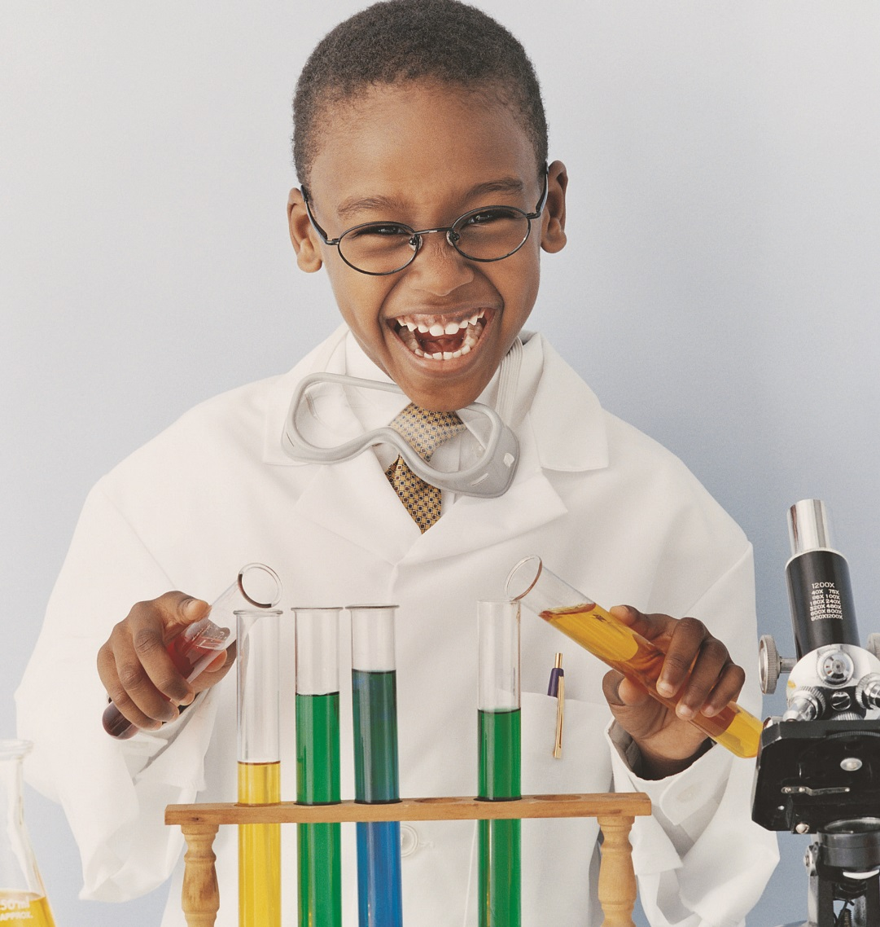


Preschool Science
Notes:
Introduce STEAM @ VBPL and Preschool Science learning objectives and classroom expectations
Keep title slide as is

Slide 15
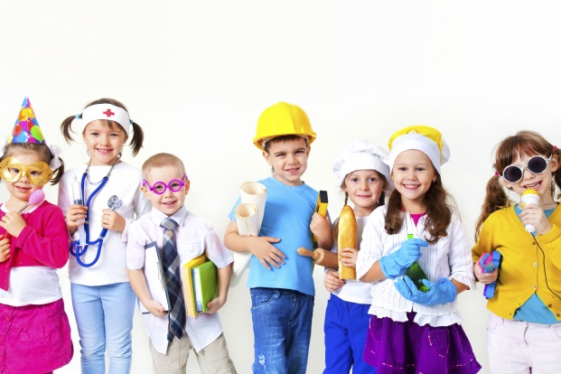
Hello Song
Hello everybody, and how are you?
How are you? How are you?
Hello everybody, and how are you?
How are you today?
Come on everybody, let’s clap our hands.
Come on everybody, let’s stomp our feet.
Come on everybody, let’s reach up high.
Notes:
Use any Hello Song

Slide 16
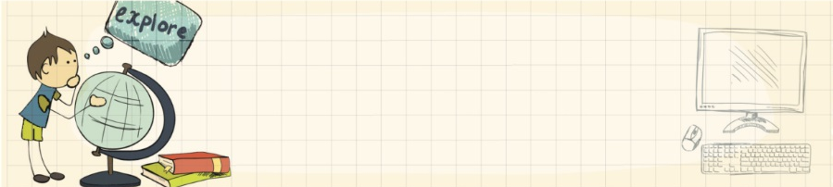
Welcome!
Preschool Science is a program designed to be an exploration of a particular topic along with your child.
Please be sure to dress to experiment.
Notes:
Include this slide for the first class only!

Slide 17
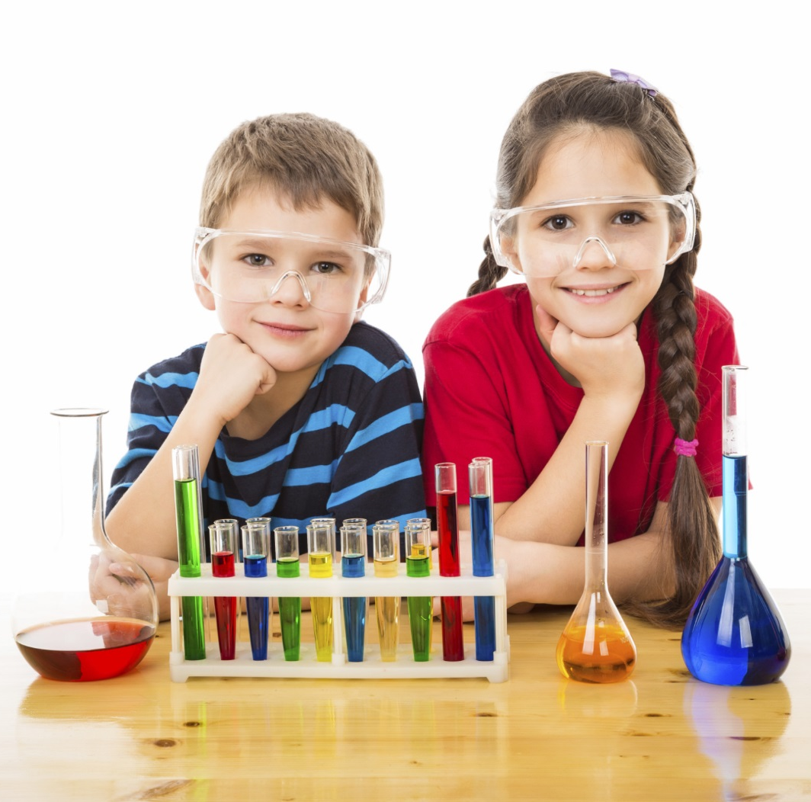
What do scientists do?
Scientists ask questions.
Scientists are explorers.
Scientists experiment.
Scientists are problem solvers.
You are a Scientist!
Notes:
These are the steps scientists use to make discoveries:
1) Observe and ask a question. We watch and ask a question.
2) Form a hypothesis. We answer the question with what we think.
3) Test the hypothesis through experimentation. If the experiment fails, try something new.
4) Analyze the experiment and draw a conclusion.
5) Communicate the results.

Slide 18

Scientists explore by using their senses…
Singing the Senses
(Sung to the tune of "Bingo")
We use five senses every day
To help us learn and play.
See, hear, smell, touch, taste
See, hear, smell, touch, taste
See, hear, smell, touch, taste
We use these every day!
Notes:
Alternative Songs:
Tune: The Farmer in the Dell
I use my eyes to see, I use my eyes to see, and when I want to see a star (or ask for examples from the kids), I use my eyes to see.
I use my nose to smell, I use my nose to smell, And when I want to smell a flower, I use my nose to smell.
I use my tongue to taste, I use my tongue to taste, And when I want to taste a peach, I use my tongue to taste.
I use my ears to hear, I use my ears to hear, And when I want to hear a bird, I use my ears to hear.
I use my hands to touch, I use my hands to touch, And when I want to touch a cat, I use my hands to touch.
TUNE: Head, Shoulders, Knees, & Toes
I have five senses, this I know, this I know.
I have five senses, this I know, this I know.
Eyes, ears, skin, and tongue, and nose.
I have five senses, this I know, this I know.
My eyes can see, my ears can hear; this I know.
My tongue can taste, my nose can smell; this I know.
My skin can touch, so much, so much!
I have five senses, this I know, this I know.

Slide 19

We Are Learning About…
and the letter E
Building and Engineering
Notes:
Introduce STEAM concept or topic and the letter of the day. See examples below for ideas on how to incorporate letter knowledge:
Put mix of magnetic or felt letters on a board and find the Es
Write the letter E on the dry-erase boards or windows – use your “Magic Pencil” to draw the letter; adults can trace the letter on their children’s backs
Use sensory bins with items starting with the letter of the day
Incorporate the letter of the day into the topic. For example, if you are discussing butterflies, have the children try to make a letter B out of tiny butterflies.

Slide 20
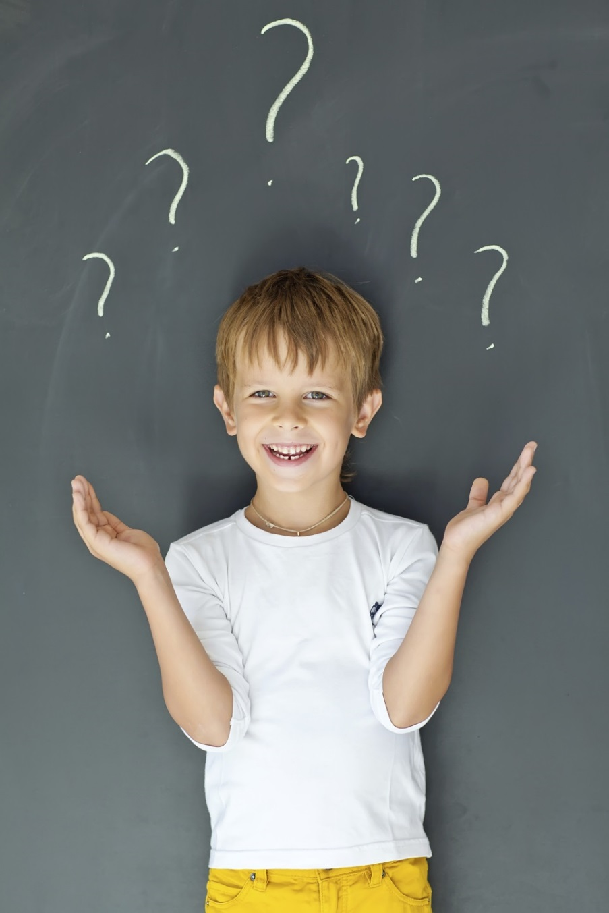
What do you know about building and engineering?
What do you want to know about building and engineering?
Notes:
Ask questions to ascertain the group’s background knowledge.

Slide 21
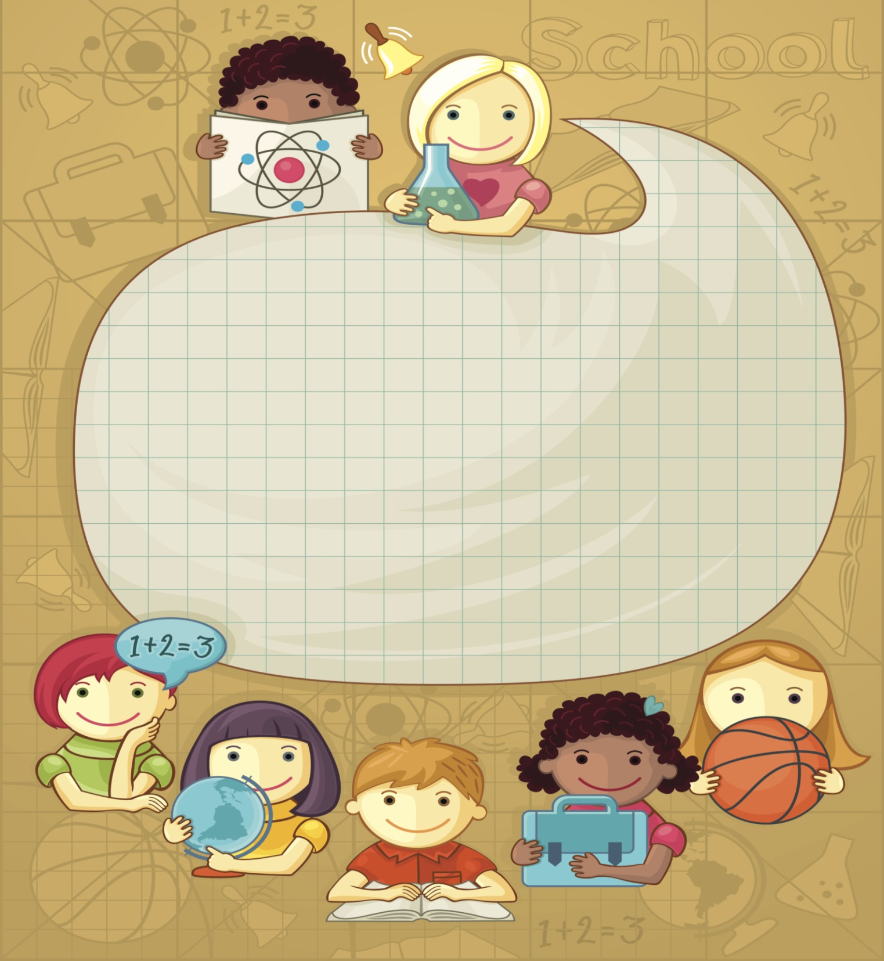
(insert callout)
Notes:
Literacy/Kindergarten Readiness Tip
This slide can be moved around to fit in a place in the storytime where you feel comfortable presenting the tip. It might be after the “We Are Learning About” slide if it is related to the letter of the day, or near the “What do you know..” slide if it is related to the group activity that you are doing after knowledge sharing.

Slide 22

Let’s read a story about building!
Notes:
Using a nonfiction book as your first read aloud will give you the opportunity to try and answer some of these questions.
If you don’t have the answer, look for more library resources after class or conduct an Internet search.

Slide 23

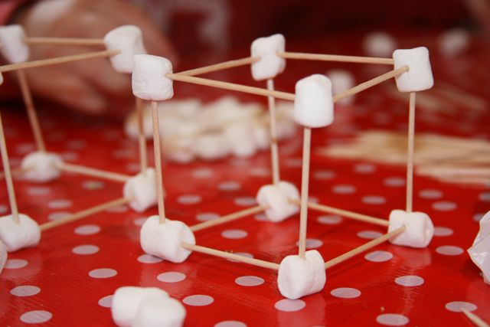
Notes:
Hands-on activity demonstrating STEAM concept/more discussion of concept—led by teacher
Use the additional slides for diagrams, fast facts, and/or pictures of objects related to today’s topic.

Slide 24

What did we learn today?
Notes:
Invite the children and parents back to group discussion about the activity. What did you learn? Remember to offer books for checkout!

Slide 25

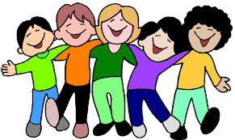
Goodbye Song
The more we get together
Together, together
The more we get together
The happier we’ll be
Because your friends are my friends
And my friends are your friends
The more we get together
The happier we’ll be!
Notes:
Use any Goodbye Song

Slide 26
How To Implement Your Ideas
Hands-On Demonstrations

Slide 27
How To Implement Your Ideas
Tell Us What Has Worked for You

Slide 28
Questions?

Slide 29
How To Implement Your Ideas
Kathi DuBois kedubois@vbgov.com
Matthew Haddox mhaddox@vbgov.com

