Slide 1

Get Inspired: A Reader’s Advisory Guide to Christian Fiction
Presented by:
Lonnie Elliott-Chesterfield County Public Library
Alexandra Hamby-Henrico County Public Library
Notes:
How many of you read Christian fiction? (show of hands) Lonnie: I’ve been reading Christian fiction for years. Before I became a public librarian that is mainly what I read. Alex: As I said a minute ago, I was not a reader of this until we began our work on this project. In fact, I was unclear on what Christian fiction is. Can anyone define it? (ask audience) The main factor is that the content of the novel must portray Christian values and/or a Christian worldview. This can be as blatant as the reader being reminded that we are living in a fallen world through character dialogue, or subtly woven into the story by general biblical teachings being referenced. Regardless, the Christian doctrine will be a building block in the story.

Slide 2
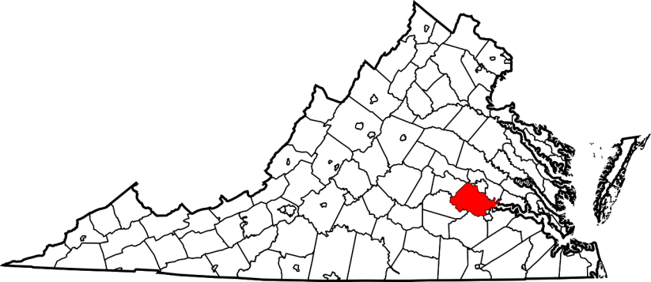
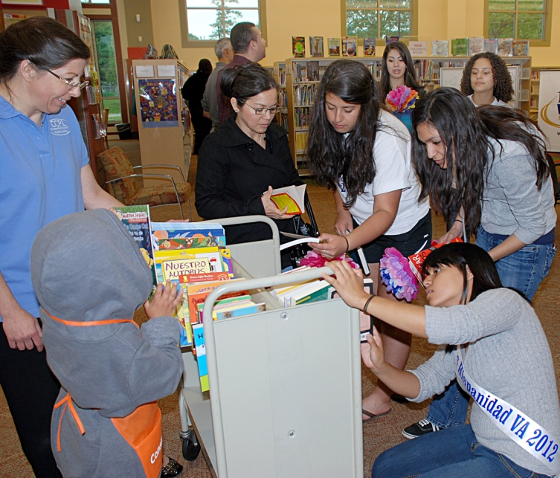
Chesterfield County
Public Library
Just south of Richmond, VA
315,000 residents
250,000 cardholders
10 branches
850,000 items
1500 informational and educational programs
50 degreed information professionals
Notes:
(We continued our introduction while showing slides from our library systems. Henrico’s slides were added at the last minute, so they are not included here.) Being a novice reader, I assumed that the books I selected to read were going to be thin stories that tied proverb to scripture together, and that the character development would be pretty weak. I instead was pleasantly surprised at the meatiness of both the stories and the characters, and that I found the religious tone ran the gamut from mild to heavy. At this point, I was also surprised at the deftness that certain authors were able to make this feel effortless, resulting in a natural telling of the story.

Slide 3
LIBRARY = LEARNING
Mission: to help people transform data and information into usable knowledge
70% of our customers use the library for learning
We support learning experiences through all mediums
The library is a town square
Notes:
Selecting our titles from various award lists, I thought that there would be little outside of romance to choose from, and that a “bonnet ripper” was the universal story of choice. Not so! The genres now contained under this umbrella are varied, and most are all able to be found in Christian fiction. Many fiction writers create characters, environments, and even worlds that they themselves may have no actual experience with. The Christian fiction writer is usually a Christian, and though he or she may also create an experience on the paper that is not real, the Christian values represented throughout the story are non-negotiable.

Slide 4
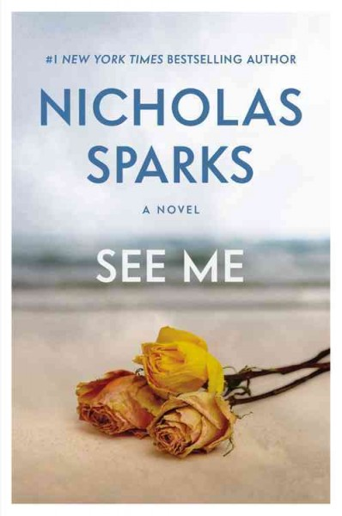
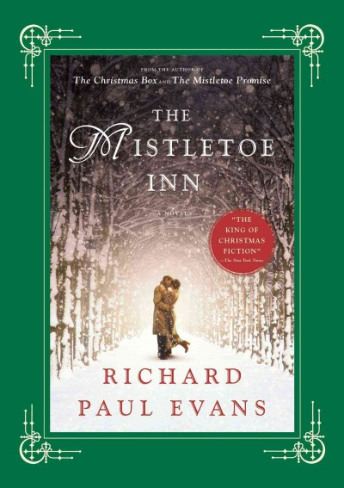
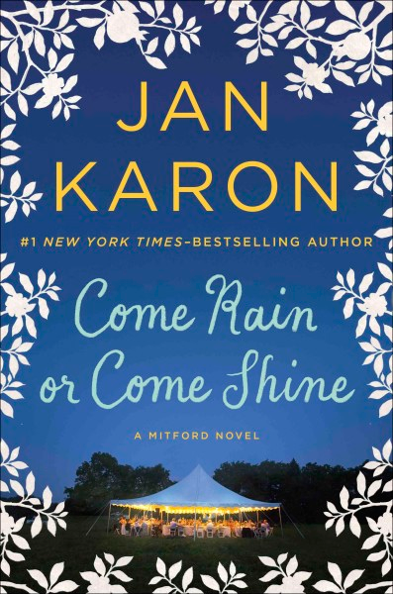
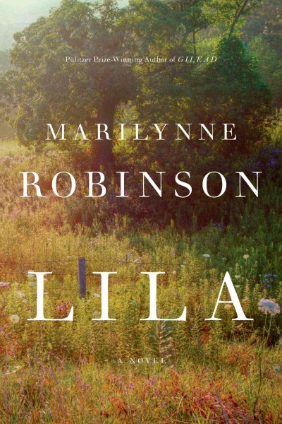
Notes:
On the flip side of this, there are many authors that are Christians, but are not considered to be Christian fiction writers. The themes contained within in the books may be consistent with their faith, but they are not pigeonholed. Examples would be Nicholas Sparks, a Catholic, Richard Paul Evans, a Mormon, Jan Karon, an Episcopalian, and Marilynne Robinson, a Presbyterian. If you find that you have readers that may like authors such as these, or the themes that they deal with in their writings, this becomes a gateway into the world of Christian fiction. So, let’s start taking a look at some of the authors and their works in the world of Christian fiction.

Slide 5
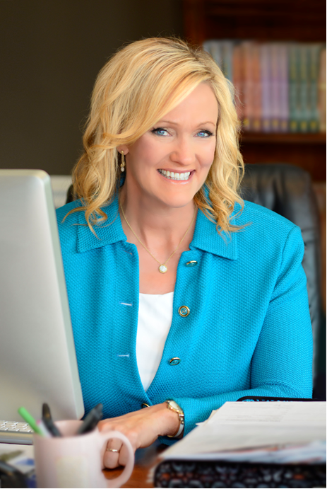
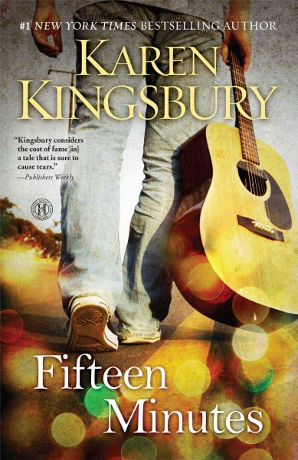
Notes:
Karen Kingsbury: “Queen of Christian Fiction”; mostly writes series, a few stand-alones. // Fifteen Minutes -- TV show “Fifteen Minutes” is fictionalized “American Idol”; main character, Zack Dylan – will he compromise his Christian beliefs in order to be the winner?

Slide 6
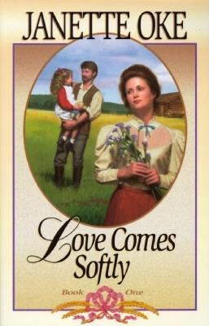
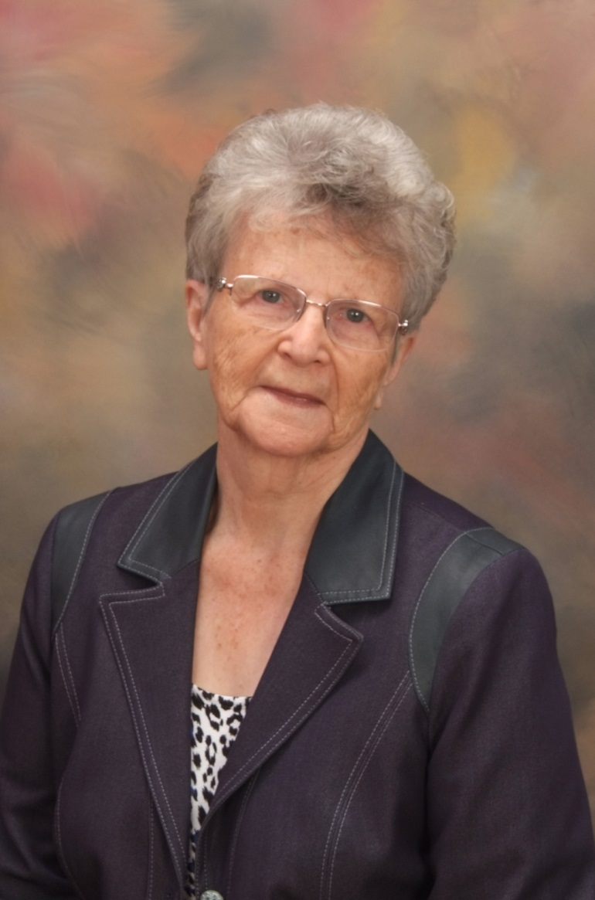
Notes:
Janette Oke: If K.K. is “queen”, Janette Oke is the grand dame; Inventor of Christian “prairie romance” that celebrates old-fashioned pioneer virtues; predecessor was Grace Livingston Hill.

Slide 7
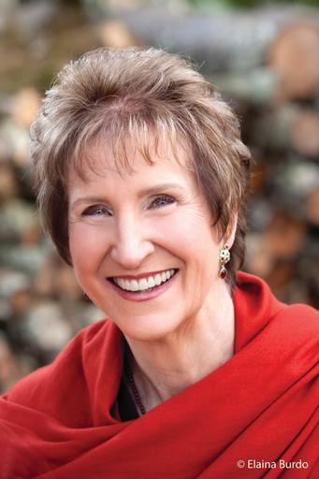
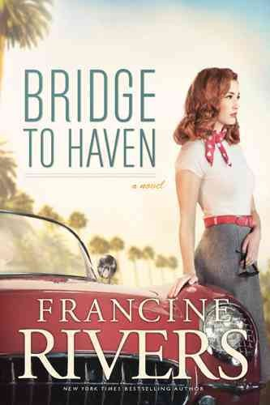
Notes:
Francine Rivers: In 1997, after winning her third RITA award for Inspirational Fiction, Francine was inducted into the Romance Writers’ of America Hall of Fame. // Bridge to Haven -- Having been abandoned as a newborn and found and raised by Pastor Ezekiel Freeman in the small California town of Haven, Abra Matthews feels like she doesn't belong and at the age of seventeen runs off to Hollywood, becoming starlet Lena Scott. 1950’s

Slide 8
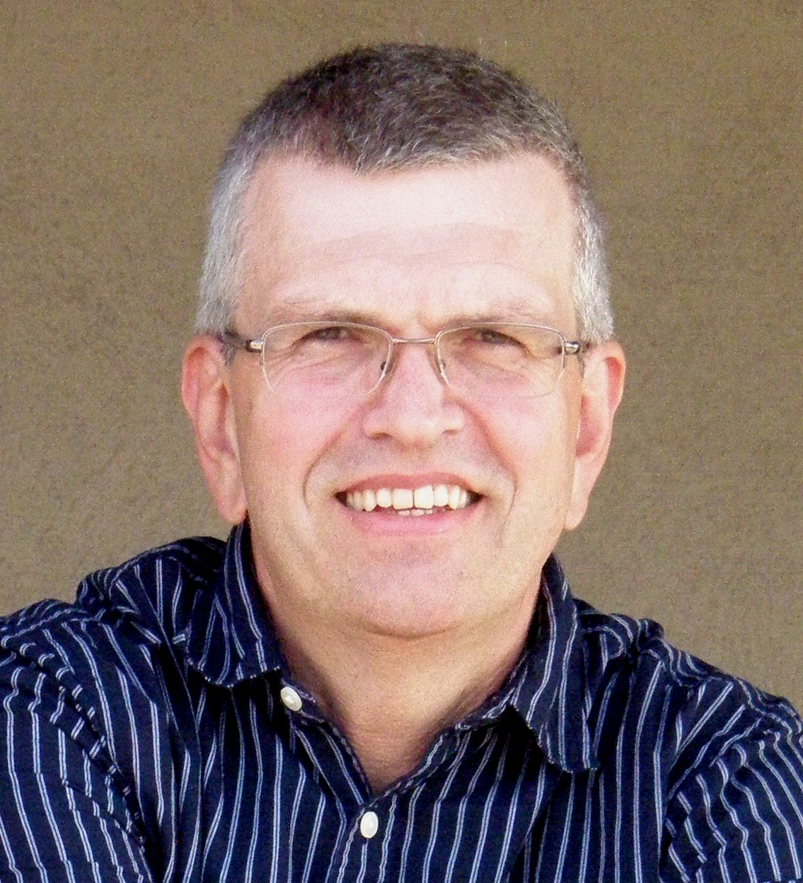
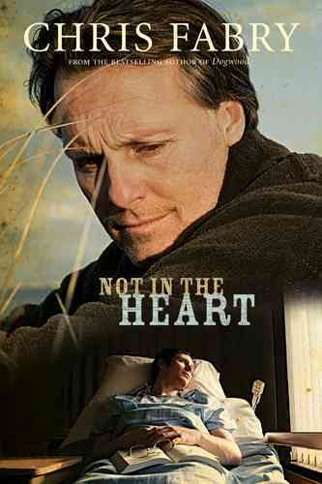
Notes:
Chris Fabry: Three time Christy Award winner for contemporary novels. // Not in the Heart tells of a down-and-out journalist, Truman Wiley, who abandoned his family. His son is dying and needs a heart transplant. Truman is asked to write a biography of the death-row inmate who has always maintained his innocence but is willing to donate his heart to Truman’s son after his execution.

Slide 9
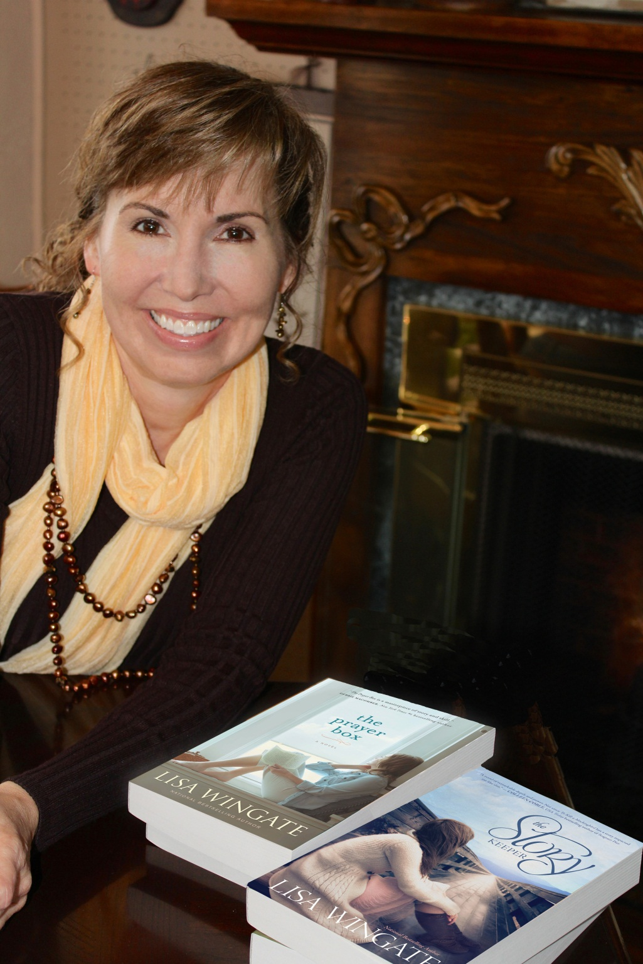
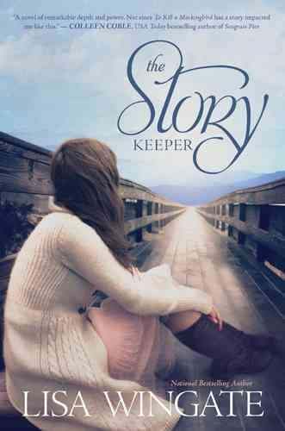
Notes:
Lisa Wingate: Booklist described her: “Lisa Wingate is, quite simply, a master storyteller.” // The Story Keeper, won best contemporary novel from both the Carol and Christy Awards. Main character is an editor, Jen Gibbs, returns to her roots in the Blue Ridge Mountains of NC to find the writer of a 20-yr-old manuscript found in the “slush pile” of NYC publisher.

Slide 10
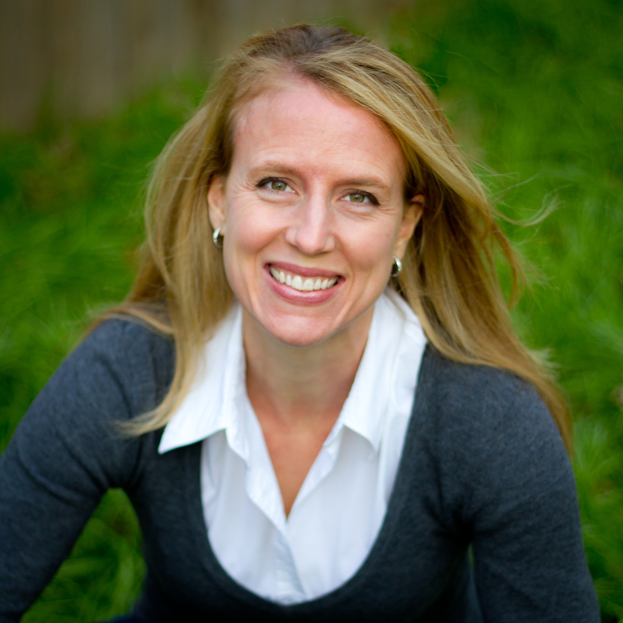
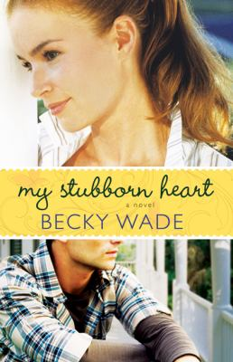
Notes:
Becky Wade. Author of inspirational Christian contemporary romance novels, and has won the INSPY. My Stubborn Heart is the story of Kate and Matt, and how God’s plan, a house renovation, and a supporting cast of eccentric senior citizens dovetail in this uplifting and redemptive contemporary romance.

Slide 11
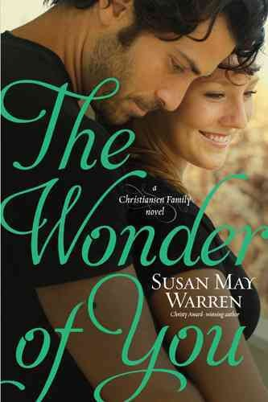
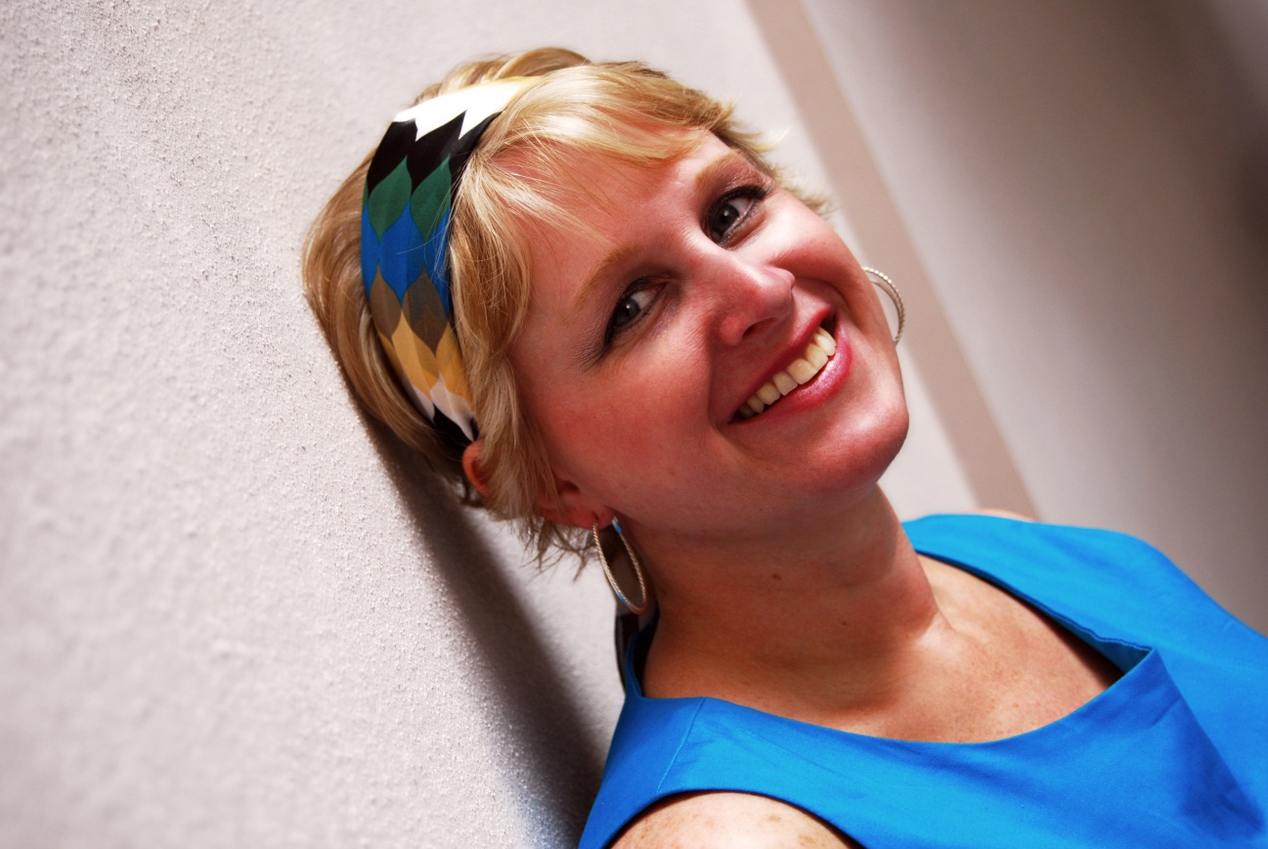
Notes:
Susan May Warren. A former missionary, she moved from writing a ministry newsletter to contemporary romance. Known for her Christiansen Family series, of which The Wonder of You is number 5. A brief romance and misunderstanding drive Amelia Christiansen home to Deep Haven, and away from hotel heir Roark St. John. Both question God for the crossroads in their lives, and if his plan includes each other in their futures.

Slide 12
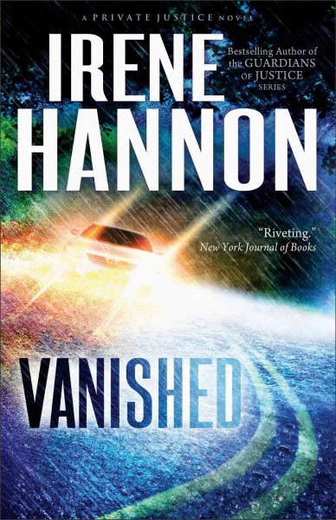
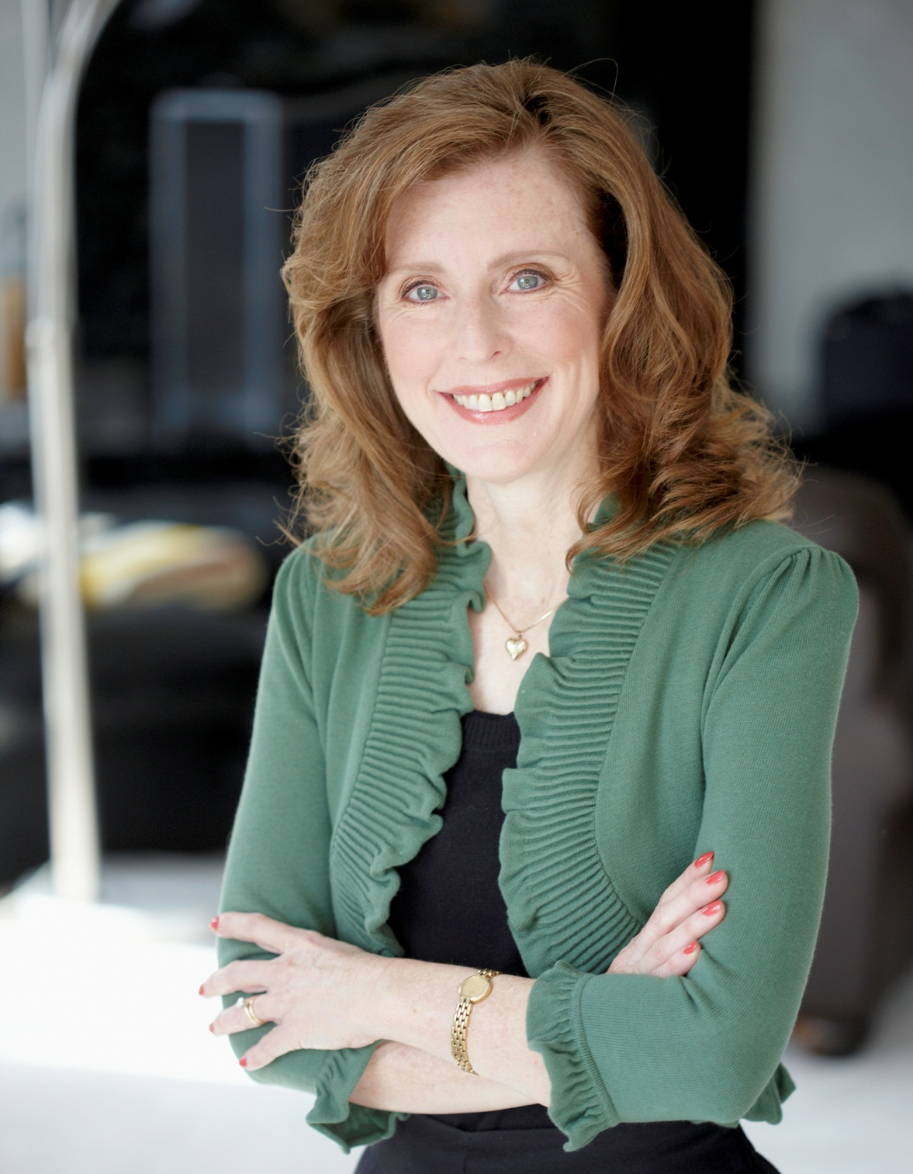
Notes:
Irene Hannon. Self-professed to keep faith content on the subtle side, RITA-Award winner Hannon is a writer of romance and suspense novels. Vanished is the first in the Private Justice series, and is a fast-paced thriller that brings reporter Moira Harrison and PI Cal Burke together to catch a killer. As the faith element is incredibly minimal, this is an excellent choice for a general suspense reader.

Slide 13
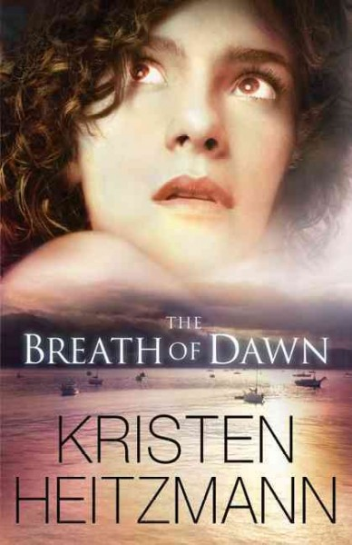
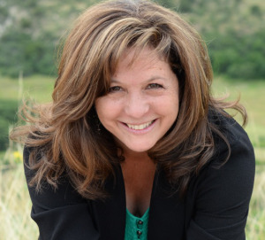
Notes:
Kristen Heitzmann. In 2013, won both the Christy and the INSPY award for The Breath of Dawn. A romantic suspense novel, this story is book 3 in The Breath of Wings series. An excellently plotted story of Quinn Riley and Morgan Spencer, both running from their past, and the demons haunting both of them, real and imagined. The suspense factor is cranked up in the second half of the book. The faith level is a little higher than Hannon, but still mild enough to be recommended to readers of regular romantic suspense.

Slide 14
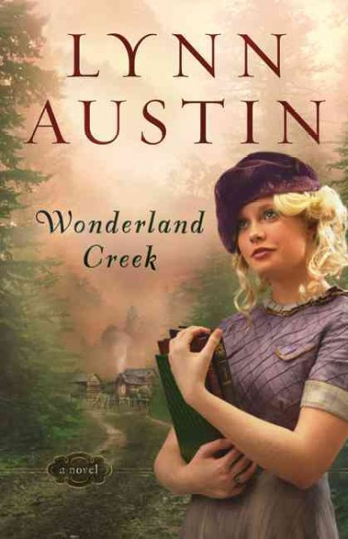
No author photo provided.
Notes:
Lynn Austin: Eight of her historical novels have won Christy Awards for excellence in Christian Fiction. // Wonderland Creek set in 1930’s, main character inadvertently becomes a packhorse librarian in rural Kentucky when she delivers donated books to a small “town” and is stranded there.

Slide 15
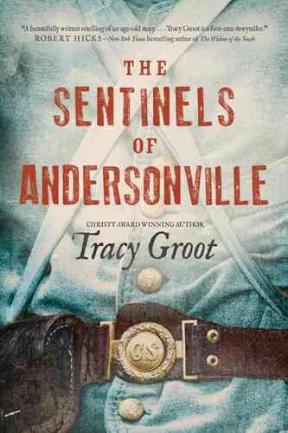
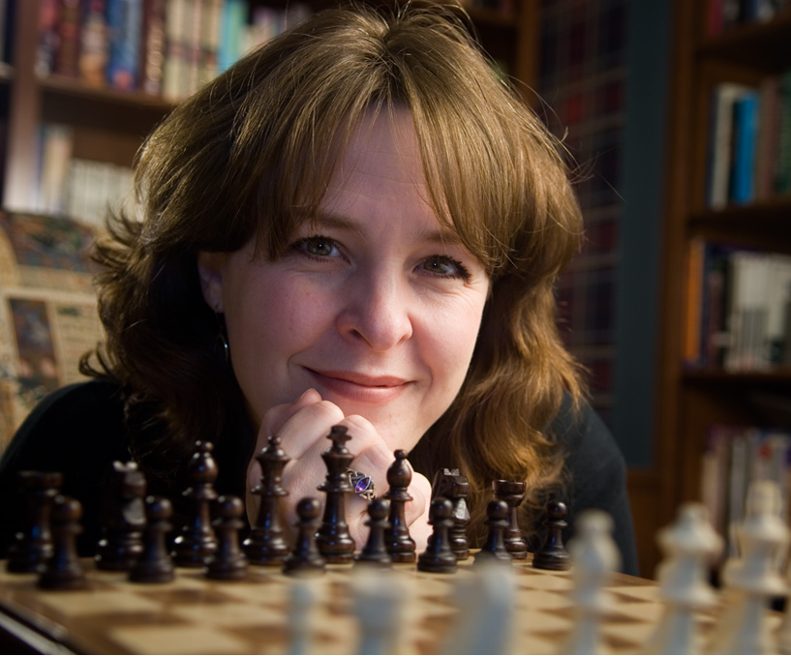
Notes:
Tracy Groot: This year’s historical fiction Christy Award winner is The Sentinels of Andersonville, a novel about the Andersonville Prison during the Civil War: Near the end of the Civil War, inhumane conditions at Andersonville Prison caused the deaths of 13,000 Union soldiers in only fourteen months. Three young Confederates and an entire town come face-to-face with the prison’s atrocities and learn the cost of compassion, when withheld and when given.

Slide 16
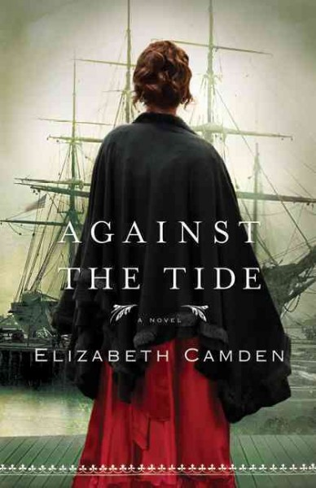
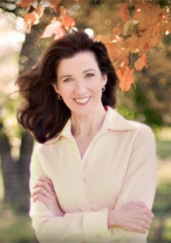
Notes:
Elizabeth Camden: From Elizabeth Camden’s email to me: “I'm thrilled to be mentioned at the Virginia Library Association....some of the happiest years of my life were at UVA. (masters in history); now a college research librarian in my day job.” // Against the Tide: orphaned Greek immigrant, Boston, 1890’s, opium trade.

Slide 17
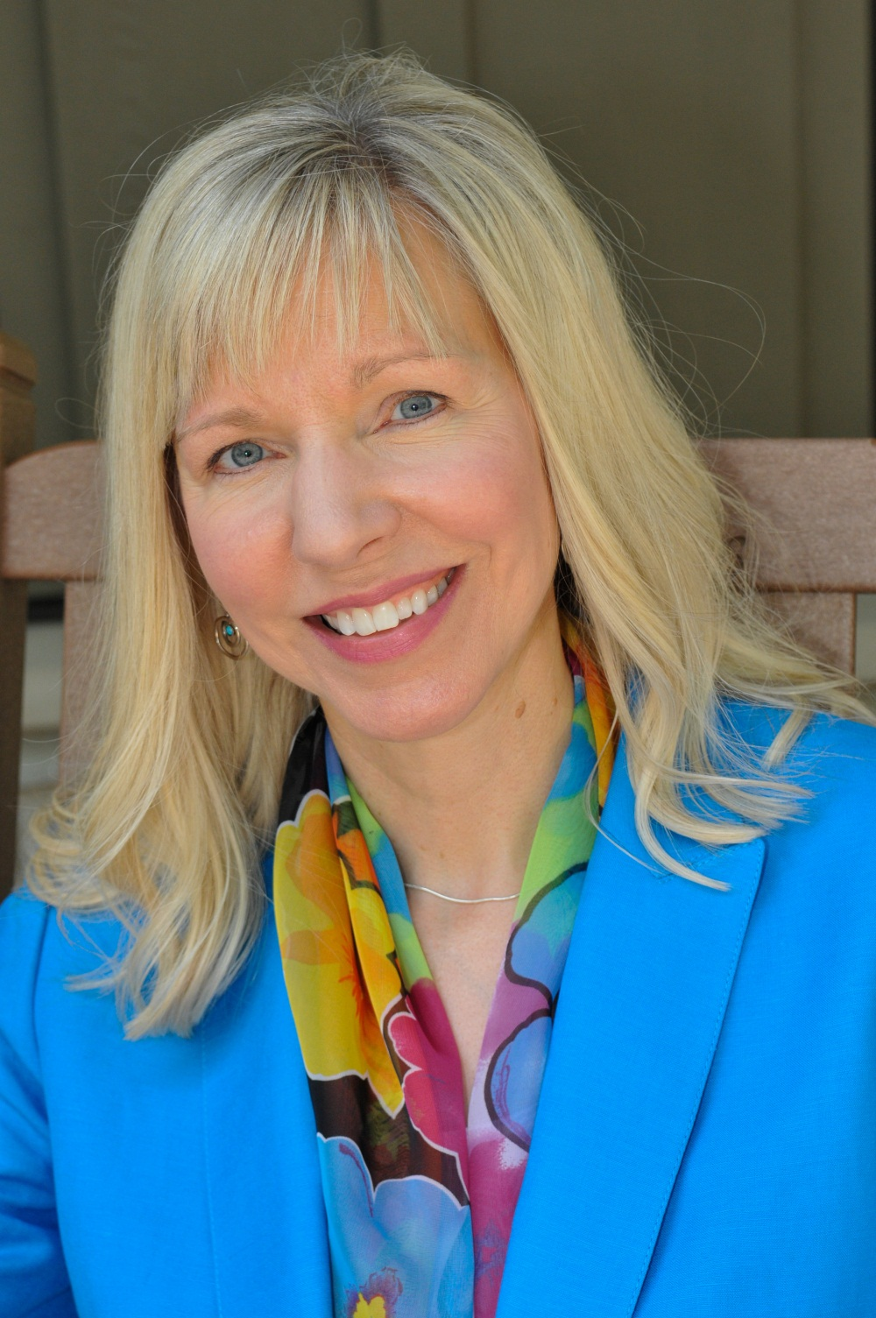
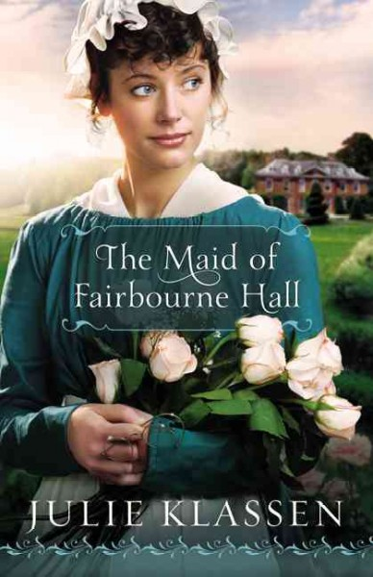
Photo credit: Farrow Media
Notes:
Julie Klassen: Three-time winner of Christy Award for historical romance. // The Maid of Fairbourne Hall – Margaret flees her stepfather and her upper-class family by hiding as a housemaid in the country home of a suitor she once rejected.

Slide 18
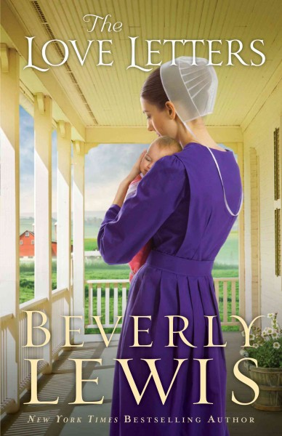
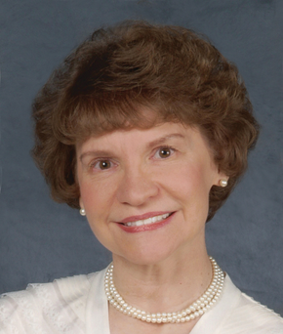
Photo Credit: Photo courtesy of Gene Photography
Notes:
Beverly Lewis: Beverly Lewis born in Lancaster County, PA, sets her books there. First book, The Shunning, was loosely based on her grandmother. // The Love Letters – young Old Order Amish woman seeking her way; cares for her sister’s baby girl; neighbors interact with a homeless man with dementia/Alzheimer’s. Only clue to his identity are the love letters he kept.

Slide 19
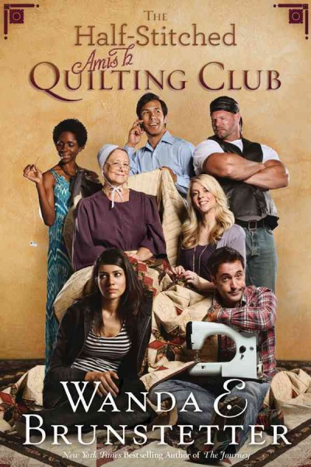
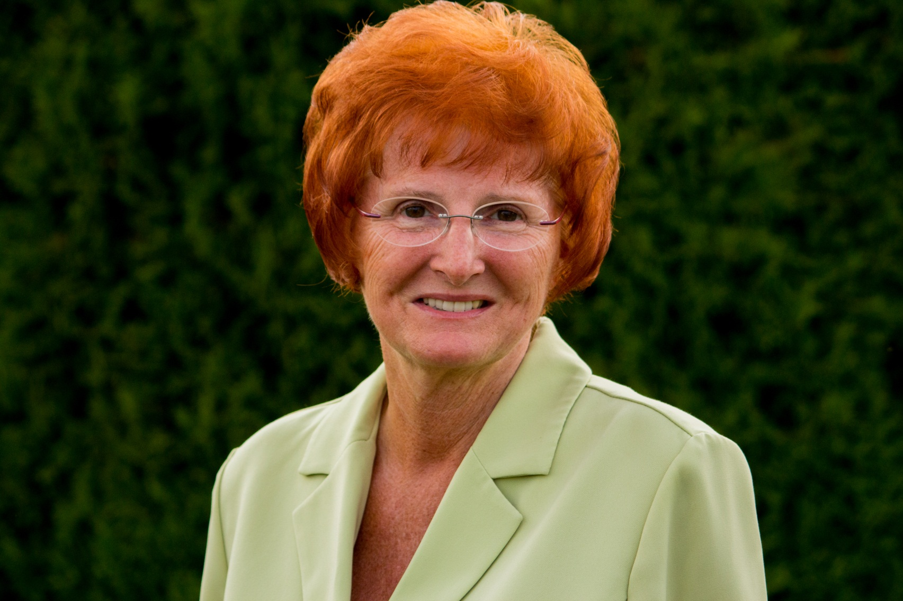
Notes:
Wanda Brunstetter: Wanda Brunstetter is considered one of the founders of Amish fiction. Her husband’s PA Dutch heritage triggered her interest in the Amish. // The Half-Stitched Amish Quilting Club – Amish widow tries to support herself by teaching quilting to a group of “Englishers.”

Slide 20
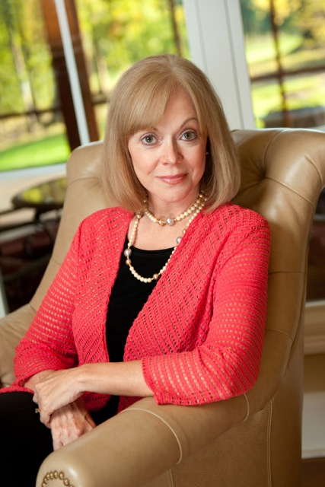
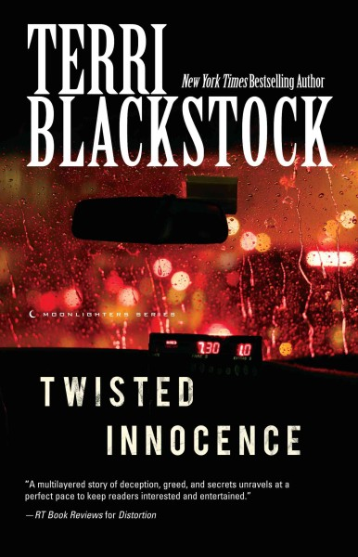
Notes:
Terri Blackstock. A recipient of the RT Book Reviews Career Achievement Award, Blackstock worked for years as a regular romance writer. A spiritual awakening guided her toward writing suspense, and she is a bestselling author in this genre. Twisted Innocence is 3rd and final book in the Moonlighters series, telling the story of how Holly Cramer’s poor choices in her past have led her to finally clean up her act, only to find it catching up to her and her new baby. Can her daughter’s father, a man she barely knows, be relied upon to help to untangle them both from their mistakes before they turn deadly? Redemption is a theme that drives all of the characters, tying in to the author’s strong faith.

Slide 21
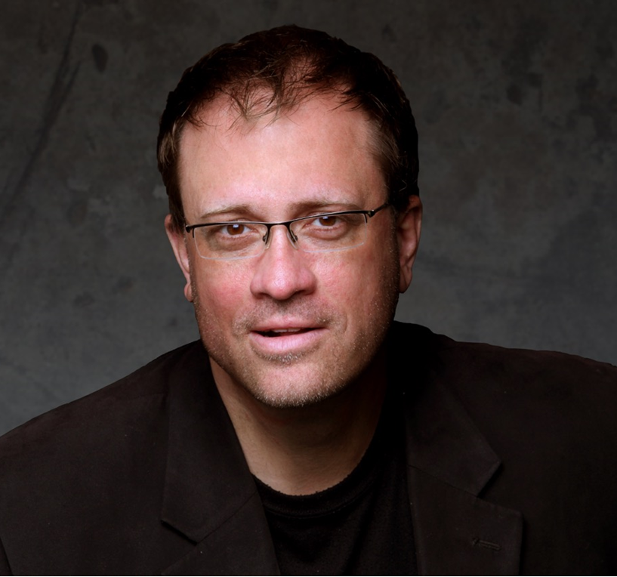
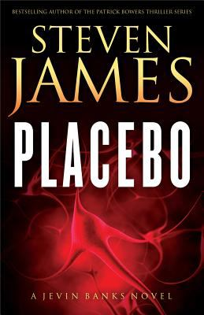
Notes:
Steven James. A multiple Christy Award winner, he also writes inspirational nonfiction. Placebo, the first in the Jevin Banks Experience series, is a taut suspense novel where questions of faith are raised when other issues of government experiments, top secret projects, and a potential assassination all intersect for magician Jevin Banks and his team. Working with a heavy personal past, Banks finds a way to redeem himself. The violence was a bit more pronounced in this novel, but descriptions are still tame in comparison to secular novels.

Slide 22
Brief Bibliography
Austin, Lynn. Wonderland Creek.
Blackstock, Terri. Twisted Innocence.
Brunstetter, Wanda. The Half-stitched Amish Quilting Club.
Camden, Elizabeth. Against the Tide.
Fabry, Chris. Not in the Heart.
Groot, Tracy. The Sentinels of Andersonville.
Hannon, Irene. Vanished.
Heitzmann, Kristen. The Breath of Dawn.
James, Steven. Placebo.
Kingsbury, Karen. Fifteen Minutes.
Klassen, Julie. The Maid of Fairbourne Hall.
Lewis, Beverly. The Love Letters.
Oke, Janette. Love Comes Softly.
Rivers, Francine. Bridge to Haven.
Wade, Becky. My Stubborn Heart.
Warren, Susan May. The Wonder of You.
Wingate, Lisa. The Story Keeper.
All author photos provided by the author or publisher.
Notes:
Challenge members of audience to pick one author and read a book. We worked from awards lists to pull these titles, and in no way scratched the surface.

Slide 23
CHRISTIAN FICTION AUTHORS
Books to Movies
Karen Kingsbury
Janette Oke
Francine Rivers
Contemporary Fiction
Chris Fabry
Lisa Wingate
Romance
Becky Wade
Susan May Warren
Romantic Suspense
Irene Hannon
Kristen Heitzmann
Historical Fiction
Lynn Austin
Tracy Groot
Historical Romance
Elizabeth Camden
Julie Klassen
Amish Fiction
Beverly Lewis
Wanda E. Brunstetter
Mystery/ Suspense/ Thrillers
Terri Blackstock
Steven James
Speculative/ Visionary Fiction
James L. Rubart
Anne Elisabeth Stengl
Notes:
These last two slides show the contents of a two-sided bookmark that we gave out to attendees.

Slide 24
Websites
American Christian Fiction Writers
www.acfw.com/index.php
Christian Fiction Blog
www.christianfiction.blogspot.com
Christian Fiction Online Magazine
www.christianfictiononlinemagazine.com
Faithful Reader
www.bookreporter.com/faithfulreader
FamilyFiction
www.familyfiction.com
Awards
Carol Awards
www.acfw.com/carol
Christy Awards
www.christyawards.com
ECPA Christian Book Awards
www.christianbookexpo.com/Christian
bookawards
INSPY Awards
www.inspys.com
RITA Inspirational Romance Awards
https://www.rwa.org/p/cm/ld/fid=535

