Slide 1
Flipping for the Framework :
Adapting a Library Instruction Session to the Framework for Information Literacy using Flipped and Discovery Based Learning Tactics
Avril Cunningham
acunningham@thechicagoschool.edu

Slide 2
Icebreaker
Who has flipped instruction?
Who loves this idea?
Who is still undecided?

Slide 3
Learning Outcomes
By the end of the session, attendees will:
Learn how the new Framework for Information Literacy differ from the older ACRL Standards of Information literacy
Learn what a flipped classroom is and how to adapt a class so new content is learned online prior to an in-class library session and how in-class time is changed to include more personalized guidance and interaction with students.
Learn how to create a classroom activity in a flipped classroom that incorporates ‘discovery based’ online searching which dovetails with the new Framework for Information Literacy

Slide 4
Why Flip?
Use of in class time for higher level cognition skills and in- person discovery experiences in an active learning environment
Allows students to actively participate in their own learning instead of passively receiving knowledge in a lecture format
Flipping allows students to pause and rewind their teacher

Slide 5
How To Flip
Assign students readings, online tutorials, or audio visual materials on the class topic before in person instruction. This must be a mandatory activity as it lays the groundwork for the in-person instruction
Design an in class experience that requires the student to engage in an activity either together with their classmates or alone.
The in class activity can be completing a worksheet, answering Q&A’s, producing group reports. See here for a list of typical flipped learning activities

Slide 6
Framework for IL
The Information Literacy Competency Standards for Higher Education, adopted by ACRL back in 2000, were a granular, behavioral based set of learning outcomes
“Richer, more complex set of core ideas” and as such includes a new definition of information literacy.
Now “based on a cluster of interconnected core concepts, with flexible options for implementation, rather than a set of standards or learning outcomes, or any prescriptive enumeration of skills”.

Slide 7
Framework (cont’d)
It defines information literacy as “ a repertoire of understandings, practices, and dispositions focused on flexible engagement with the information ecosystem, underpinned by critical self-reflection
“The repertoire involves finding, evaluating, interpreting, managing, and using information to answer questions and develop new ones; and creating new knowledge through ethical participation in communities of learning, scholarship, and practice”
Social Constructivist lens through which we see information literacy

Slide 8
Research as Inquiry
Refers to an understanding that research is iterative and depends upon asking increasingly complex questions whose answers develop new questions or lines of inquiry.
In order for students to physically experience this continuous research loop, I dedicated substantial class time to hands on database searching.
During the searching activity, students evaluated a source for its quality and suitability for use

Slide 9
Scholarship as Exploration
Locating information requires a combination of inquiry, discovery, and serendipity. There is no one size fits all source to find the needed information. Information discovery is nonlinear and iterative, requiring the use of a broad range of information sources and flexibility to pursuit alternate avenues as new understanding is developed”

Slide 10
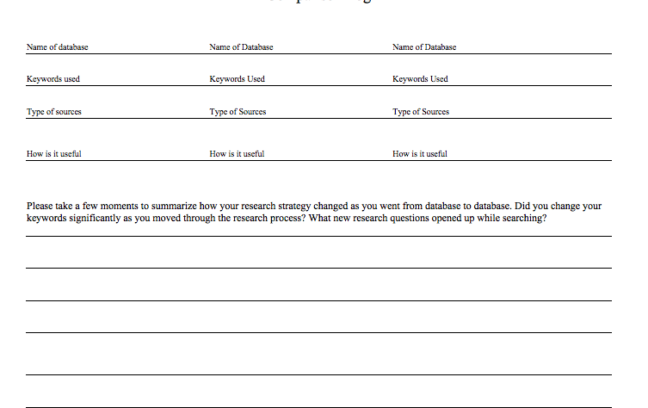
Comparison Log Worksheet

Slide 11
Out of Class Tutorial
24/7/ access to information on
Pre-searching
Searching
Selecting sources
Evaluating
Citing
Students can pause-repeat to deepen comprehension
Tutorial is self paced lecture material
Comprehension check in class

Slide 12
In Class
Guided discovery (active learning) annotated bibliography assignment
Find research articles on the social impact of popular culture (selfies, emojios, food trucks, bitcoin, twerking)
Increased allotted time for student/ faculty/librarian interaction
Increase student engagement research process
Experience ‘messiness’ of real life research
Students received explanatory not corrective feedback

Slide 13
Why the switch
Blooms Taxonomy
Lower order skills Understanding & Recalling out of class
Higher order skills Evaluating, Analyzing, & Synthesizing in-class

Slide 14
Classroom Management
Class capped at 15 students per session
Writing faculty available for assistance
Teaching librarian available for assistance
Explanatory vs. Corrective feedback

Slide 15
Cognitive Overload
As students searched for information on the social impact of their popular culture topic, some became overwhelmed.
Some research does indicate free exploration of a highly complex environment, such as database searching, may generate a heavy cognitive load that is detrimental to learning (Sweller 1999; Paas, Renkl and Sweller 2003)

Slide 16
Suggestion #1
1) Allow students in class to repeat, review, and ask questions about the out of class videos and lecture.

Slide 17
Suggestion #2
2)Have both the teaching faculty of the course and the teaching librarian available for one on one questions during the class session. Take the time to explain aspects of information searching or the research process to each student and refer them to the writing faculty if it is appropriate

Slide 18
Suggestion #3
3) Create a think-pair-share activity where students are paired up with one other person in the class to work through research questions together. Have students report back to the group on how they solved research problems together

Slide 19
3 Suggestions for Cognitive Overload
All three examples take advantage of the in person research help available and leverage existing resources to help students work through the research process

Slide 20


