Slide 1
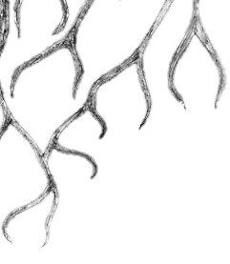
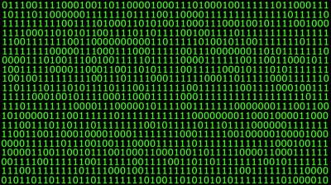
Digital Writing and
Information Literacy:
A Collaboration of Metaliteracy Learners
Lauren Wallis and Trevor Hoag
Christopher Newport University
tiny.cc/metaliteracy
Virginia Library Association Annual Conference
October 23, 2015
#2015VLA

Slide 2
Session Goals
Discuss the ACRL Framework and collaboration
Describe the application of metaliteracy in a First Year Writing course
Identify strategies for moving toward organic, expansive metaliteracy-based collaboration

Slide 3
Metaliteracy
Expands IL to recognize the importance of digital environments.
Traditional: Find, Evaluate, Use
Expanded: Collaborate, Create, Share
Foregrounds affective and metacognitive practices

Slide 4
ACRL Framework
Authority is Constructed and Contextual
Information Creation as Process
Searching as Strategic Exploration
Information
has Value
Scholarship as Conversation
Research
as Inquiry

Slide 5
Framework Dispositions
Authority is Constructed and Contextual
Example Disposition:
“Learners who are developing their information literacy abilities question traditional notions of granting authority and recognize the value of diverse ideas and worldviews.”

Slide 6
How do you feel about the ACRL Framework
and its grounding in metaliteracy?
Excited
Somewhat interested
Neutral
Negative

Slide 7
How much do you think the Framework will change IL instruction at your institution over the next year?
Not at all
Slightly
Significantly
Completely

Slide 8
Framework in Practice
Local learning outcomes
Need for intensive faculty involvement
Mandate or conversation?
Pre-Framework collaboration models
Digital Writing and Information Literacy Initiative

Slide 9
First Year Writing Course
Flexible departmental goals
Metaliteracy intervention: Writing in open, participatory online spaces
Discussion topics
Writing assignments and librarian involvement

Slide 10
Authority and First Year Writers
Building students’ authority:
Producing sophisticated arguments
Analyzing challenging texts
Considering audience
Inhibiting students’ authority:
Limited audience
Mimicking scholarly writing without being a part of the conversation

Slide 11
Authority and First Year Writers
On Empowered Authorship:
“Often it requires students to throw almost two-decades’ worth of imposed authority into question before they realize they can be contributing members to information structures.”
-Carrie Donovan and Sara O’Donnell

Slide 12
Metaliteracy Goals
1) Evaluate content critically
2) Understand information ethics issues
3) Share information and collaborate in a variety of participatory environments
4) Connect classroom learning with lifelong learning

Slide 13
Information Autoethnography
Use of genre of autoethnography
Focus on interactions with information through fieldnotes
Engage in metacognition
Write a blog post that connects personal experiences to larger social/cultural issue

Slide 14
Metaliteracy | English Dept.
Goal 3: Share info and collaborate in participatory environments Effectively communicate personal experiences to inform and assist others Recognize that learners can also be teachers Value user-generated content See oneself as a producer and consumer of info | Analyze and produce sophisticated arguments that position their views within ongoing social and cultural questions

Slide 15
Acting as Learners and Teachers
Student 1 | Student 2
Personal experience with filter bubble Argues it is positive and gives her control over online content Instagram Example: “The accounts I follow don’t tell girls to starve themselves. Instead of having to deal with users and accounts that make me feel insecure about my body, I get to follow these accounts and filter out the bad ones.” | Personal experience with race issues Argues that it is impossible for her not to see race issues everywhere, an experience that is much different than most of her classmates “Everything I see and hear talks about race, so I’ll give the world what it wants, my experience and the brutal truth.”

Slide 16
Valuing User-Generated Content
Student 1 | Student 2
Values UGC as a way to improve her life Instagram as inspiration for healthy lifestyle Twitter and Facebook as means to connect with family and friends Using Pinterest to set goals for the future | Values UGC as a way to stay educated about issues of race in America Following “Twitter War” about Viola Davis after Emmys Using YouTube to learn about psychology experiments related to race issues

Slide 17
Acting as Producers
and Consumers
Student 1 | Student 2
Positions herself mostly as a consumer of UGC Only act of production is on Pinterest, not meant for wide audience | Positions herself only as a consumer of UGC Discusses issues of race in informal, face-to-face context with friends

Slide 18
Acting as Producers
and Consumers
Student 3:
“I tend to have my phone in my hand if I am ever waiting for someone or eating alone. It’s as if it’s my only friend when there isn’t anyone around I actually know. And the crazy part is that I rarely post anything...I just look at what everyone else is posting. For me the internet is a one way street and traffic is heading in my direction.”

Slide 19
Rhetorical Analysis
and Wikipedia
Choose a topic for a Wikipedia entry
Conduct a rhetorical analysis of a source for the Wikipedia entry
Write a Wikipedia entry and reflect on embedded values in all pieces of information

Slide 20
Metaliteracy | English Dept.
Goal 1: Evaluate Content Critically Evaluate author’s goals/purpose Recognize that values and beliefs are embedded in all information | Read and discuss challenging texts, evaluating text styles, conclusions, and evidence Incorporate multiple print and electronic resources into writing

Slide 21
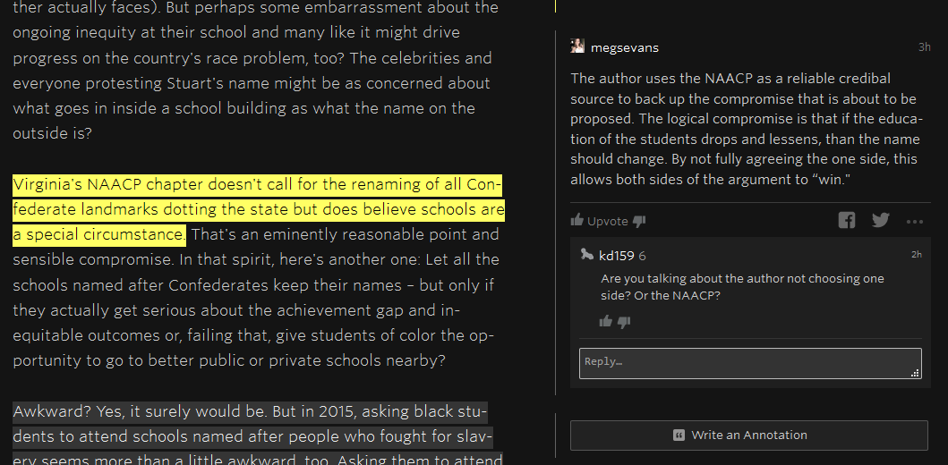
Evaluating Goals and Purpose

Slide 22
Recognizing Embedded Values
Wikipedia Entry
What does it mean to try to
produce “neutral” information?

Slide 23
Challenges
Students’ acceptance of position as creators of digital information
Faculty acceptance of digital pedagogy and participatory online spaces for learning
Easy erasure of information literacy in digital pedagogy

Slide 24
Expanding the Collaboration
Informal meetings with faculty interested in digital pedagogy across departments
Collaboratively building web presence
Shared lesson plans and instructor contracts
Digital classroom working group
Sharing results of First Year Writing class

Slide 25
Questions?
Contact Us:
lauren.wallis@cnu.edu
trevor.hoag@cnu.edu
tiny.cc/metaliteracy

Slide 26
Resources
Donovan, C., & O’Donnell, S. (2013). The tyranny of tradition: How information paradigms limit librarians’ teaching and student scholarship. In L. Gregory & S. Higgins (Eds.), Information literacy and social justice (122-139). Sacramento: Library Juice Press.
Ellis, C., & Bochner, A. (2000). Autoethnography, personal narrative, reflexivity. In N. Denzin & Y. Lincoln (Eds.), Handbook of qualitative research (733-769). Thousand Oaks, CA: Sage Publications.
Mackey, T., & Jacobson, T. (2014). Metaliteracy: Reinventing information literacy to empower learners. Chicago: ALA.

Slide 27
Resources
Metaliteracy.org
ACRL Framework
Vortext First Year Writing Blog
DWILI Website
Plickers
Genius

