Slide 1
Student, Teacher, and Partner
Understanding and Supporting the Many Roles of Graduate Teaching Assistants
Julia Feerrar, Virginia Tech
Rebecca K. Miller, Penn State

Slide 2
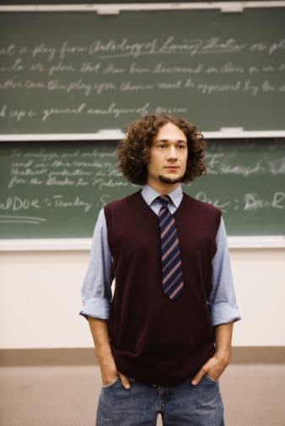
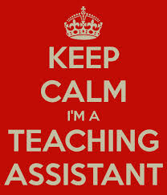
Notes:
GTAs are: important partners (teaching core undergraduate classes), important learners (new teachers and scholars)

Slide 3
Today we will...
Recognize common characteristics and needs of GTAs and other new academics
Identify ways to support GTAs and other new academics as they grow into their identities as teachers
Develop strategies for preparing GTAs and other new academics to take on collaborative roles in teaching and learning in order to apply to the context of your own institutions

Slide 4
Discussion Question 1
What interested you in this session?
What sorts of ideas do you hope to leave this session with?

Slide 5
GTAs: Learners in Transition

Slide 6
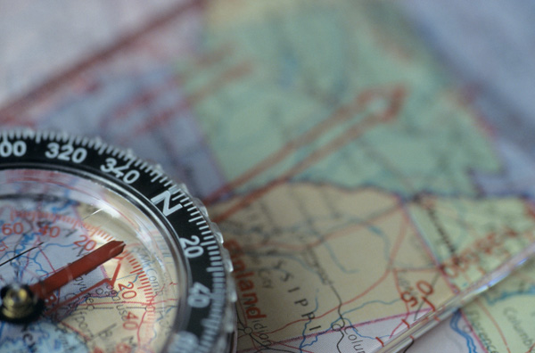
Navigating Learning Roles

Slide 7
Developing a New Professional Identity

Slide 8
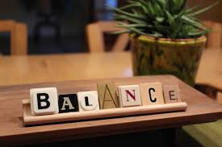
Relationships with faculty members
Relationships with peers
Teaching responsibilities with own coursework
Perceptions and expectations from undergraduate students

Slide 9
Discussion Question 2
Think about the evolution of your identity as you went from a student to a new professional to a seasoned librarian and educator.
What experiences, resources, or people supported this evolution of your identity?

Slide 10
How we support GTAs and other new academics in their teaching and learning roles:
A Virginia Tech case study

Slide 12
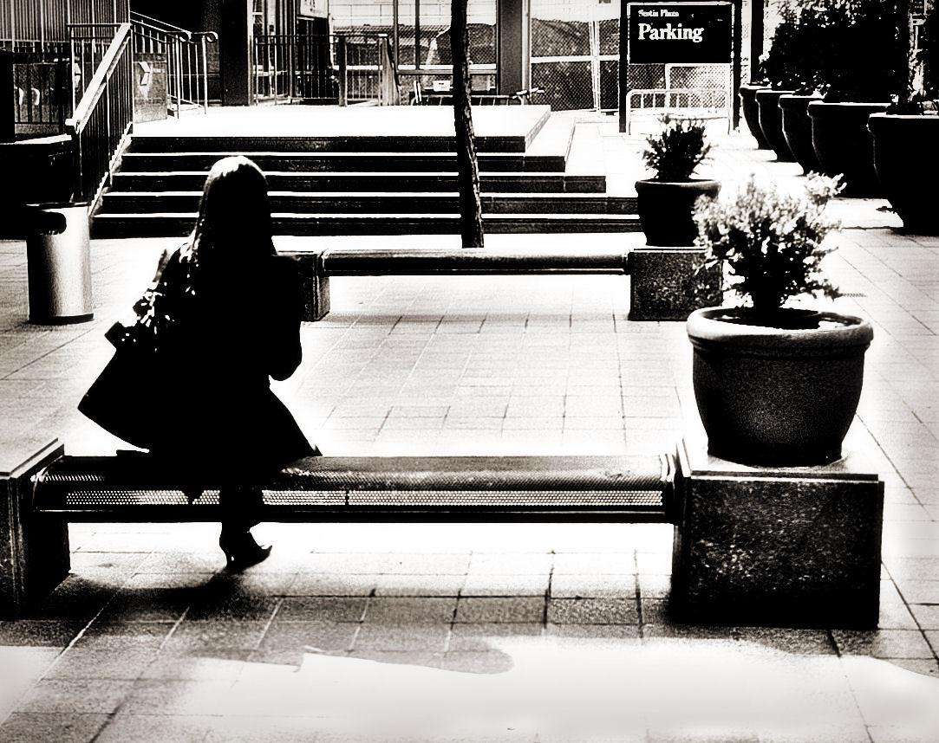
Meeting GTAs Where They Are

Slide 13
Providing Resources and Training
http://guides.lib.vt.edu/1106toolkit

Slide 14
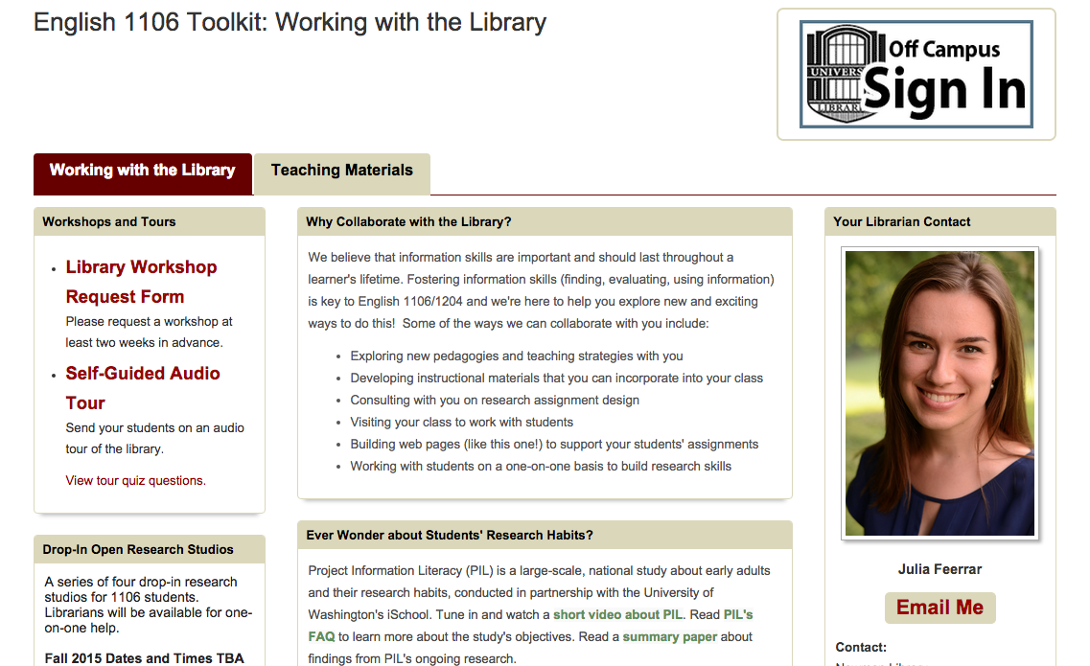
http://guides.lib.vt.edu/1106toolkit

Slide 15
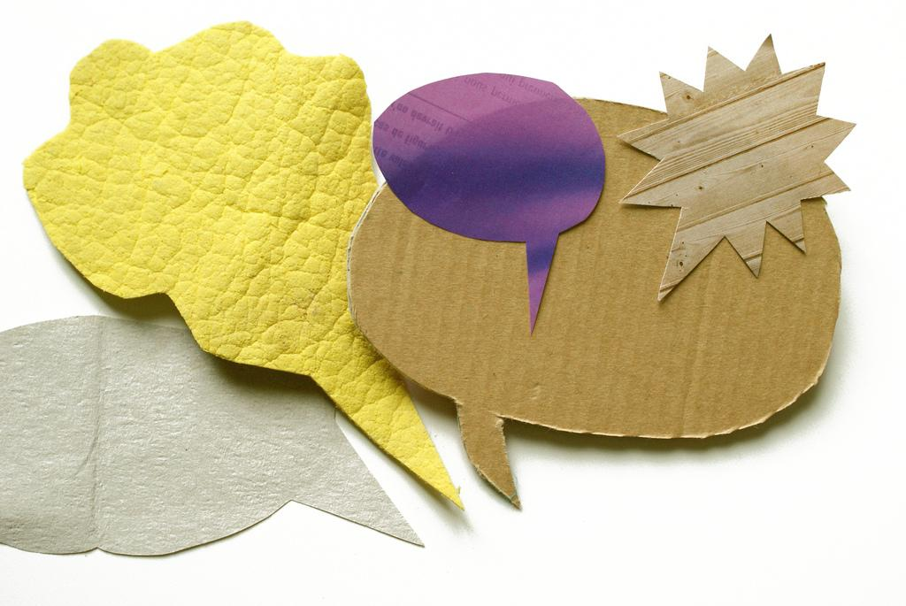
Starting Conversations

Slide 16
When working with GTA partners...
Recognize their unique experiences and expertise
Have empathy for their roles
Identify and integrate with departmental structures
Focus on shared goals and challenges
Seek opportunities to be a mentor

Slide 17
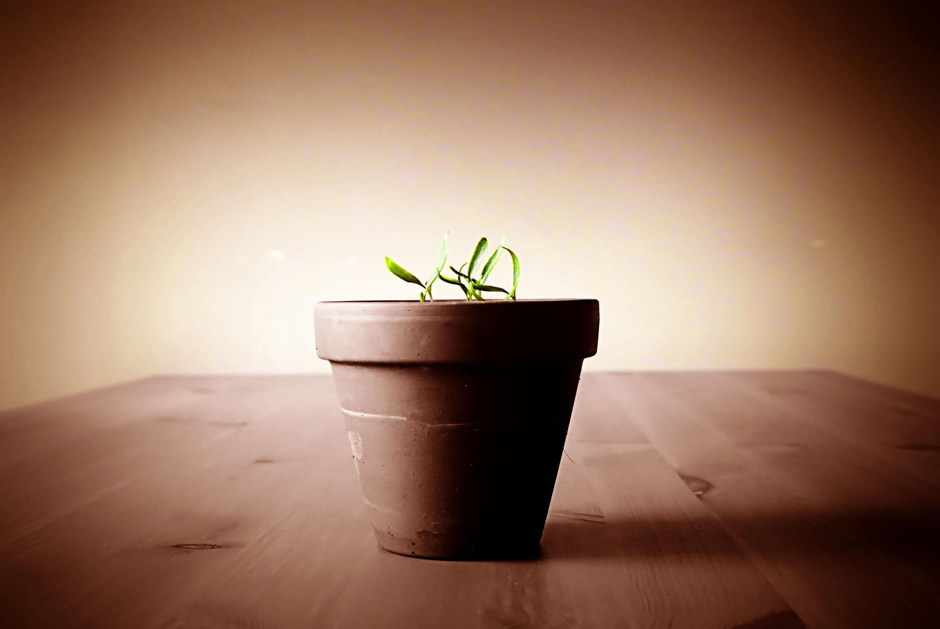
Future Plans

Slide 18
Discussion Question 3
To help us meet our third learning outcome, we have developed an opportunity for you to think about what we’ve discussed here today and apply it to a scenario.
Listen to the scenario and work with your group to develop a strategy for this scenario.

Slide 20
Readings and Additional Resources
Austin, A. “Preparing the Next Generation of Faculty: Graduate School as Socialization to the Academic Career.” Journal of Higher Education, 2002, 73(1), 94–122.
Magrino, W., & Sorrell, P. (2014). Professionalizing the Amateur: Social Media, the "Myth of the Digital Native," and the Graduate Assistant in the Composition Classroom. Journal Of Interdisciplinary Studies In Education, 3(1), 76-94.
Gallego, M. (2014). Professional development of graduate teaching assistants in facultylike positions: Fostering reflective practices through reflective teaching journals. Journal Of The Scholarship Of Teaching & Learning, 14(2), 96-110. doi:10.14434/josotl.v14i2.4218
Dunn-Haley, K., & Zanzucchi, A. (2012). Complicity or multiplicity? Defining boundaries for graduate teaching assistant success. New Directions For Teaching & Learning, 2012(131), 71-83. doi:10.1002/tl.20028
Meanwell, E., & Kleiner, S. (2014). The Emotional Experience of First-time Teaching: Reflections from Graduate Instructors, 1997–2006. Teaching Sociology, 42(1), 17-27. doi:10.1177/0092055X13508377
Wise, A. (2011). Supporting Future Faculty in Developing their Teaching Practices: An Exploration of Communication Networks among Graduate Teaching Assistants. International Journal Of Teaching & Learning In Higher Education, 23(2), 135-149.

Slide 21
Thank you!
Julia Feerrar
Learning Services Librarian
Virginia Tech
feerrar@vt.edu | @JuliaFeerrar
Rebecca K. Miller
Head, Library Learning Services
Penn State University Libraries
rebeccakate.miller@gmail.com

Slide 22
Image Credits
“College Profs and TAs” http://www.collegeconfidential.com/admit/college-profs-and-tas/
“Keep Calm I’m a Teaching Assistant” http://www.redbubble.com/people/custom333/works/14700487-keep-calm-im-a-teaching-assistant-custom-tshirt?p=t-shirt
“Finding the Perfect Balance” http://kerriemore.com/2012/02/05/finding-the-perfect-balance/
“Map and Compass” Ian Kelsall flickrCC
“Little Professor” http://www.platinumelearning.com.au/development.aspx
“It’s Not Me” Grumpy Cat
“Fashionably Parked” Grant MacDonald flickrCC
“Tools” Natasha Wheatland flickrCC
“Graphic Conversation” Marc Wathieu flickrCC
“Questions” http://www.stevewiens.com/

