Slide 1
Getting Started – Project Ideas
Free or nearly free projects
Invention box
Building challenges using whatever you have on hand: cardboard, Lego, craft sticks, plastic cups, tape, paper clips. Use your imagination.
Altered books using books you’ve weeded
Marshmallow catapults
Computer-based projects – borrow existing laptops or devices and do Scratch Programming or Mozilla Webmaker

Slide 2
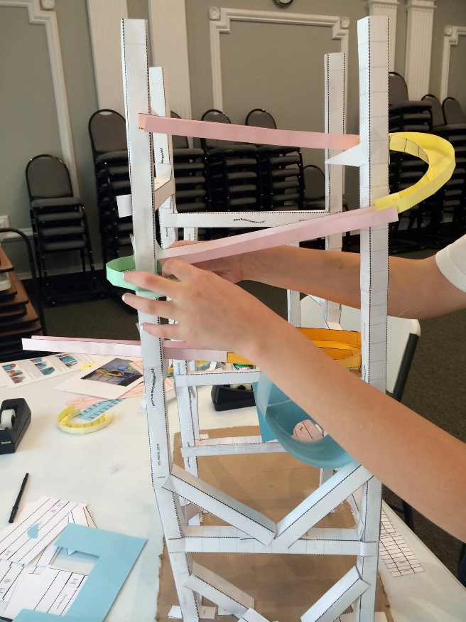
Low Cost Engineering
Paper Roller Coasters:
http://paperrollercoasters.com
Downloadable templates
Copy onto your own card stock
Pros: Good collaborative project with lots of room for creativity
Cons: Time consuming – extra long program or multiple sessions
Lots of prep time required

Slide 3
Low Cost Engineering
Paper Roller Coasters:
http://paperrollercoasters.com
Downloadable templates
Copy onto your own card stock
Pros: Good collaborative project with lots of room for creativity
Cons: Time consuming – extra long program or multiple sessions
Lots of prep time required

Slide 4
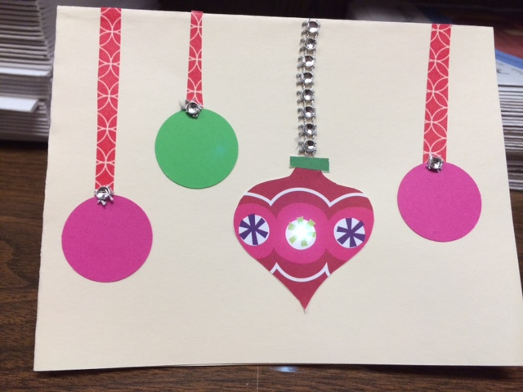
Basic Tech Project Ideas
LED Cards:
Copper Foil Tape (6mm x 15m) $ 5.95/roll
Sticker LED lights (24 asst.) $14.95
3V Lithium Coin Batteries (20) $ 7.40
Card Stock
Assorted trim
Glue or glue sticks
Supply sources:
Adafruit - https://www.adafruit.com
Amazon (batteries)

Slide 5
Basic Tech Project Ideas
Scribbling Machines:
DC hobby motors $2.85 each Carolina Science supply
AA batteries
Non-drying clay, glue sticks
Inexpensive markers/crayons
Strawberry baskets or small plastic containers

Slide 6
Other Tech Programs
MakeyMakey
$60 to $70 per kit, but can use in group
Loads of ideas online, including videos
Easier than you think!
3D Doodler
3D printer pen
Free form, no programming or computer required
$100 with starter plastic, plastic strands approx. $.40
Lego Architecture Studio
Not truly tech, but definitely engineering
Approx. $160

Slide 7
Basic Maker and Tech Resources
MakerSpacePlaybook:
http://makered.org/wp-content/uploads/2014/09/Makerspace-Playbook-Feb-2013.pdf
Maker Ed: http://makered.org
Make Magazine
Tech Girls:http://www.tech-girls.org
Resource page:http://www.tech-girls.org/resources.html
Scratch Programming: https://scratch.mit.edu
MozillaWebmaker Tools: https://webmaker.org/en-US/tools

Slide 8
Library-specific Resources
YALSA Making in the Library Toolkit:
http://www.ala.org/yalsa/sites/ala.org.yalsa/files/content/MakingintheLibraryToolkit2014.pdf
A Librarian’s Guide to MakerSpaces:
http://oedb.org/ilibrarian/a-librarians-guide-to-makerspaces
Library As Incubator Project:
http://www.libraryasincubatorproject.org
Make It @ Your Library: http://makeitatyourlibrary.org
MakerSpaces and the Participatory Library Facebook Group

Slide 9
Supply Sources
Adafruit:http://www.adafruit.com
Maker Shed: http://www.makershed.com
MakeyMakey: http://makeymakey.com
Paper Roller Coasters: http://paperrollercoasters.com
Squishy Circuits:
http://courseweb.stthomas.edu/apthomas/SquishyCircuits

