Slide 1
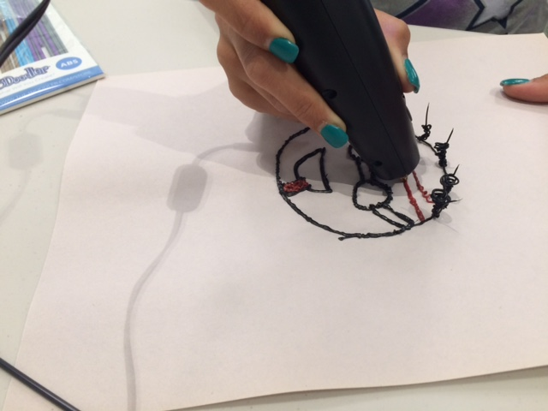
Make It @ The Library
Connecting teens with the Maker Movement
Angela Critics – Teen Librarian
Jefferson-Madison Regional Library
Charlottesville, VA

Slide 2
What is the Maker Movement?
A collection of tools does not define a Makerspace. Rather, we define it by what it enables: Making.
- MakerSpace Playbook, School Edition Spring 2013
Making emphasizes learning-through-doing in a social environment.
- YALSA Making in the Library Toolkit
Maker is really a do-it-yourself and be willing to take chances mindset.
- Vinnie Vrotny, Chair of the ISTE Independent School Educator Network

Slide 3
Why bring Making into the library?
Because making:
Ties in with STEM initiatives, even when not hi-tech
Is a form of connected learning
Helps bridge the digital and knowledge divide
Helps teens learn practical skills
Can help connect teens with other community agencies
Your community is interested
It fits your library’s mission statement to foster life-long learning and the free exchange of ideas

Slide 4
Pop-up Makerspaces
When you just don’t have room for a dedicated space.

Slide 5
Make It @ the JMRL Central Library
Goals:
Open-ended projects that encouraged problem solving and an iterative process
Encourage creativity and making in the broadest sense
Make available materials and projects to which teens might not have access otherwise
Limitations:
Small budget
No possibility of a dedicated space
Limited storage space
Couldn’t leave passive program materials out in Teen Zone

Slide 6
Make It @ the JMRL Central Library
Format:
Regular schedule – every second Wednesday, year round
One primary activity each month
All materials available at each session
Mix up tech projects with craft or low-tech projects
Collecting supplies:
What was already on hand that I could use for this project?
What could I borrow from other departments: Legos, laptops?
Could I partner with other departments or branches to share the cost?
Let it be known that I was looking for supplies.

Slide 7
Scribbling machines

Slide 8
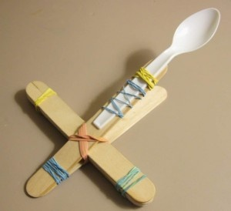
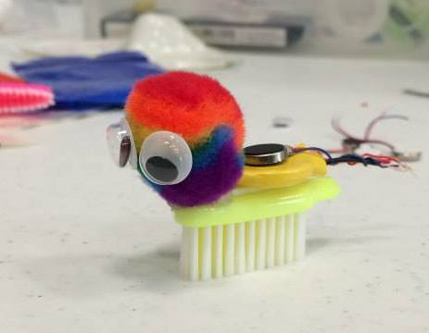
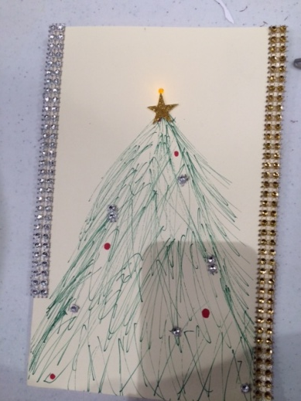
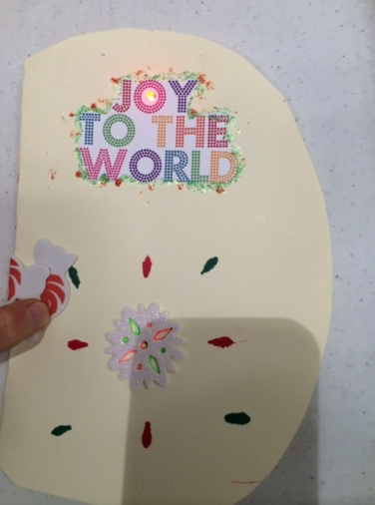
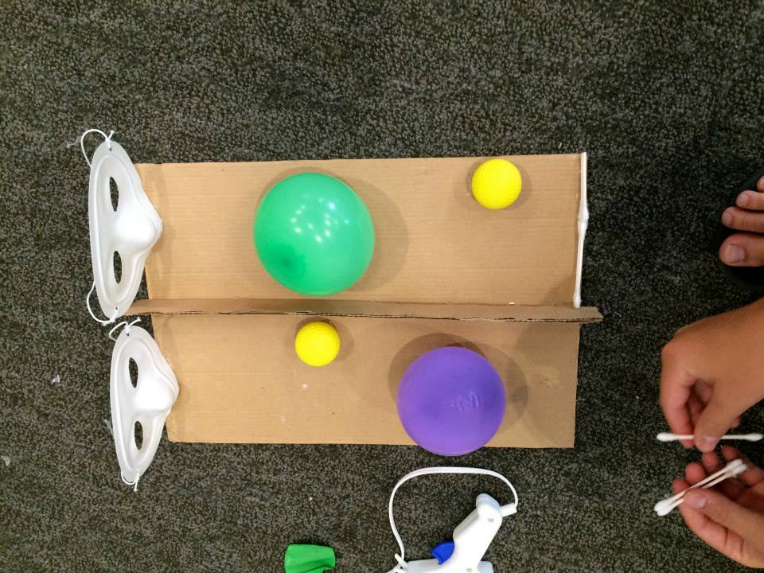
Marshmallow Launchers
Brush Bots
LED Holiday
Cards

Slide 9
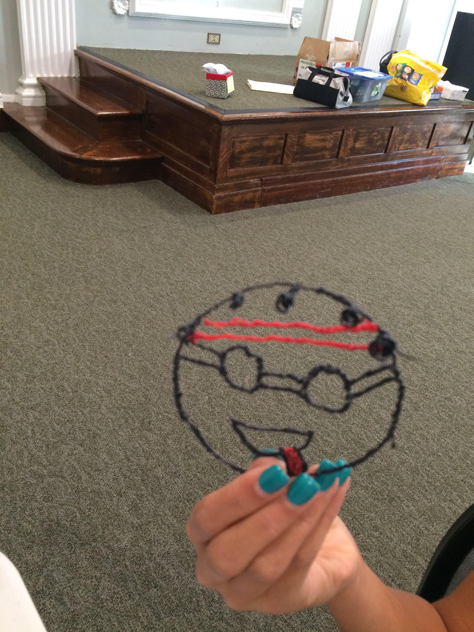
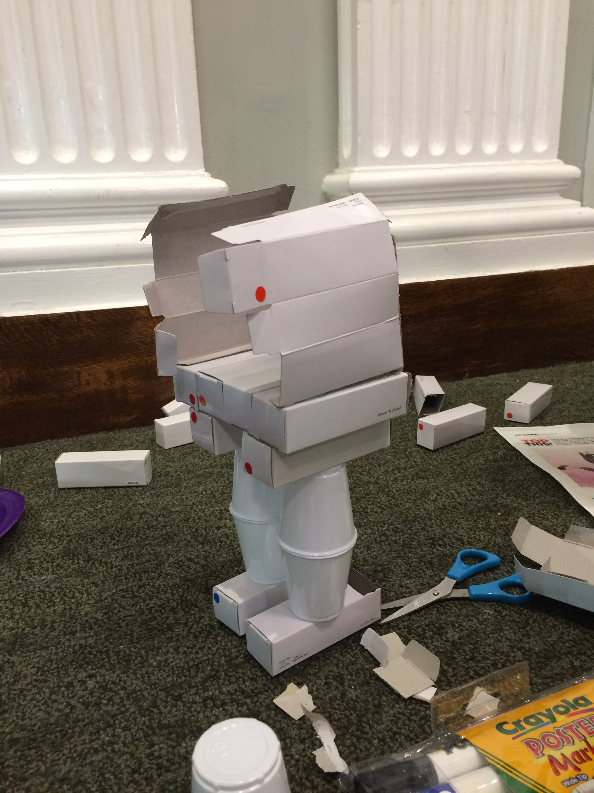
Why bring Making into the library?
A success story

Slide 10
Getting Started
Determine Your Goals
Repeating program, passive program, or one-off events
How open-ended
Hi-tech only or include a mix of creative projects
Who is your audience?
Collect Materials
Start small – work with what you have on hand
Build slowly, one project at a time
Make a wish list of materials – prioritize it
Ask, both for donations and to borrow equipment
Plan for storage
For expensive tech materials, you don’t need one for every person!
Small is big and slow is fast.
- Jeff Sturges, Mt. Elliot MakerSpace, Detroit, MI

Slide 11
But I Can’t Do That Tech Stuff . . .
Remember –
Not all Maker projects have to be tech.
“We’ll learn together” is a valid approach. Let the teens teach you!
It’s not as hard as you fear. Take your time and learn one project at a time.
Find community partners who can present programs or help you learn about them.

Slide 12
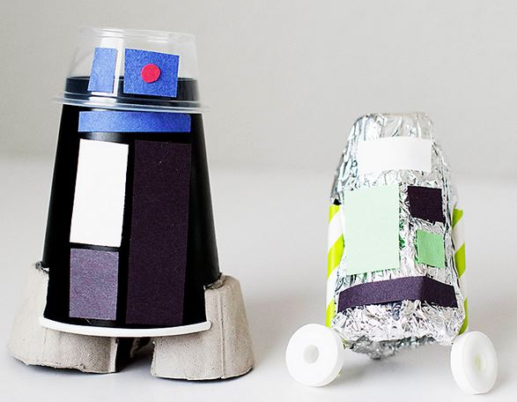
Extending the Maker culture
Include Maker activities in other programs
Passive programming
Small-scale projects to check out for in-library use
Program in a box
Partnership and Outreach
Remember, Making is a mindset that focuses on learning by doing and taking creative chances. Any time you create a space for that to happen, you connect teens, and children, to the Maker movement.

Slide 13
Partners help make it possible
Find a Maker Faire: http://makerfaire.com/map
A community Makerspace
Local schools – robotics clubs, etc.
Colleges and universities
Community organizations like Tech Girls

Slide 14
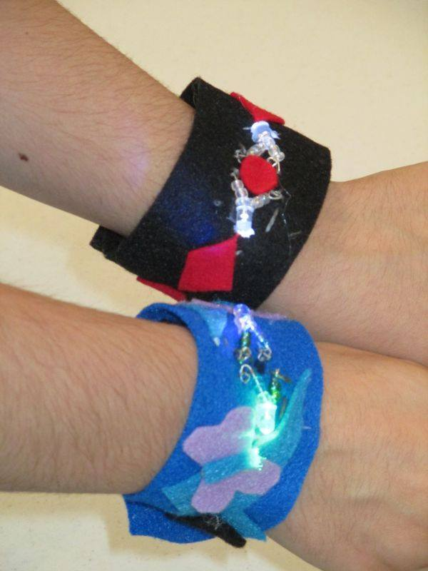
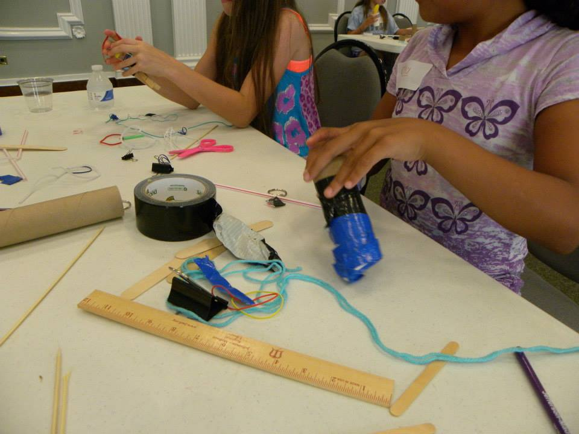
Thank You!
Presented by:
Angela Critics
Young Adult Librarian
JMRL -Central Library
acritics@jmrl.org

