Slide 1
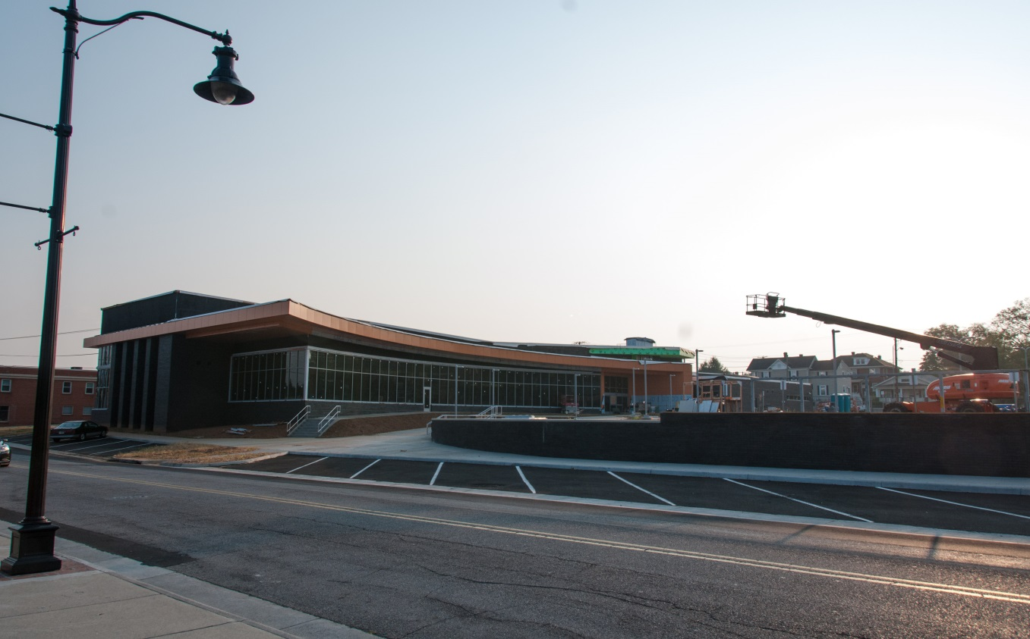
Library Construction, Renovations, and Disasters
The Dos and Don’ts of Moving Collections

Slide 2
So….We have to plan for a move!

Slide 3
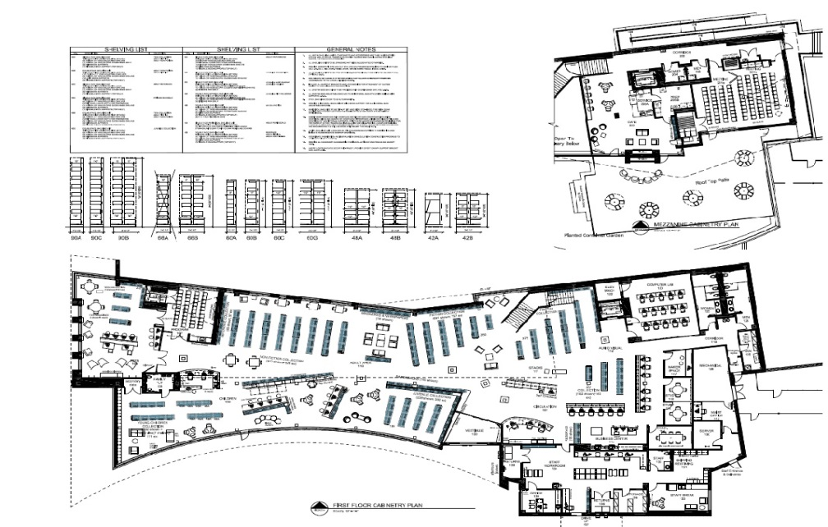
Planning, planning, planning
The Numbers Game: Space needs analysis
Do we need to weed?
What does the future hold? What will this collection be used for? What will it be like in 20 years?

Slide 4
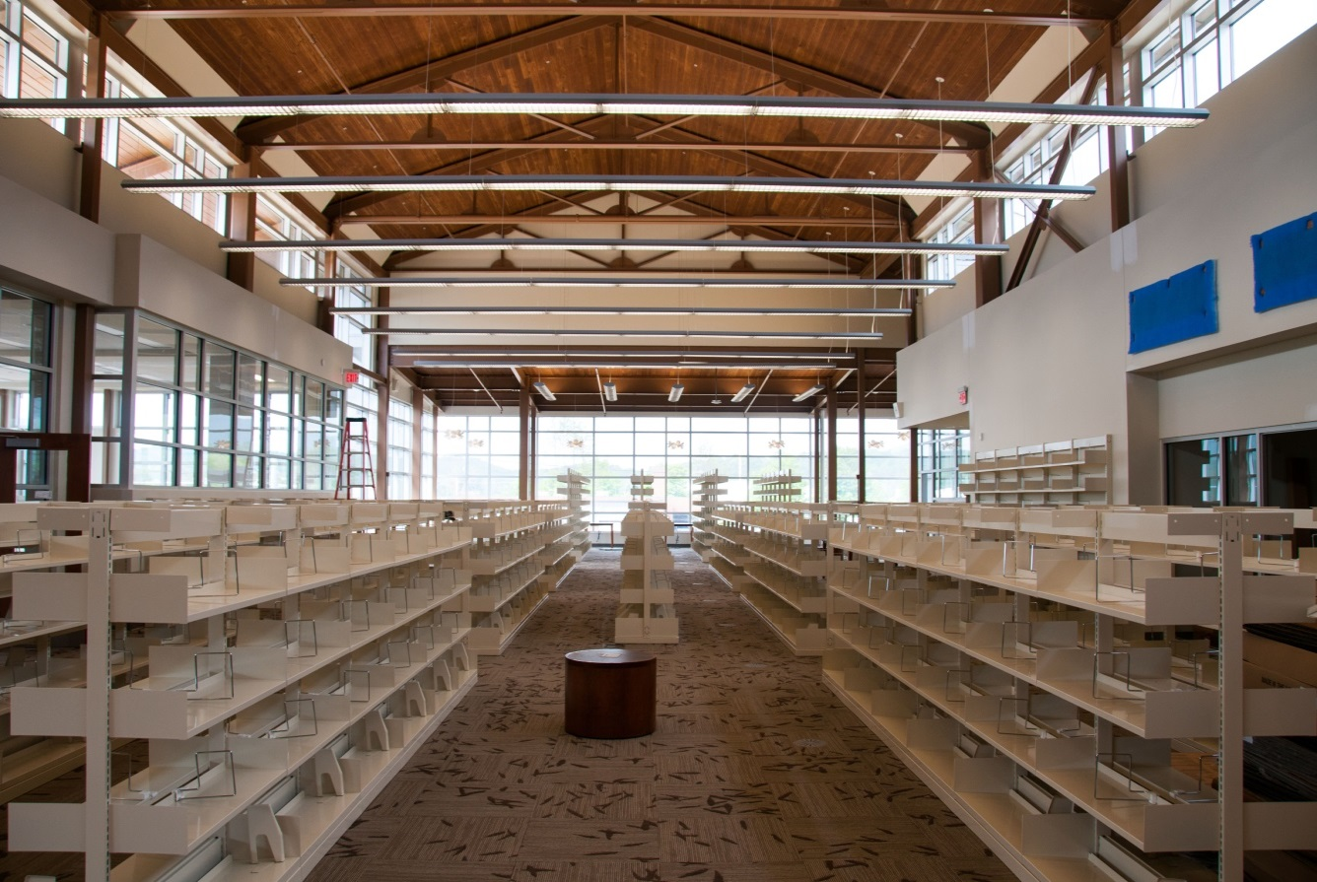
Planning for shelving
How much do we need?
How do we measure it?
Is there a “best way?” What are your experiences?

Slide 5
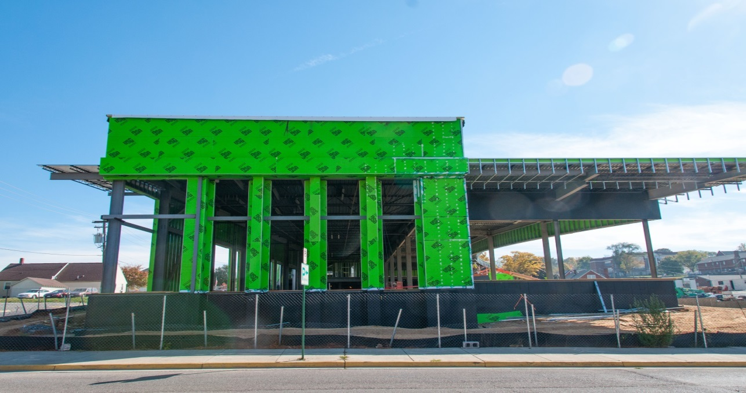
Potential pitfalls
Paralysis by analysis
Construction delays
Collection maintenance history
ILS capabilities (or lack thereof)
Noise issues during renovations

Slide 6
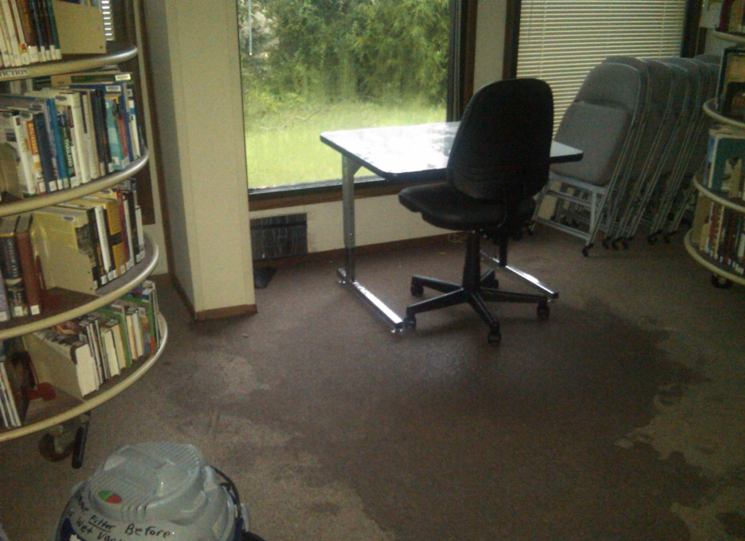
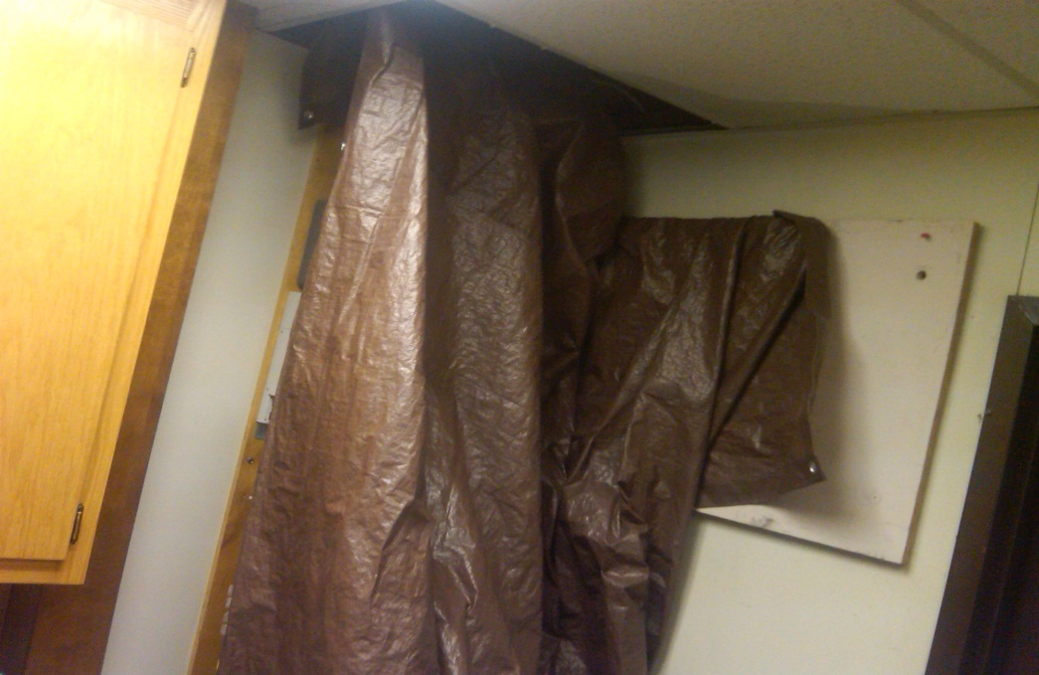
Disasters to existing spaces
How can we handle them?
What can we do to be ready for them?

Slide 7
Other issues
Who is doing the actual moving? Staff or hired movers?
Do you need a temporary storage facility?
How do you estimate space for multiple move sites and items that are in storage?
Are there other issues you can think of?

Slide 8
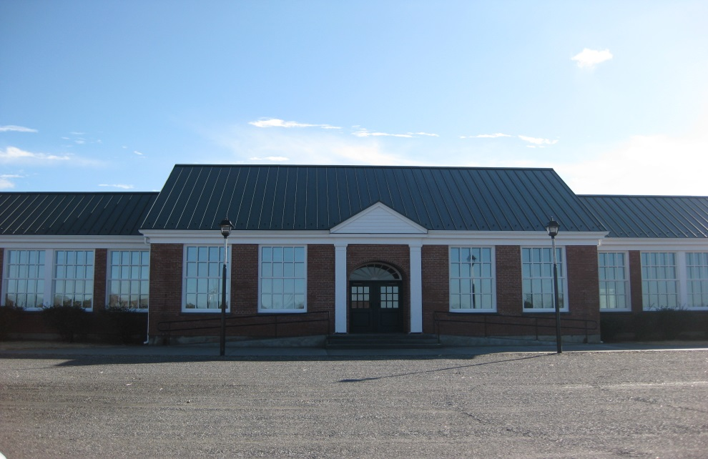
Move-in time
Who is in charge of the move?
Staffing the move. What role does the community play in the move?
How long will it take?
Why did our precise formulas not work?

Slide 9
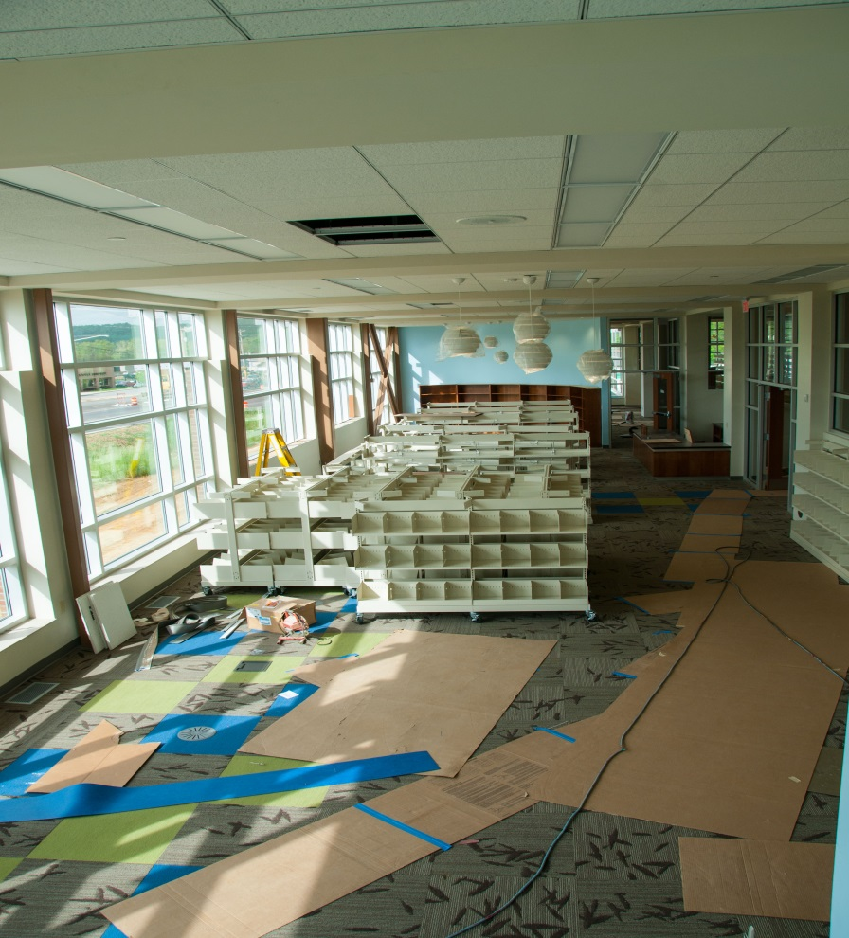
From our discussion today, what do you think is the most important aspect of planning for a move/renovation/recovery?

Slide 10
Thank you!
Adrian L. Whicker Roanoke County Public Library awhicker@roanokecountyva.gov
Carol Farmer Appomattox Regional Library cfarmer@arls.org
Tom Shepley Pamunkey Regional Library tshepley@pamunkeylibrary.org

